Slide 1
Joint PEN-CP European Customs Training network Workshop and non-PEN-CP members
25-26 November 2023
Rotterdam, The Netherland

Slide 2
Meeting agenda, Day 1
 | Topics
09:00 – 09:30 | Welcome and opening of the workshop
09:30 – 10:30 | Training offers by PEN-CP, DG TAXUD and CELBET – possibilities and challenges
10:30 – 10:45 | Coffee break
10:45 – 11:30 | Workshop 1: Innovative training solutions – Virtual reality in customs training
11:30 – 12:30 | Academic customs programmes – cooperation between universities
12:30 - 13:30 | Lunch
13:30 – 14:30 | Centres of Excellence
14:30 – 16:00 | Workshop 2 (Coffee included) Trainings for customs laboratories Common learning development Future of customs training
16:00 – 16:45 | Reporting back from Workshop 2 and discussions
16:45 – 17:00 | Closing day 1
19:30 – 21:30 | Common dinner
Notes:
Bilat contacts in April:
P1 bank transfers & outlook for P2 reporting
EU18+ invitatitions...
Security Handbook team...
Horizon Europe new calls

Slide 3
Meeting agenda, Day 2
 | Topics
09:45 – 10:15 | Welcome and short introduction Customs in the Port of Rotterdam
10:15 – 10:45 | Customs training in the Dutch Customs
10:45 – 11:00 | Coffee break
11:00 – 12:30 | Introduction of Dutch Customs Practical Training Centre Visit Location DCPTC in sub groups: round 1
12:30 – 13:30 | Lunch
13:30 – 14:30 | Visit Location DCPTC in sub groups: round 2
14:30 - 15:30 | Workshop 3 (Coffee included): - How to implement the experiences in the national training system
15:30 – 15:45 | Formal end of working visit
15:45 – 17:00 | Tour by bus in the Port of Rotterdam
Notes:
Bilat contacts in April:
P1 bank transfers & outlook for P2 reporting
EU18+ invitatitions...
Security Handbook team...
Horizon Europe new calls

Slide 4
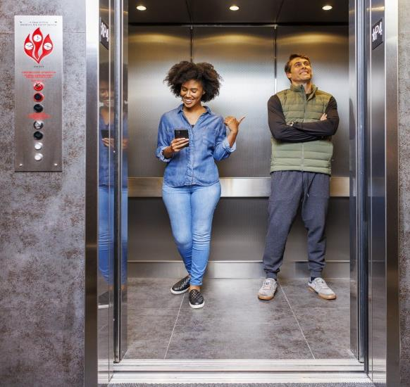
Elevator speech
Basic rules
Please stand up and choose 1-2 partners (in the first round not from your country)
You will have max. 60 seconds in each rounds to speak with each others
There will be 4 rounds (4 different questions on the screen)
Notes:
Bilat contacts in April:
P1 bank transfers & outlook for P2 reporting
EU18+ invitatitions...
Security Handbook team...
Horizon Europe new calls

Slide 5

Elevator speech, question 1
How do you say good morning in your language?
Notes:
Bilat contacts in April:
P1 bank transfers & outlook for P2 reporting
EU18+ invitatitions...
Security Handbook team...
Horizon Europe new calls

Slide 6
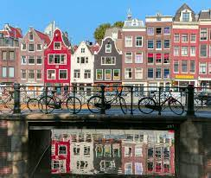
Elevator speech, question 2
Thinking about Holland. What comes in your mind first?
Notes:
Bilat contacts in April:
P1 bank transfers & outlook for P2 reporting
EU18+ invitatitions...
Security Handbook team...
Horizon Europe new calls

Slide 7

Elevator speech, question 3
How long are you working for customs and customs training?
Notes:
Bilat contacts in April:
P1 bank transfers & outlook for P2 reporting
EU18+ invitatitions...
Security Handbook team...
Horizon Europe new calls

Slide 8

Elevator speech, question 4
In which networks are you participating?
Notes:
Bilat contacts in April:
P1 bank transfers & outlook for P2 reporting
EU18+ invitatitions...
Security Handbook team...
Horizon Europe new calls

Slide 9
Available training courses
DG TAXUD
CELBET
PEN-CP/CBRA
Notes:
Bilat contacts in April:
P1 bank transfers & outlook for P2 reporting
EU18+ invitatitions...
Security Handbook team...
Horizon Europe new calls

Slide 10

Customs and Tax EU Learning Portal
https://customs-taxation.learning.europa.eu/
Notes:
Bilat contacts in April:
P1 bank transfers & outlook for P2 reporting
EU18+ invitatitions...
Security Handbook team...
Horizon Europe new calls

Slide 11



eL development process
DG TAXUD
Topic suggested by MS or DG TAXUD
Ask MS for experts that can participate
Project charter
Storyboard
Instructional Design Map
Share national material (even in national language)
Release of the course in Customs & Tax EU Learning Portal
Development
Notes:
Bilat contacts in April:
P1 bank transfers & outlook for P2 reporting
EU18+ invitatitions...
Security Handbook team...
Horizon Europe new calls

Slide 12
CELBET trainings
X-ray image analysing
Risk analysing – fake documents
Bus search
Car search
Customs Control proces
Sniffer dogs
English language training in the field of specialized terminology for customs control
Train search
Enhanced cooperation between Customs and Border Guard at external land border crossing points
Seals control
Integrity and professional ethics
Truck search
Notes:
Bilat contacts in April:
P1 bank transfers & outlook for P2 reporting
EU18+ invitatitions...
Security Handbook team...
Horizon Europe new calls

Slide 13
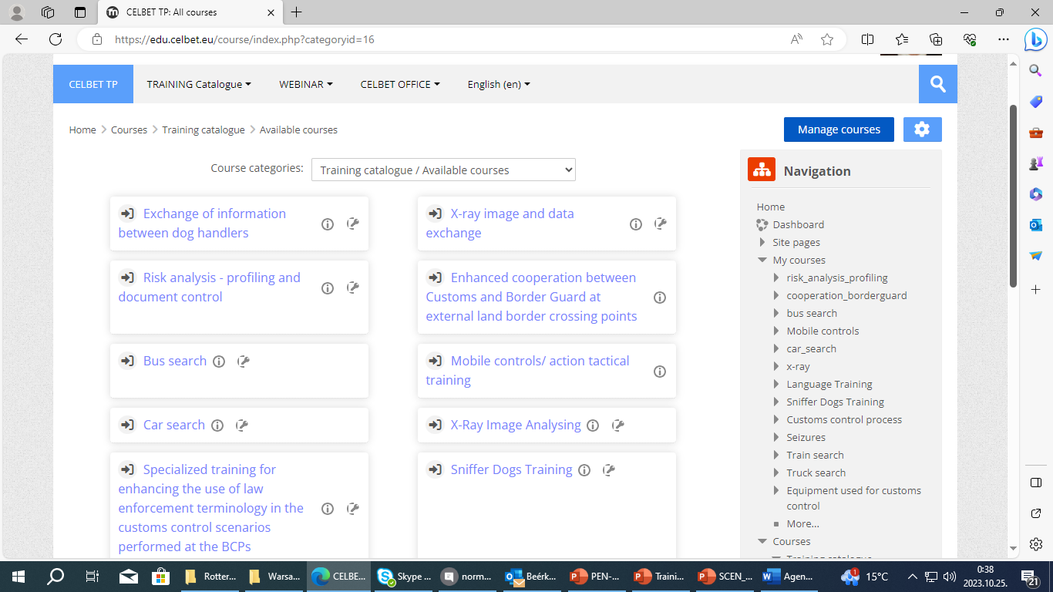
Notes:
Bilat contacts in April:
P1 bank transfers & outlook for P2 reporting
EU18+ invitatitions...
Security Handbook team...
Horizon Europe new calls

Slide 14
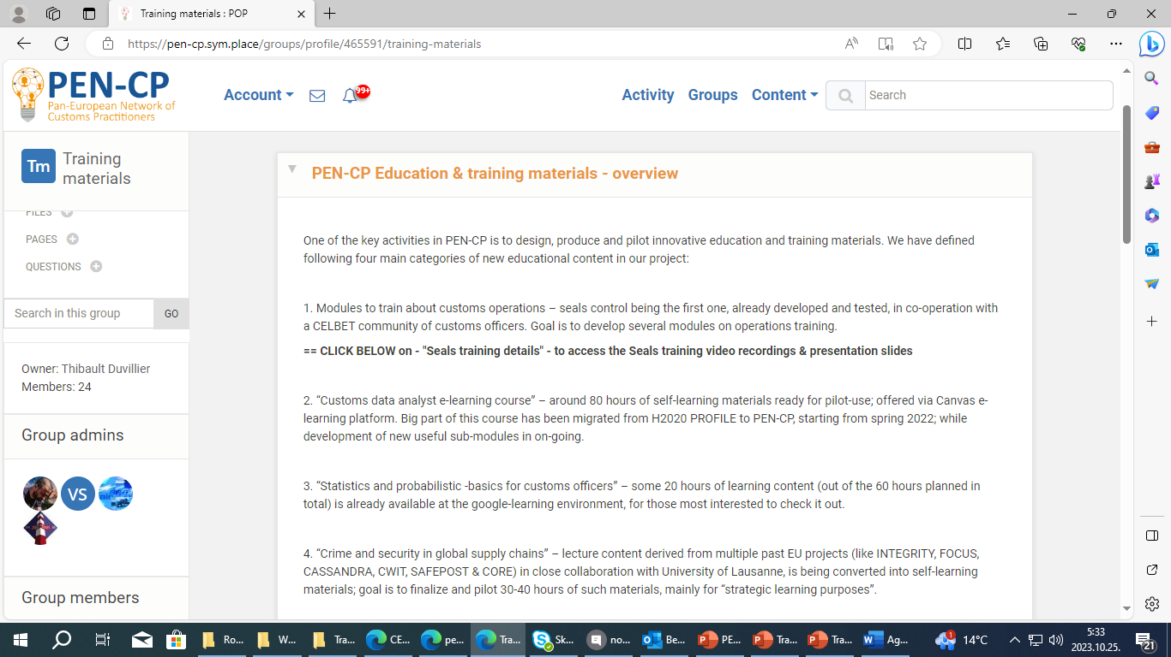
Header...
Aaa
Bb
Cc
Notes:
Bilat contacts in April:
P1 bank transfers & outlook for P2 reporting
EU18+ invitatitions...
Security Handbook team...
Horizon Europe new calls

Slide 15
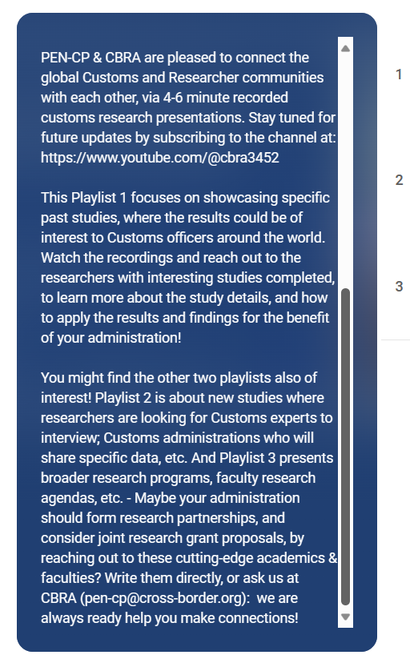
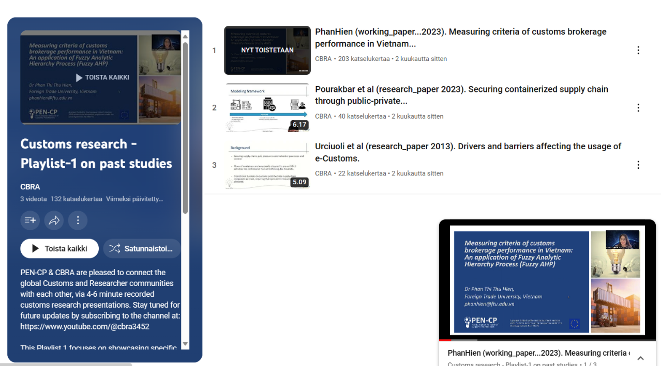
Researcher to Customs Playlists in the YouTube channel - please subscribe at: https://www.youtube.com/@cbra3452

Slide 16
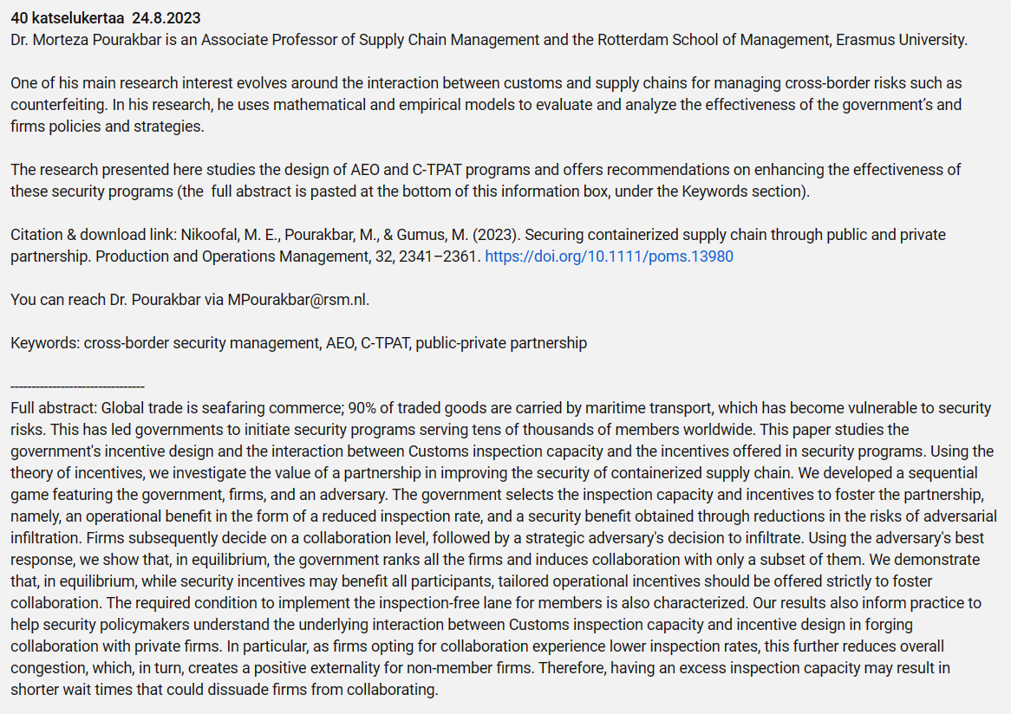
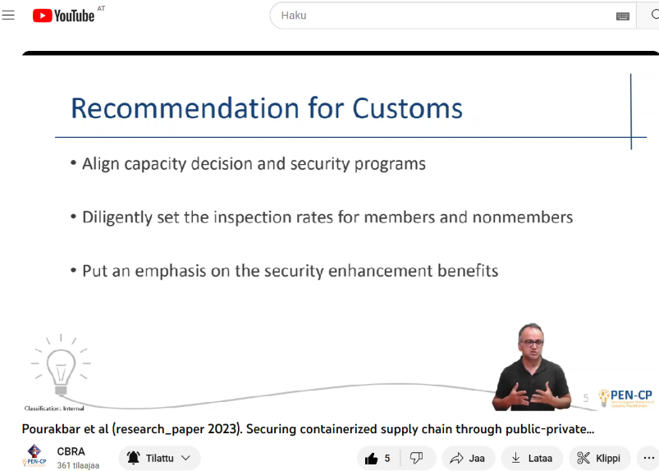
Example with Playlist-1
https://www.youtube.com/watch?v=0xuKzSBkhnU&list=PLwiRBCj7ddoJ1kxLSUmUlHL8jnhPz6Opd&index=2

Slide 17
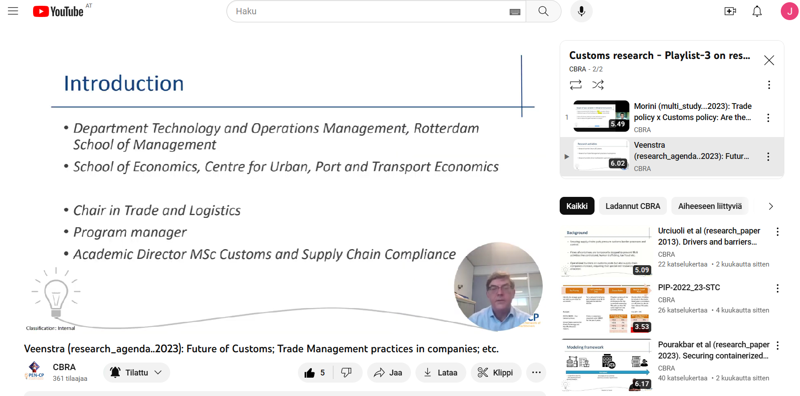
Example with Playlist-3:
https://www.youtube.com/watch?v=6gwL-s7dMzU&list=PLwiRBCj7ddoLefZiyBM1guEOX3pUAuuub&index=2

Slide 18
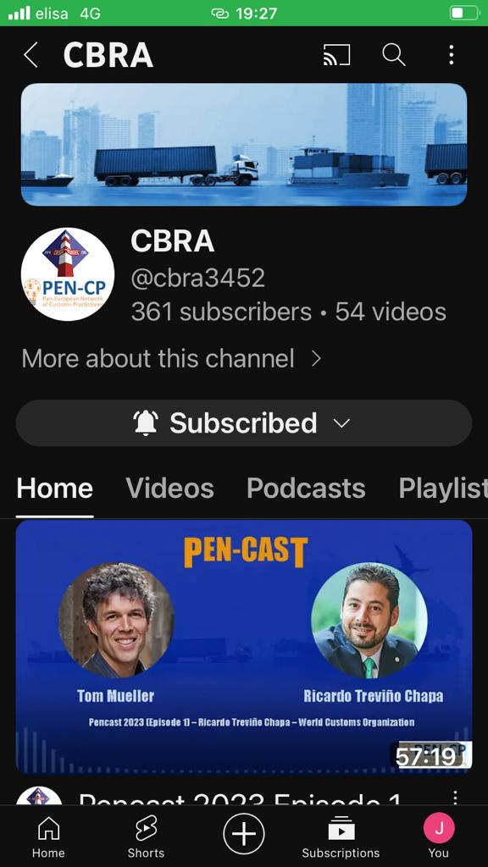

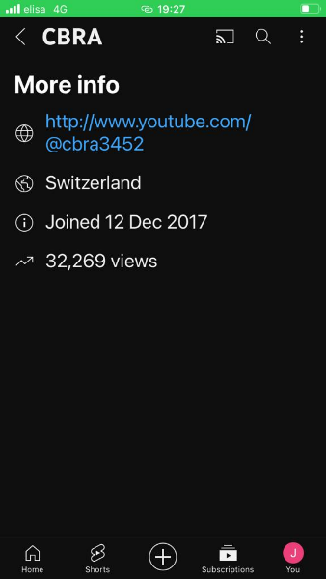
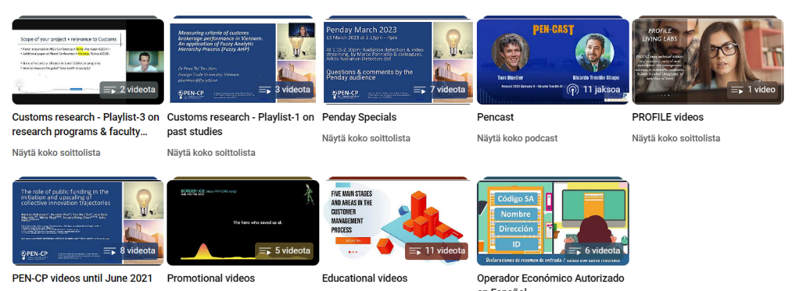

Slide 19
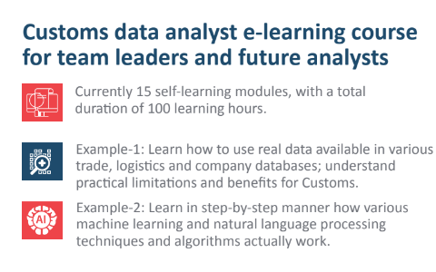
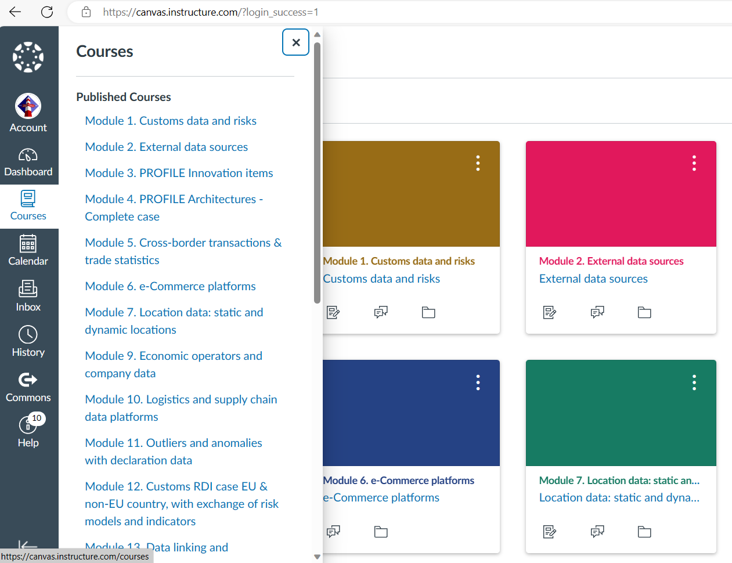
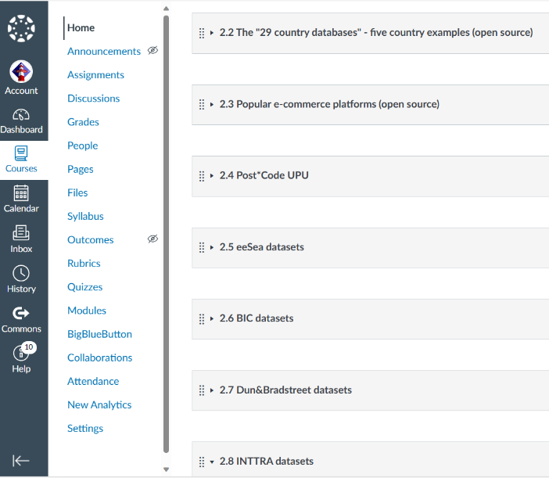

Slide 20
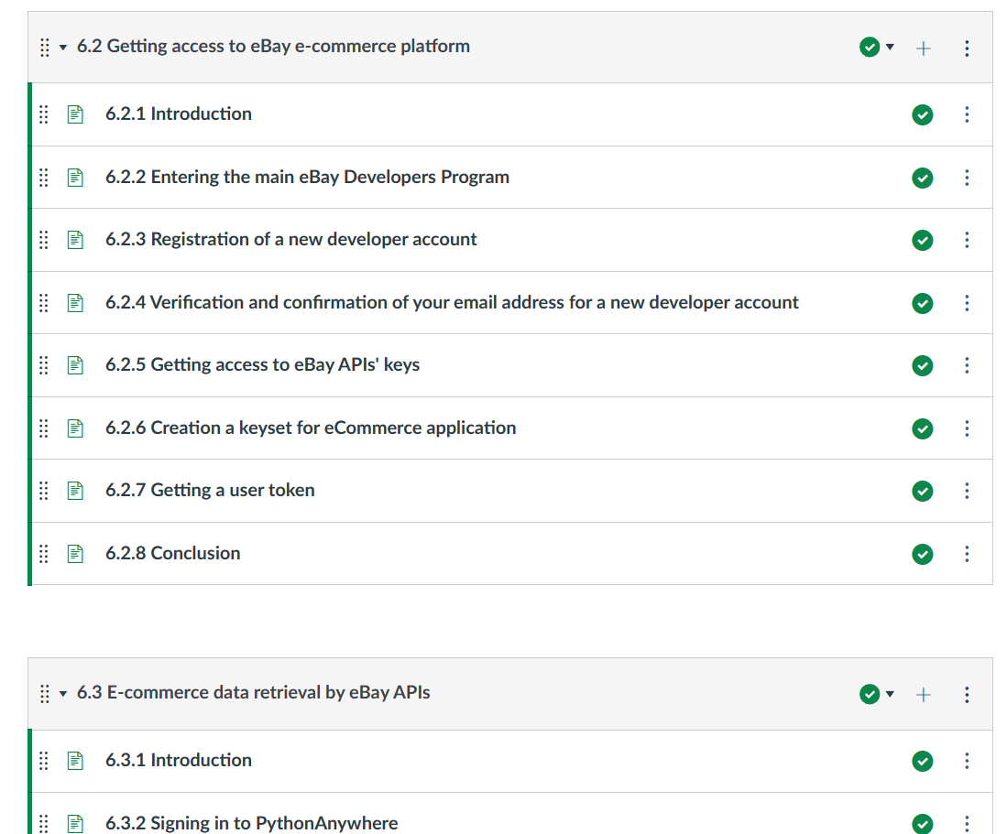
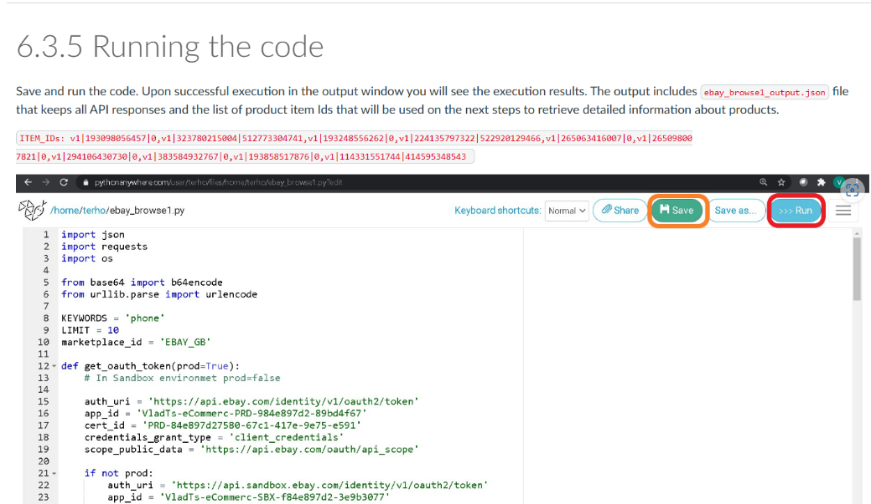

Slide 21
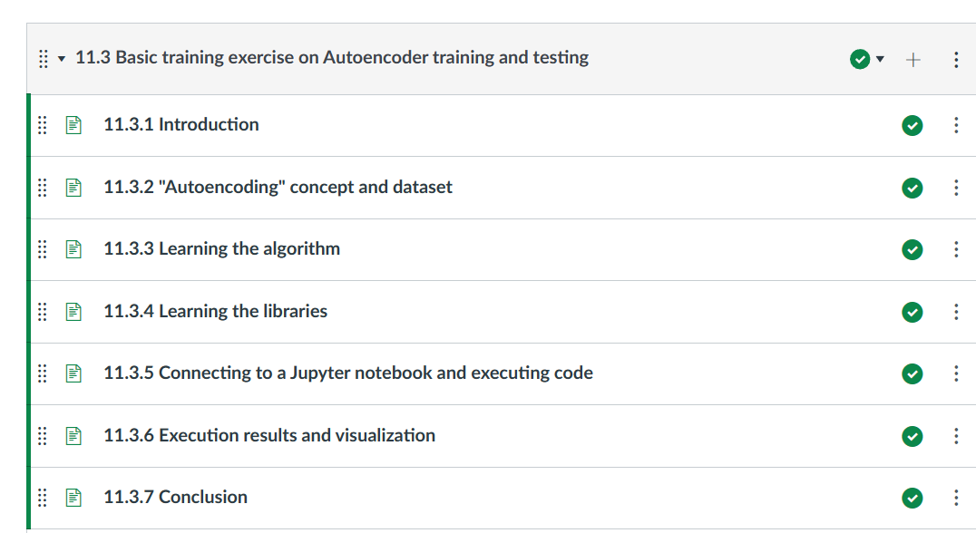
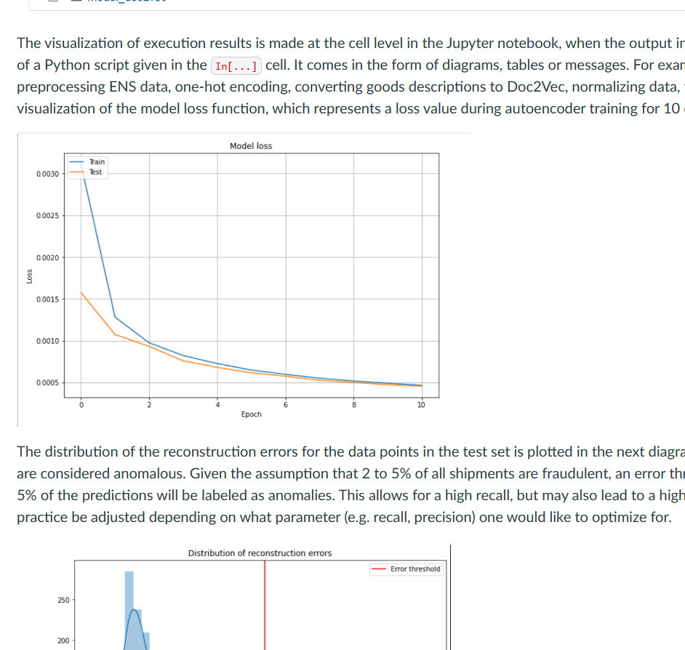
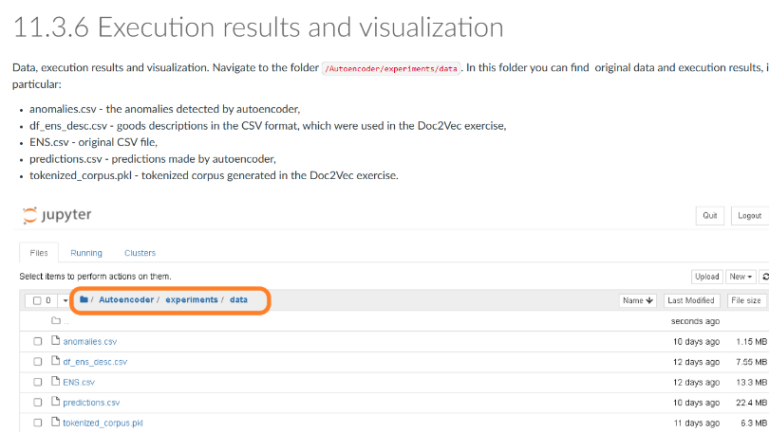

Slide 22


Interested to learn more about existing and under construction materials & courses?

Slide 23

Notes:
Bilat contacts in April:
P1 bank transfers & outlook for P2 reporting
EU18+ invitatitions...
Security Handbook team...
Horizon Europe new calls

Slide 24
Workshop 1: Innovative training solutions – Virtual reality in customs training
Notes:
Bilat contacts in April:
P1 bank transfers & outlook for P2 reporting
EU18+ invitatitions...
Security Handbook team...
Horizon Europe new calls

Slide 25
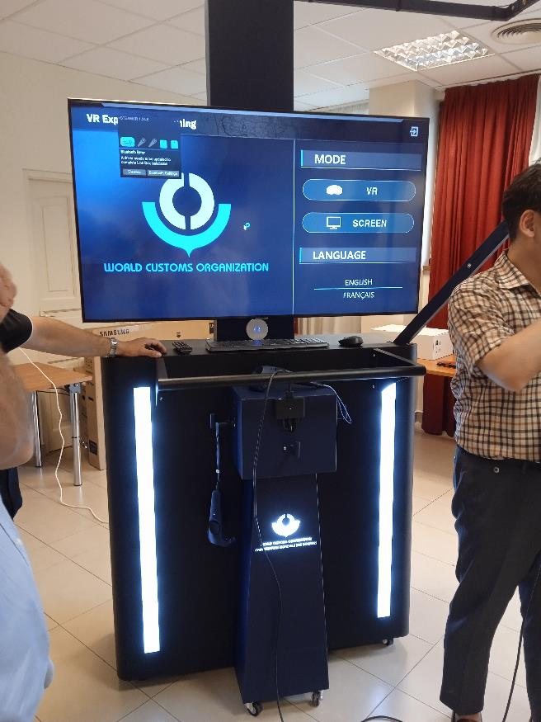
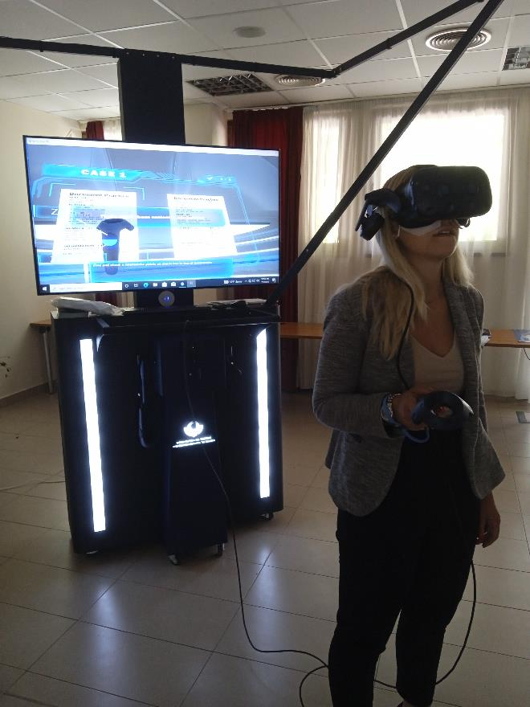
VR tool in the Hungarian customs
Notes:
Bilat contacts in April:
P1 bank transfers & outlook for P2 reporting
EU18+ invitatitions...
Security Handbook team...
Horizon Europe new calls

Slide 26

Workshop 1: Innovative training solutions – Virtual reality in customs training
Notes:
Bilat contacts in April:
P1 bank transfers & outlook for P2 reporting
EU18+ invitatitions...
Security Handbook team...
Horizon Europe new calls

Slide 27
Academic customs programmes – cooperation between universities
Panel discussion
NO, NL, HU, BE, LV, IT
Notes:
Bilat contacts in April:
P1 bank transfers & outlook for P2 reporting
EU18+ invitatitions...
Security Handbook team...
Horizon Europe new calls

Slide 28

Notes:
Bilat contacts in April:
P1 bank transfers & outlook for P2 reporting
EU18+ invitatitions...
Security Handbook team...
Horizon Europe new calls

Slide 29
Centre of excellence
Notes:
Bilat contacts in April:
P1 bank transfers & outlook for P2 reporting
EU18+ invitatitions...
Security Handbook team...
Horizon Europe new calls

Slide 30

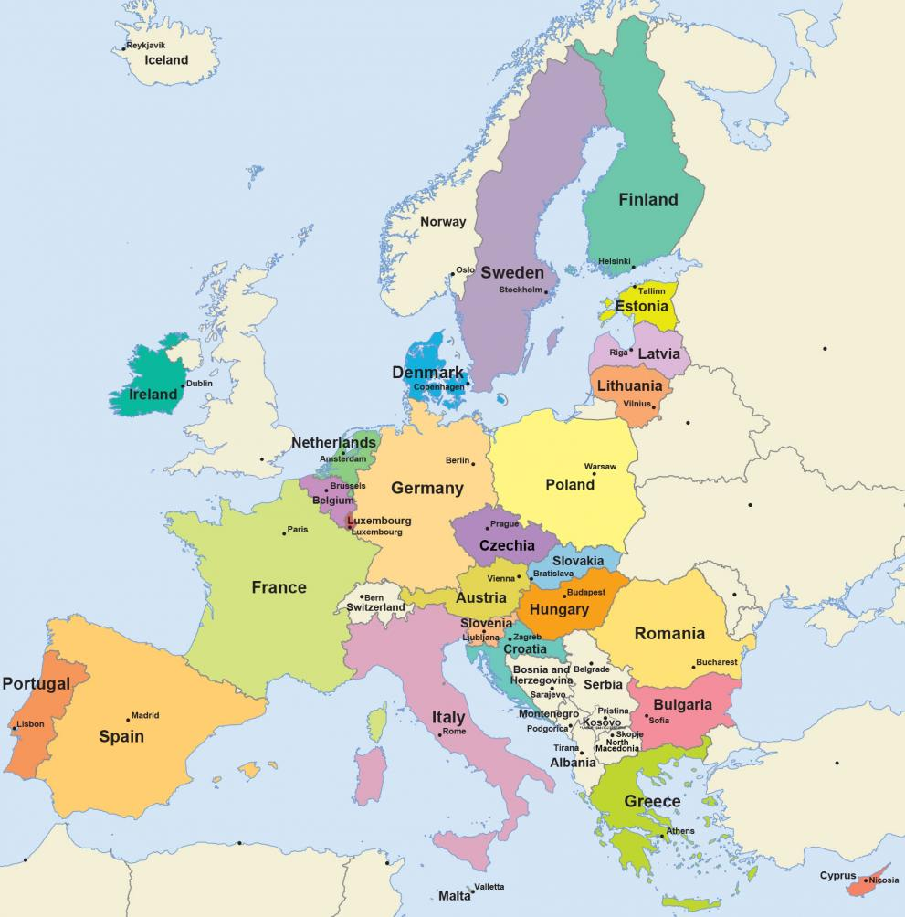


What CoE exist in EU
FI, Vaalimaa, Car search
LV, Daugavpils, Train search
PL, Gdansk, X-ray image analysing
NL, Rotterdam, see and air
PL, Przemysl, Bus search
SK, Gajary, Sniffer dogs
SK, Bratislava. E-learning
HU, Röszke, Customs control skills development

Slide 31
CoE in the EU
Country | Topic | Established in | Trainings from year
Finland | Car search | 2019 | 2016 – 1-3 per years
Hungary | Customs control skills development | 2022 | 2019 – 1-2 per years
Latvia | Cargo train search | 2023 | 2022 – 1 per years
Poland | X-ray image analysing | 2019 | 2018 – 1-4 per years
Poland | Bus search | 2022 | 2019 – 1-2 per years
Slovakia | Sniffer dogs | 2019 | 2018 – 1-4 per years
Slovakia | E-learning | 2019 | No data
The Netherland | See and air | 2009-2016 | 2009
Aaa
Bb
Cc
Notes:
Bilat contacts in April:
P1 bank transfers & outlook for P2 reporting
EU18+ invitatitions...
Security Handbook team...
Horizon Europe new calls

Slide 32
CCEI Deliverable 14 – draft structure of the final document
Context
  Definitions
  Link to other deliverables and to Customs Reform
Background
Existing practises
  CELBET
  Poland
  The Netherland
Vision for Centre of Excellence in the future
Challanges
Recommendatons
Conclusions
Annexes
  Potential topics/countries for future CoE
  CELBET Guideline about CoE
32
Notes:
Bilat contacts in April:
P1 bank transfers & outlook for P2 reporting
EU18+ invitatitions...
Security Handbook team...
Horizon Europe new calls

Slide 33



Centre of expertise from idea
TO IMPLEMENTATION

Slide 34
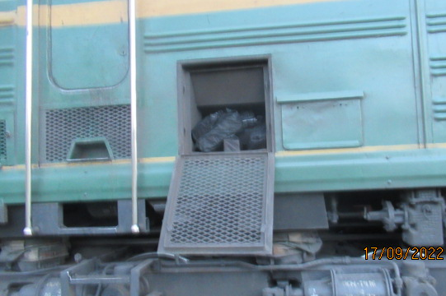
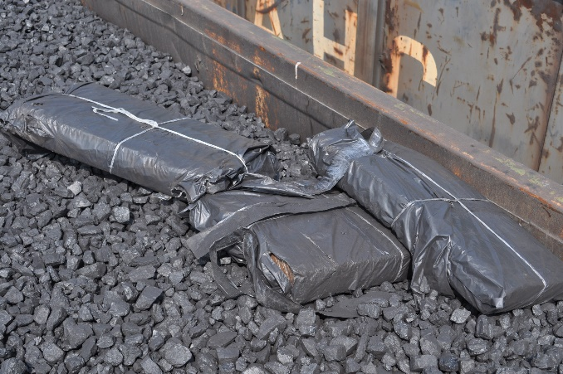
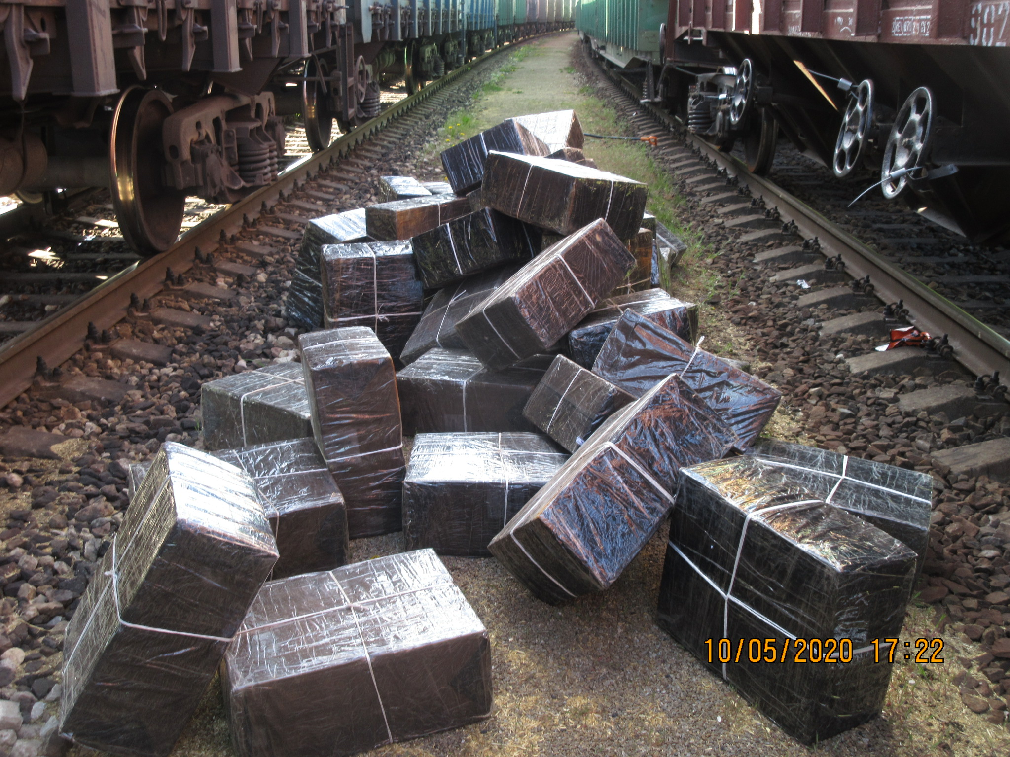
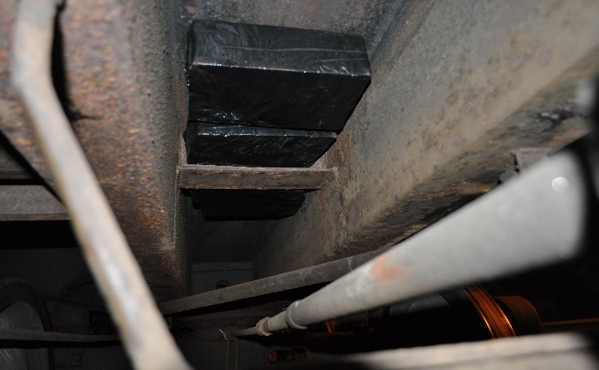
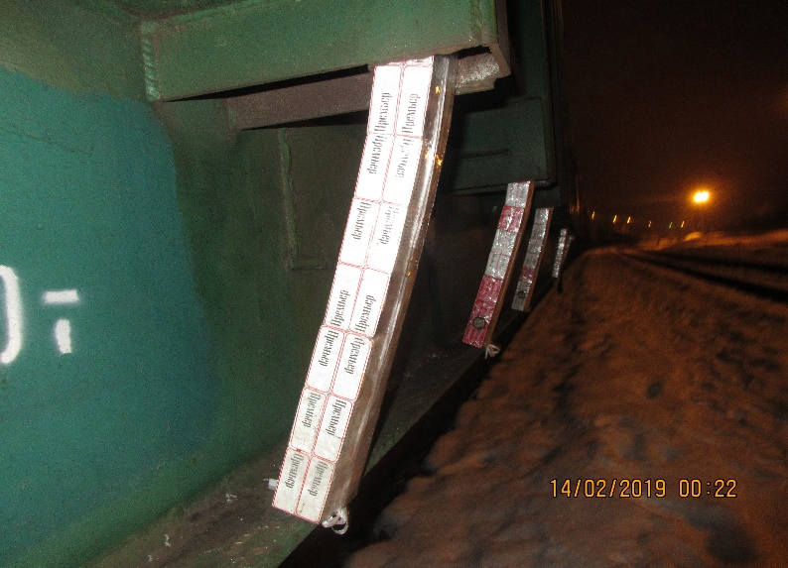
SEIZURES ON RAILWAY WITH BELARUS
2020 – 14 696 500 pcs.
2021 – 6 154 102 pcs.
2022 – 6 841 980 pcs.
2023 – 2 459 000 pcs.

Slide 35
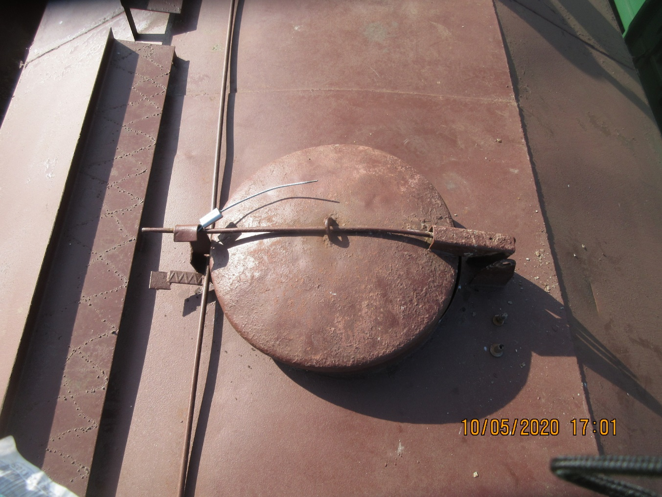
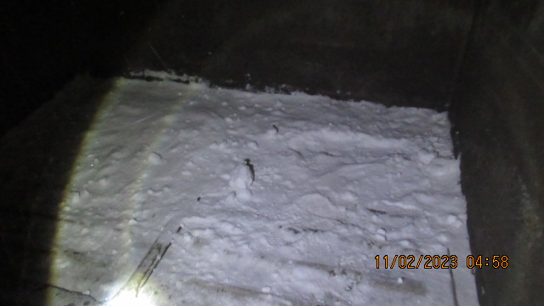
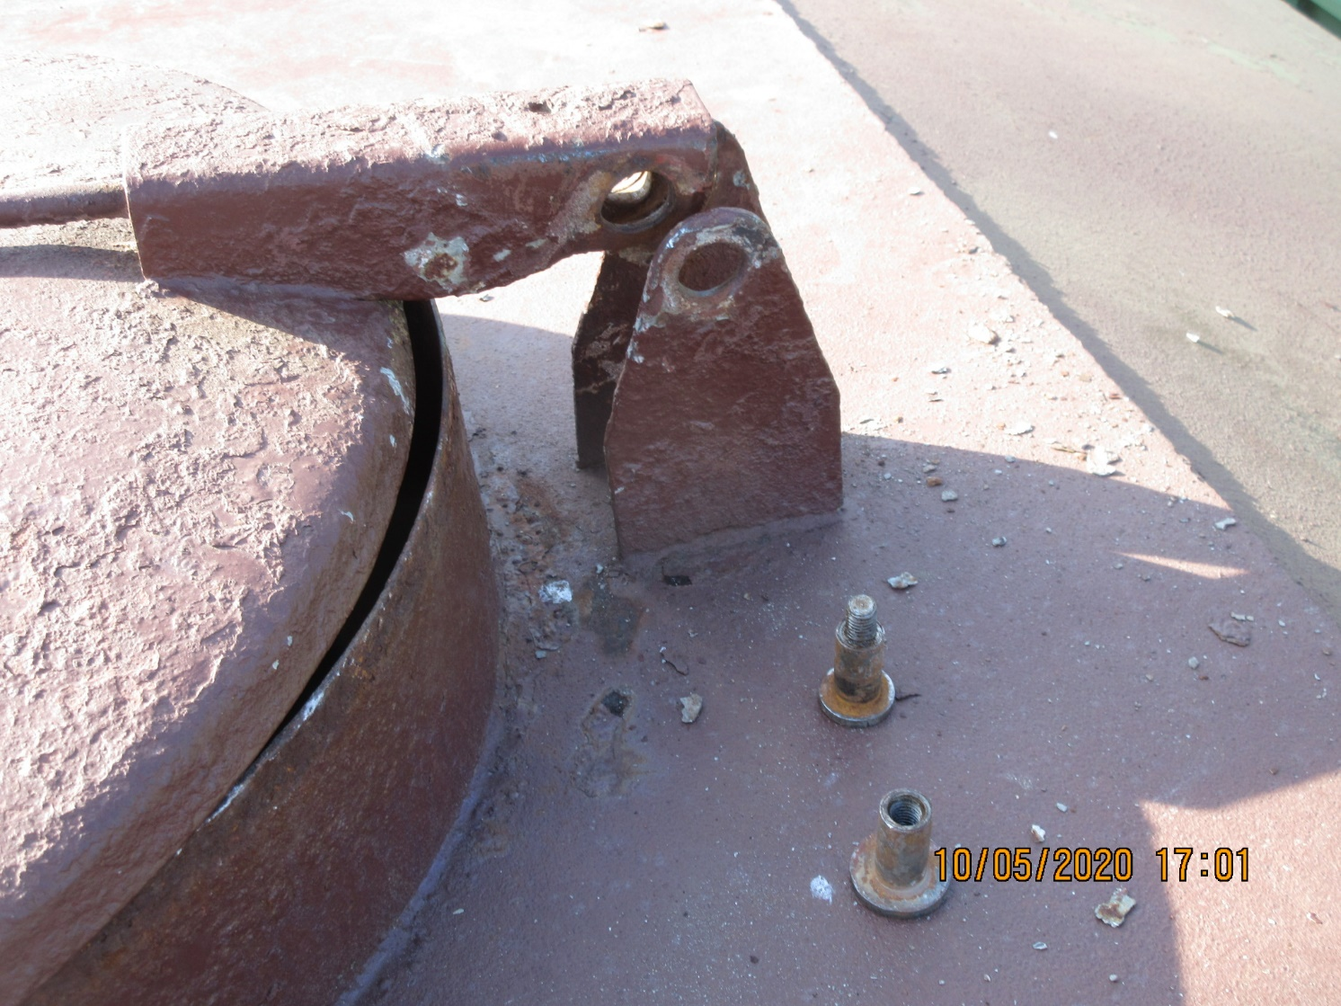
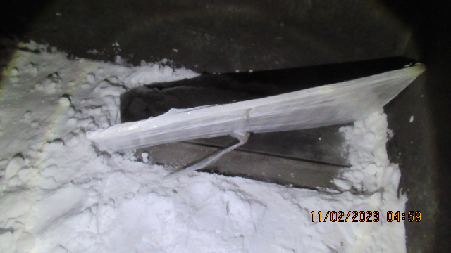
A modern view of current problems in the field of train customs control
Improvement of knowledge and experience
Management of knowledge that cannot be reflected in technical manuals and that is constantly changing
THIS KNOWLEDGES?
WE CAN
HOW
SHARE

Slide 36

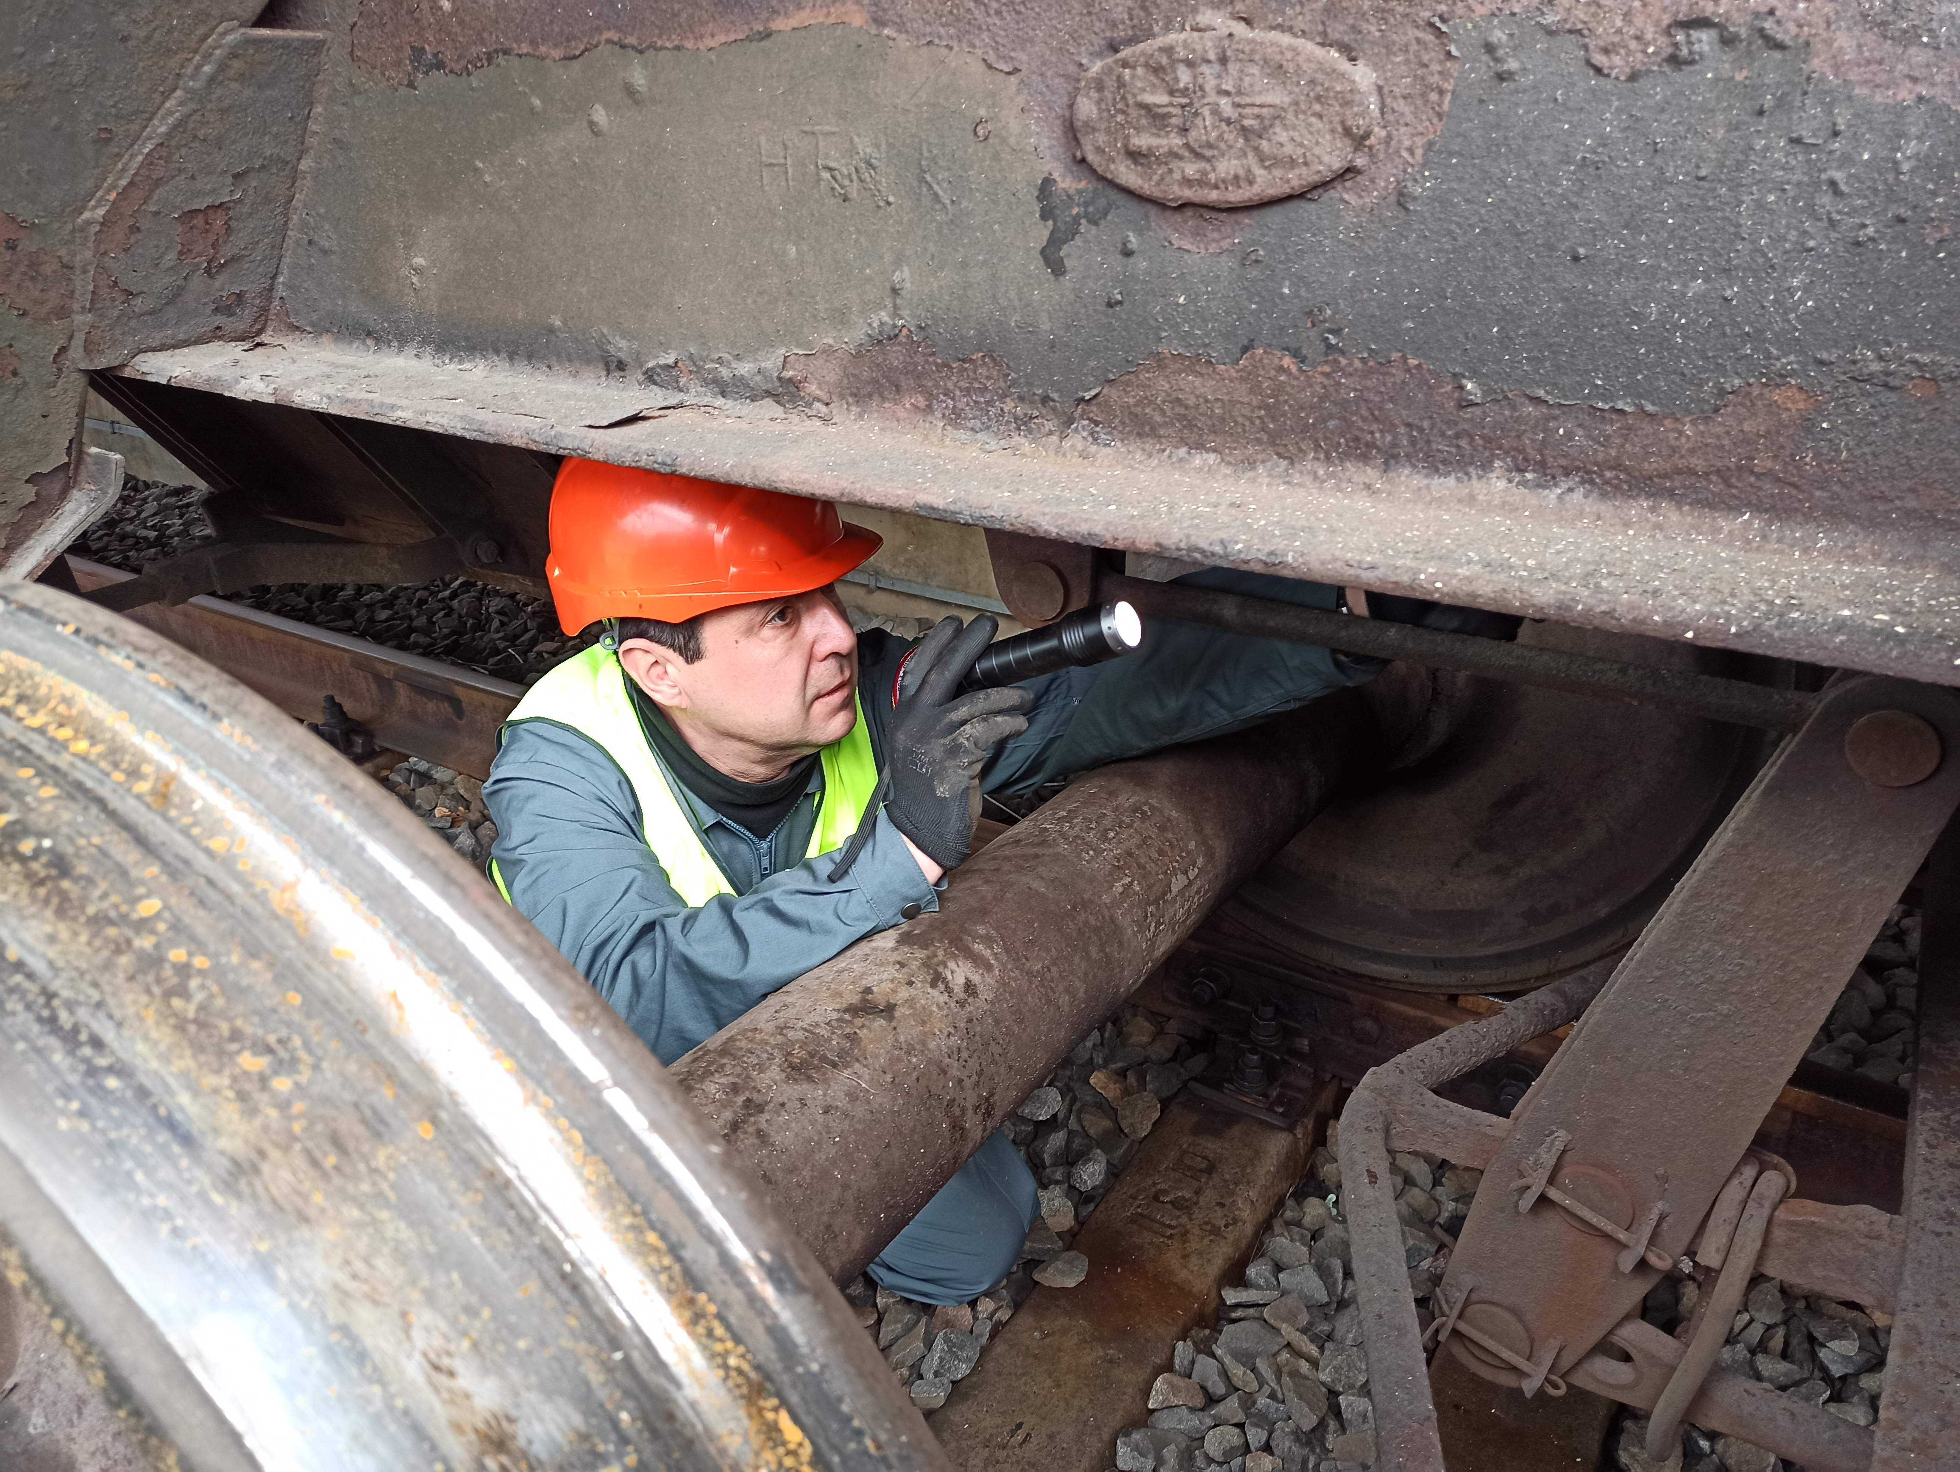
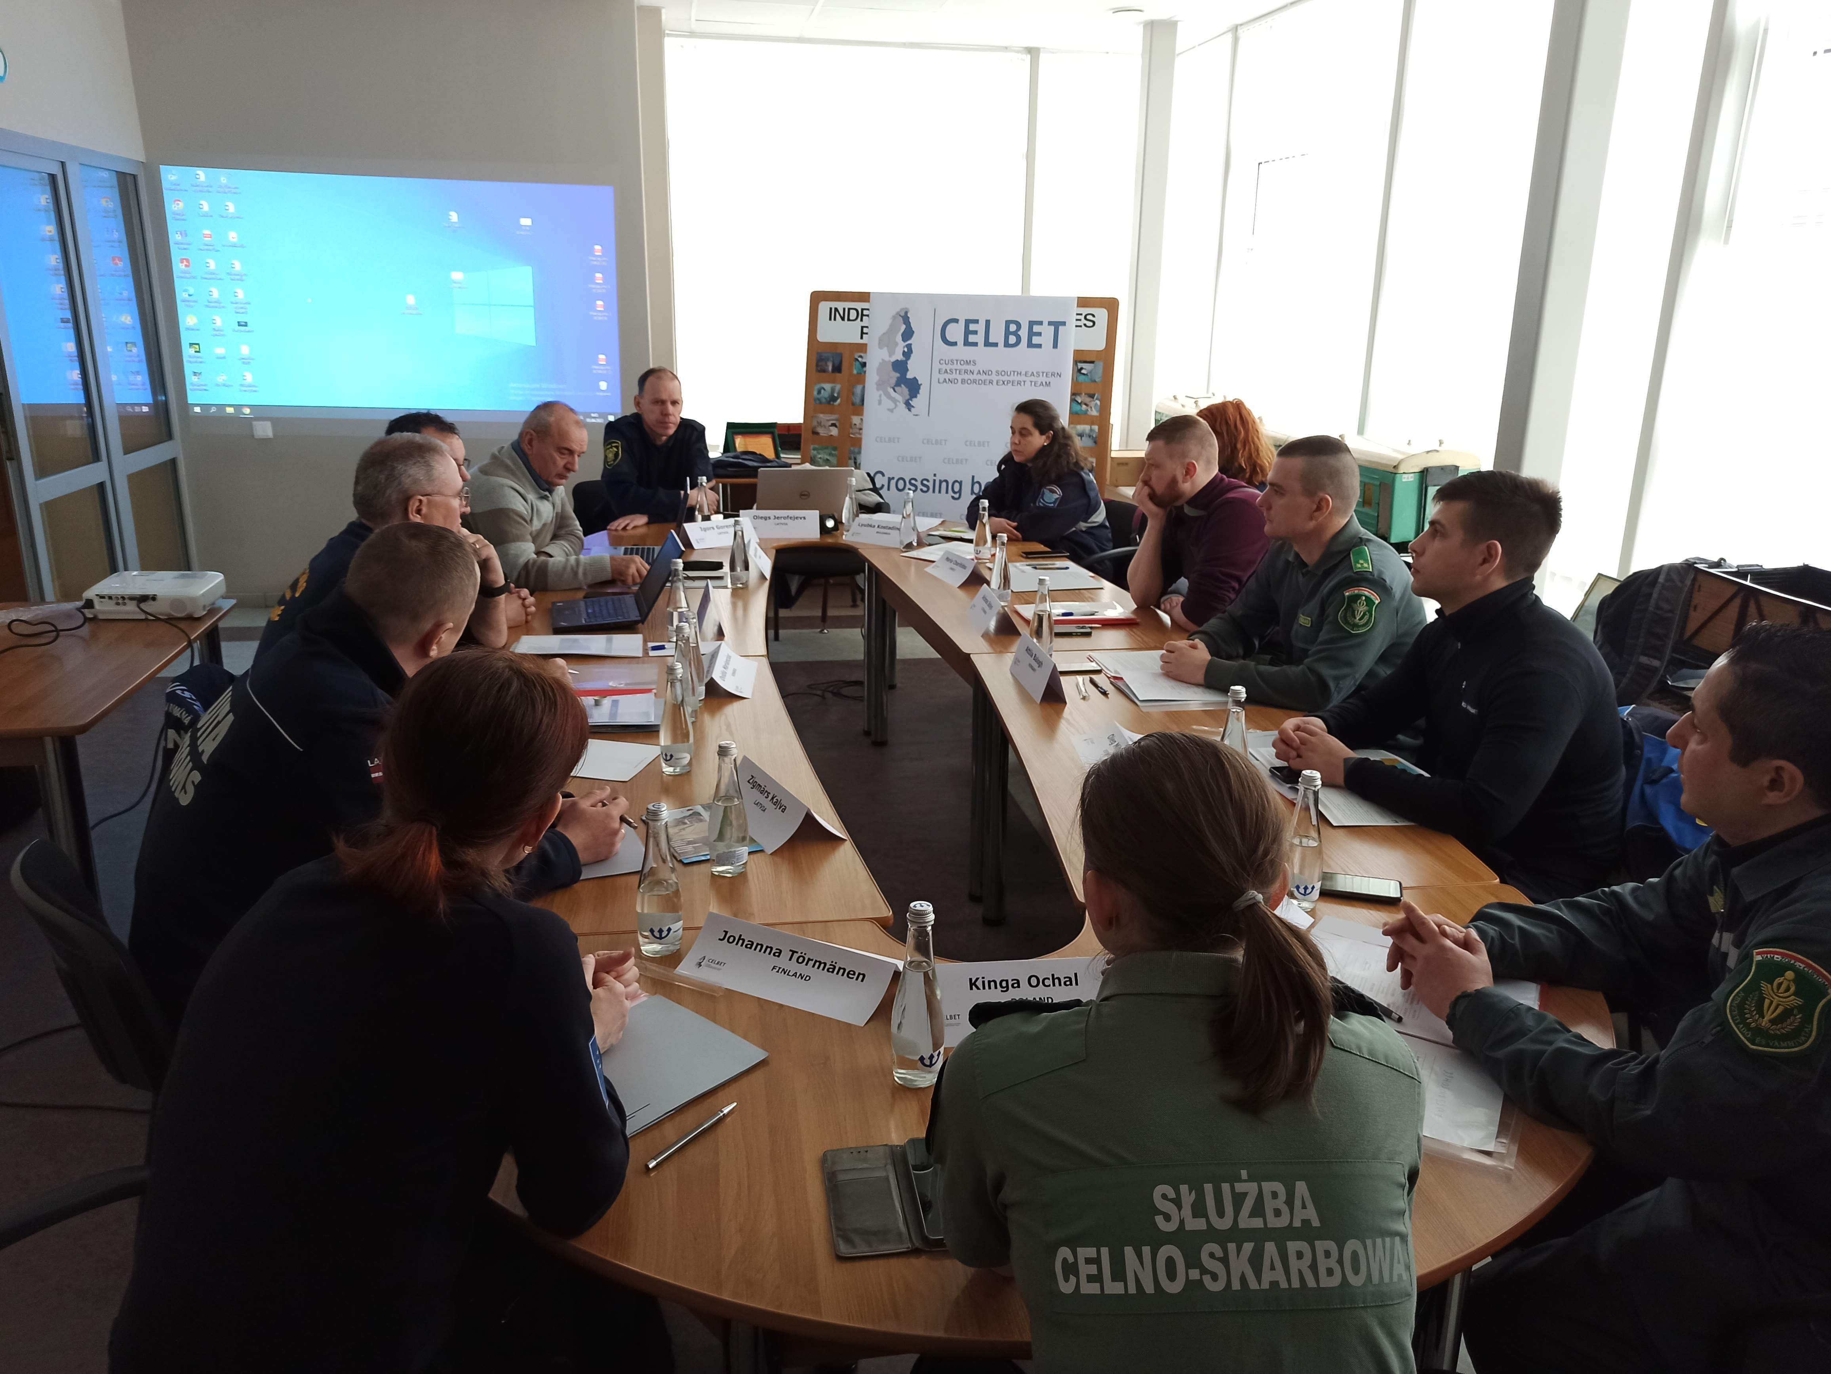

National Trainings
International Trainings
Center of Expertise

Slide 37

WHAT DO WE DEMONSTRATE
IN THE CoE
MODERN
EQUIPMENT
MOTIVATION
SAFETY RULES
REAL PRACTICE
TEAMWORK

Slide 38

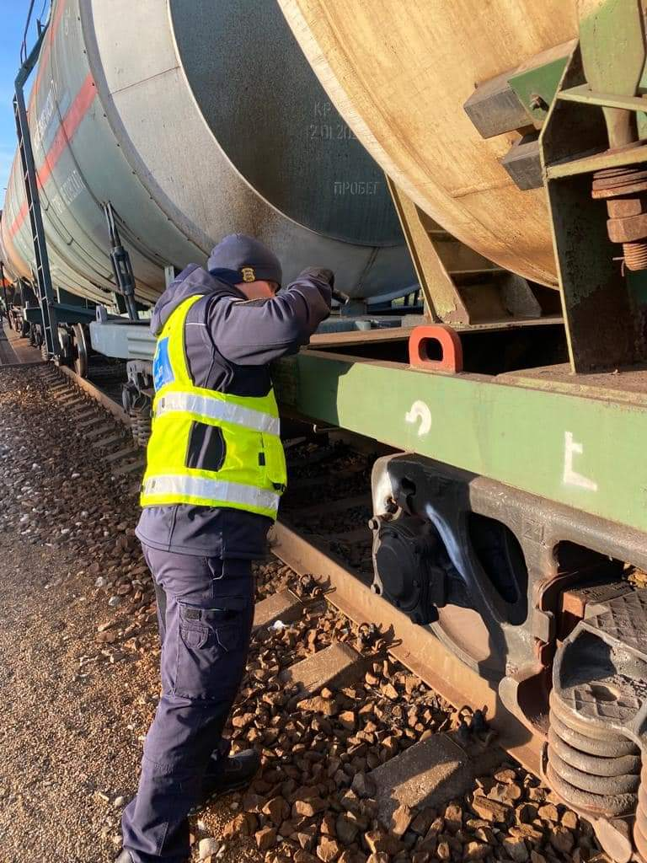
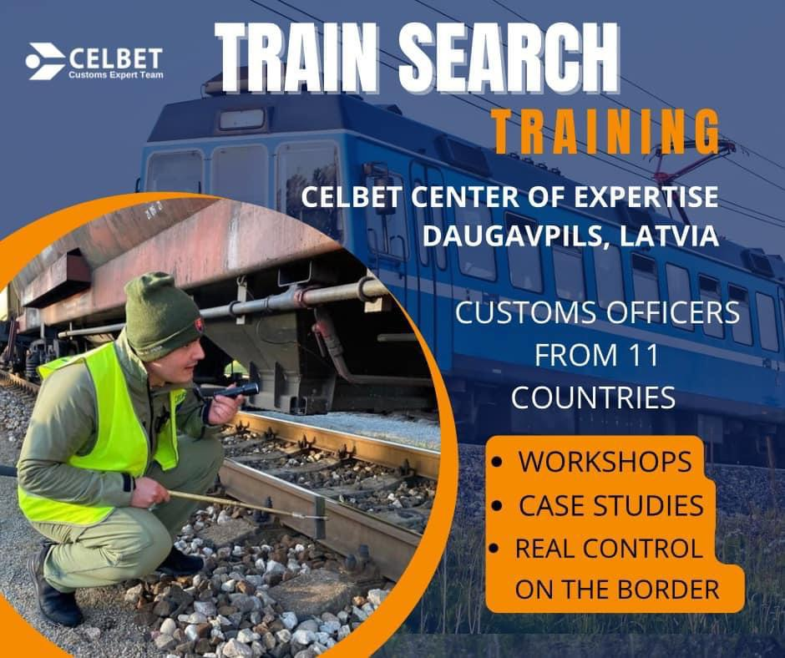
CLEP TRAIN SEARCH TRAINING
10.-12. October

Slide 39

Thank you for your kind attention!

Slide 40
Customs control skills development CoE
Hungary
Notes:
Bilat contacts in April:
P1 bank transfers & outlook for P2 reporting
EU18+ invitatitions...
Security Handbook team...
Horizon Europe new calls

Slide 41
Car search training in Vaalimaa CoE
Co-operation with other authories and companies

Slide 42
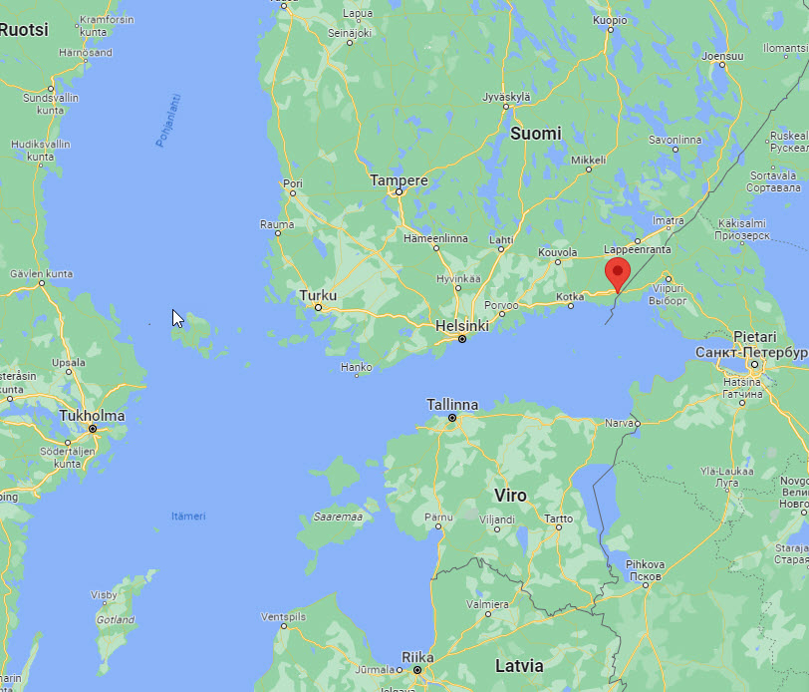
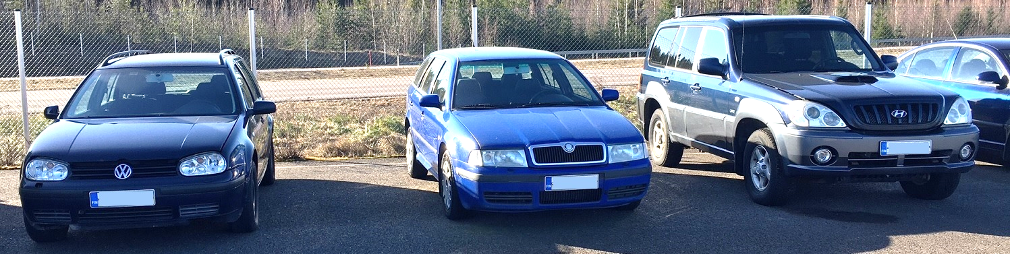
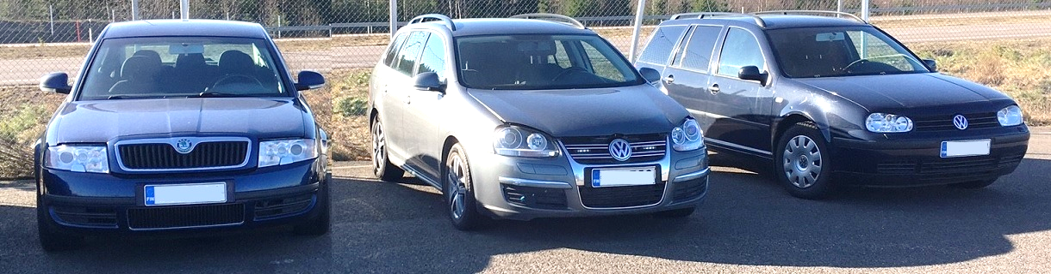
Car search training
Training centre in Vaalimaa customs
  2 – 4 trainings / year
  3 trainers, 8 participants
  Key thing is modern vehicles
  Course is based in practicality and informativity
  Collection of training cars

Slide 43
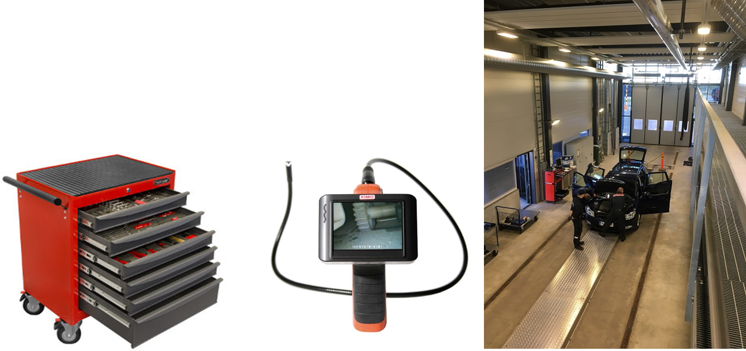
Course structure
E-learning part before the actual event
Day 1. Arrival to Finland
Day 2. Theory at Vaalimaa customs
Day 3. Practical training at Vaalimaa customs
Day 4. Visit to the company
Day 5. Clousure at Vaalimaa customs

Slide 44
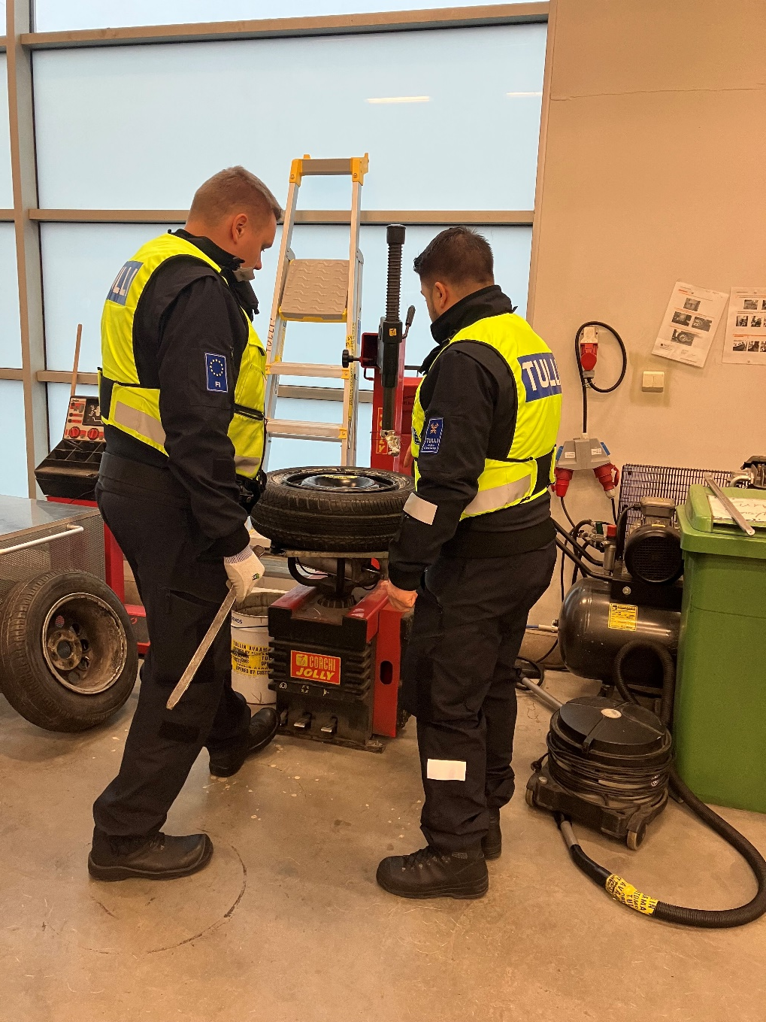
Co-operation with other authories and companies
Police officers and border guards may participate as a students
Vehicle importers
Car dealers and workshops
Material: Instructions, guides, documents
Presentations, demonstrations on-site and online
Informal communication and networking

Slide 45
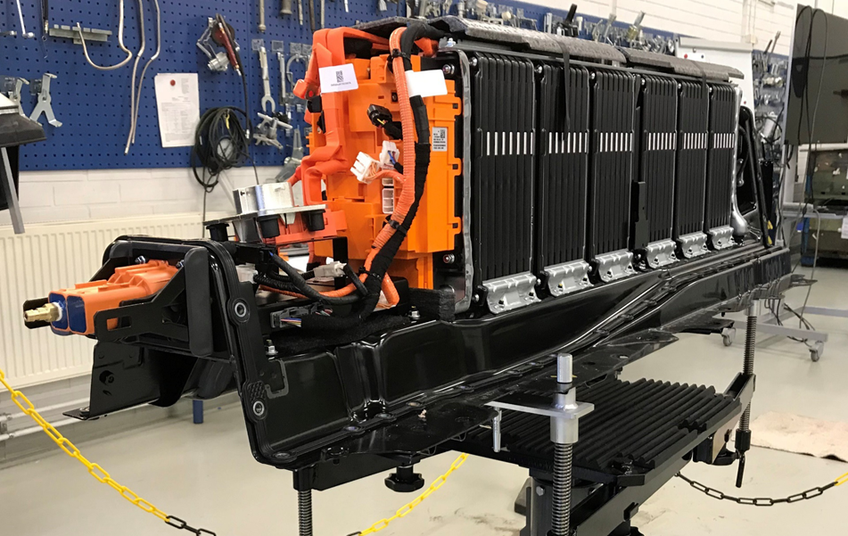
Why
Get to know new technologies and vehicle constructions
Ensure safe working methods
Share knowledge and best practices
Increase co-operation between public and private sector
Inspire and encourage officers

Slide 46
Yhteystiedot

Slide 47
Workshop 2: paralel workshops
3. Future of customs training
Overview the existing approaches
New (digital) technics
Ideas, plans for the future
Trainings for customs laboratories
Overview the training approach
Challenges
Solutions
2. Common learning development
Overview the existing practises
Challenges
Solutions
Notes:
Bilat contacts in April:
P1 bank transfers & outlook for P2 reporting
EU18+ invitatitions...
Security Handbook team...
Horizon Europe new calls

Slide 48
Notes:
Bilat contacts in April:
P1 bank transfers & outlook for P2 reporting
EU18+ invitatitions...
Security Handbook team...
Horizon Europe new calls

Slide 49
Reporting back from Workshop 2 and discussions
Notes:
Bilat contacts in April:
P1 bank transfers & outlook for P2 reporting
EU18+ invitatitions...
Security Handbook team...
Horizon Europe new calls

