Slide 1


Vaalimaa CoE
Car Search Training, Basic
Train the Trainer - events

Slide 2


CAR SEARCH TRAINING (BASIC)
Background information
During 2015-2016, Customs’ national trainers received, from several vehicle importers, ( VW, Volvo, Skoda, Toyota..) a course built to meet Customs’ needs concerning car structure and technology of modern vehicles
10 Car search trainers in Finland, Vaalimaa customs is centre of expertise in car search
National trainers have also received a certificate of electrical safety for vehicles
Notes:
2

Slide 3
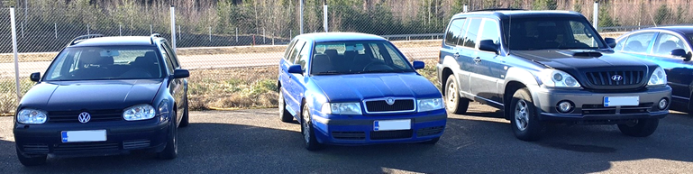
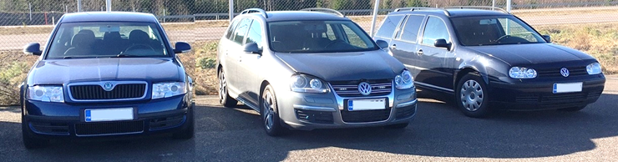
CAR SEARCH TRAINING (BASIC)
Training center in Vaalimaa customs
  Train the Trainer course
  2 – 4 trainings / year (EU CLEP + CELBET)
  3 trainers, 8 participants
  Key thing is modern vehicles
  Course is based in practicality and informativity
  Collection of training cars
Notes:
3

Slide 4
COURSE STRUCTURE
E-learning part before the actual event (MOODLE)
Day 1. Arrival to Finland
Day 2. Classroom day at Vaalimaa customs
Day 3. Garage day at Vaalimaa customs
Day 4. Workshop day (Arctic Trucks Finland)
Day 5. Classroom day at hotel meeting room, Kotka
Notes:
4

Slide 5
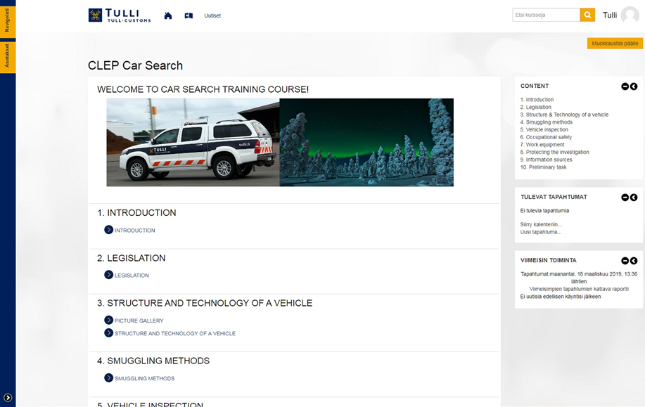
E-LEARNING
E-learning part at Moodle environment
Base information to the course
Included also preliminary task
Notes:
5

Slide 6
Day 2. Classroom day at Vaalimaa Customs
Vaalimaa Customs / X-ray scanning meeting room
Introduction, goals and practical arrangements of the course
Introduction of Finnish Customs
Main lectures:
  STRUCTURE AND TECHNOLOGY OF A MODERN VEHICLE
  SAFETY EQUIPMENT AND ALTERNATIVE FUELS
  SMUGGLING METHODS
  OCCUPATIONAL SAFETY
  INSPECTION TACTICS AND TECHNOLOGY IN FINNISH CUSTOMS, VISIT TO VAALIMAA X-RAY
Notes:
6

Slide 7
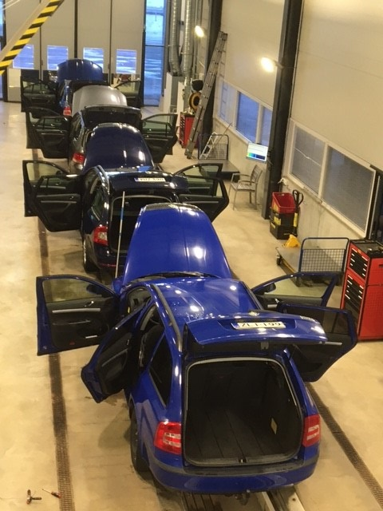
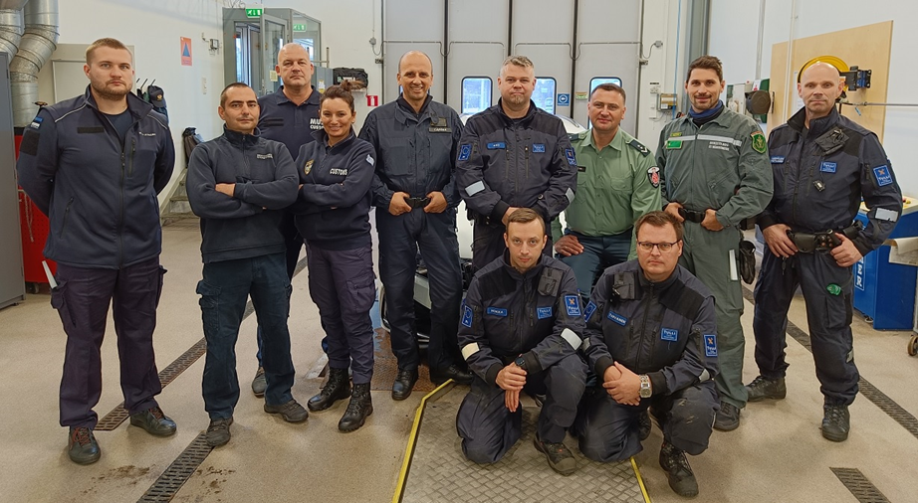
Day 3. Garage day at Vaalimaa Customs
Use of tools, refreshment of occupational safety, physical control in the car hall with demonstration, CNG-vehicle presentation
Training cars: the teams search to find the hidden packages. The training cars are re-assembled
Notes:
7

Slide 8
Day 4. Workshop day
Alternative fuels and technology
  Introduction of hybrid vehicles
Visit to a dedicated 4x4 vehicles workshop facility
  Body construction of off-road vehicles. Learning the characteristics of off-road vehicles in a practical driving session
Notes:
8

Slide 9
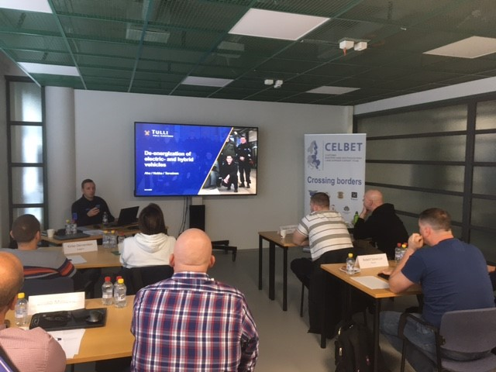
Day 5. Final day at hotel meeting room, Kotka
ALLDATA workshop software
PICS / CAVA
Car Search E-learning module
Course feedback, closing discussion and -ceremony
Transport to Helsinki airport
Notes:
9

Slide 10
EU- and CELBET Car Search events
Pilot course was held in june 2017 at Vaalimaa, the participating countries:
  2. Course 13. – 16.2.2018:
    3. Course 16. – 19.10.2018:
      4. Course 12. – 15.3.2019:
      5. Course 25. – 29.3.2019, CELBET – Pilot course, Basic
      6. Course 1. – 4.10.2019
      7. Course 15. – 18.10.2019, CELBET - Basic
      8. Course 10. – 12.12.2019, CELBET (GREECE)
      9. Webinar 5.5.2021, CELBET
      10. Webinar 11.11.2020, CELBET
      11. Webinar 28.10.2021
      12. Course 31.5.-3.6.2022 Nordic countries
      13. Course 23.-26.8.2022
      14. Course 20.-23.9.2022, CELBET - Advanced
Notes:
10

