Slide 1


Vaalimaa CoE
Car Search Training, Advanced
Train the Trainer - events

Slide 2


CAR SEARCH TRAINING (ADVANCED)
Training center in Vaalimaa customs
  Further education for those who have completed the basic Train the Trainer course
  1 training held so far (2022)
  3 trainers, 8 participants
  Key thing is hybrid- and electric vehicles, de-energization
  VDE-insulated tools
  Cooperation with Taitotalo (specialists with electric cars)
Notes:
2

Slide 3
COURSE STRUCTURE
Pre-assignment
Day 1. Arrival to Finland
Day 2. Classroom day at Vaalimaa customs
Day 3. Garage and classroom day at Vaalimaa customs
Day 4. Workshop day (Taitotalo)
Day 5. Classroom day at hotel meeting room, Kotka
Notes:
3

Slide 4
Day 2. Classroom day at Vaalimaa Customs
Vaalimaa Customs / X-ray scanning meeting room
Introduction, goals and practical arrangements of the course
Main lectures:
  DE-ENERGIZATION OF HYBRID- AND ELECTRIC CARS
  OCCUPATIONAL SAFETY
  SMUGGLING TRENDS IN EUROPE
  PARTICIPANT PRESENTATIONS
Notes:
4

Slide 5
Day 3. Garage and classroom day at Vaalimaa Customs
Garage:
De-energization of VW PASSAT GTE demonstration
VDE-insulated tools in use
Customs controls from live traffic
Classroom:
Teamwork concerning the Car Search Training courses - 2 groups
Notes:
5

Slide 6
Day 4. Workshop day – Taitotalo, Helsinki
Classroom- and training center learning
Technical trainers from Taitotalo
Notes:
6

Slide 7
Day 4. Workshop day – Taitotalo, Helsinki
Content:
  Different hybrid- and electric vehicle types
  Working safety, high voltage component locations etc.
  Car brands and models, new car registration statistics
  Charging, types and systems, batteries etc.
  Hybrid- and electric vehicles, demonstration session at training center
  Future innovations: what to expect
  Conversation and conclusions
Notes:
7

Slide 8
Day 5. Final day at Vaalimaa Customs
ALLDATA workshop software use with de-energization
Structure- and technology of a hybrid vehicle
CAVA update
Course feedback, closing discussion and -ceremony
Transport to Helsinki airport
Notes:
8

Slide 9
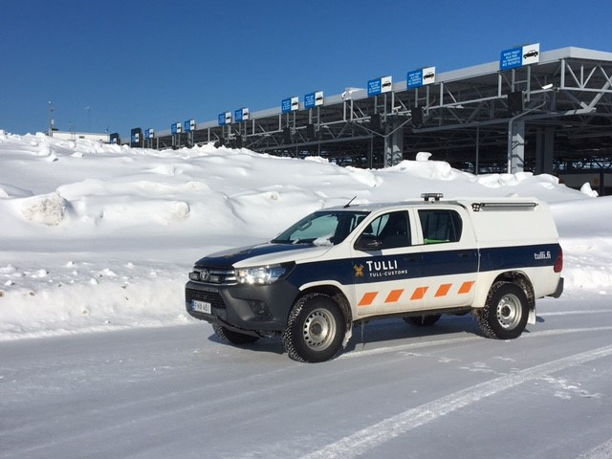
Mobile car search vehicle and service
For challenging car search situations
Special expertise in electric- and hybrid vehicles
Passenger cars
Heavy vehicles
Cooperation:
Customs
Police
Border guards
Finnish defence forces
Notes:
9

Slide 10
Mobile car search vehicle, tools
Hand tools
Socket wrench set, (big + small)
Screwdriver set + Torx + Hexagon socket
Upholstery removal kit
Cordless electric tools + chargers
Impact wrench (boltgun)
Screwdriver
Grinder
Sabresaw
Special tools
VDE Insulated special tools for hybrid- and full electricity cars
Airbag removal tools
Videoscope
Fuel sensor flap removal tool
Other tools and stuff
Laptop with network (with ALLDATA)
Inverter
Exhaust jack + racks
Assortments of screw, bolt, nut, washer and upholstery clip
Headlamps + other flashlights
Personal protection, (Corona!)
First aid kit
Notes:
10

Slide 11
Finnish Trainers:
Mr. Pekka Aho, Vaalimaa Customs, pekka.aho@tulli.fi
Mr. Jukka Nokka, Vaalimaa Customs, jukka.nokka@tulli.fi
Mr. Valtteri Serola, Vaalimaa Customs, valtteri.serola@tulli.fi
Mr. Teijo Tarvainen, Nuijamaa Customs, teijo.tarvainen@tulli.fi
Notes:
11

