Slide 1
Webinar, e-learning experience

Slide 2
General informations
By this training customs officers can get familiar with risk indicators and recognizing fake documents
Theoretical part
Practical case studies:
confirm the knowledge got during theoretical part
thought-provoking
aim of this training: give useful, practical knowledge to first-line customs officers

Slide 3
„Pre-history”
At the beggining of 2018, CELBET1 – the frist training in Vyšné Nemecké, Slovakian – Ukrainian border
the topic of customs document control mentioned
a need arised to organize a gap-filling training course on this topic

Slide 4
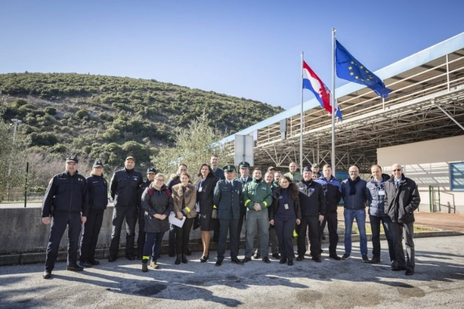
Risk analysis – profiling and document control
Trainers: 2 Polish, 1 Finnish, 1 Croatian és 1 Hungarian customs officer
First training
Dubrovnik, Karasovići Croatian-Montenegrin BCP on 4-6 February 2020
10 participants from 10 CELBET countries
Topic covered
role and importance of risk analysic, risk indicators
interviewing, profiling
methods for recognizing fake documents
using open source databases
practical tasks

Slide 5
Methods for recognizing fake documents
Theoretical outlook - definitions
Methods for falsifying documentation
Why do people fake the information on customs documents?
Methods for fake documents identification
also available in e-learning form from the summer of 2021

Slide 6
Results
1 face-to-face training
3 CELBET, 2 CLEP organised on-line training
Trained colleagues - approx. 80
E-learning

Slide 7
Benefits of online trainings
easier to reach trainees
actually – IT system can set limits only –unlimited number of trainnee can listen training, presentation
lower costs
flexible
shy people would prefer speak by microphone without personal contact

Slide 8
Disadvantages, problems, „barriers”
Technical, IT issues
general IT problems, technological requirements
microphone, voice problems
stable network necessary
accessibility issues
Not seenable reactions, interactions
communication a bit harder, complicated
participants are less willing to share their ideas, to start conversation
they are not motivated to speak, easy to „hide” behind the screen
body language is invisible

Slide 9
E-learning
Advantages
convenience
flexibility
reduced costs
availability
lectures can be repeated if necessary
there is no time limit, you can learn at your own pace
with tests, exercises teacher/trainer can give feedback or highlight the most important part of topic
opportunity to get anonym feedback
Disadvantage
very hard to make a creative, useful presentation
can’t be explained every sentence
creator must provide a clear and appropriate explanation
the lack of control
the risk of social isolation

Slide 10
Summary
Fake documents is a data based topic therefore it is appropriate for e-learning, webinarium
We suppose to create a multi-part training programs by connecting several related topics
after completing these training programs, trainees can receive certificates, level of knowledge
Closing remark
face-to-face trainings are more convenient for trainers, easier to transfer the knowledge and receive confirmation
but, numerous topics are an excelent basis for e-learning in the future

