Slide 1
Presentation of Customs Control Skills Development Centre of Expertise
CELBET Customs control process training
Zsolt Kovács Cpt., Hungarian Tax & Customs
Jenő Csáki Cpt., Hungarian Tax & Customs
Tamás Tóth Lt., Hungarian Tax & Customs
BCP Röszke, Customs Control Skills Development Centre of Expertise

Slide 2
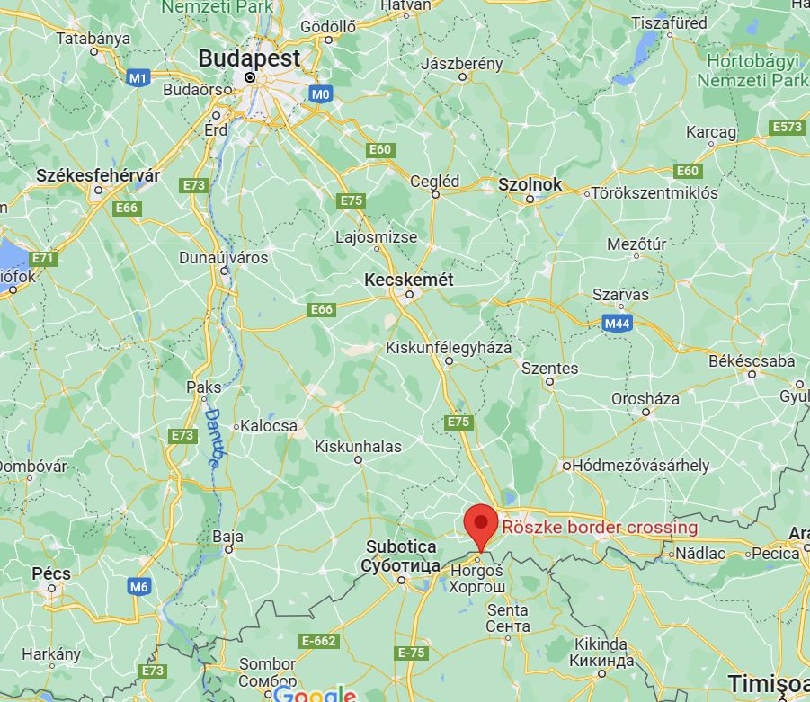
General informations Customs Control Process Training
Live training facilated @Röszke BCP, Hungary Röszke Centre of Expertise
4 trainers (3 HUN +1)
From 2019: 4 live trainings + 2 webinars
Goal and objective:
To spread common approach in performing customs control at the EU external border by sharing working examples, best practices and methods.
To increase safety and security, protect citizens and the environment.

Slide 3
General informations Customs Control Process Training
Hard skill developement
Operational competencies
Soft skill developement
Professional competencies
New modus operandi & Training metholodogy
Based on many scientific researches
Notes:
Professional competencies
- dealing with operational risk
- drive for results
- Teamwork
- coping with stress
- problem solving
- processing information
- communication
technological ability
Operational competencies:
customs legislation
Enforcement
risk analysis
control of goods

Slide 4
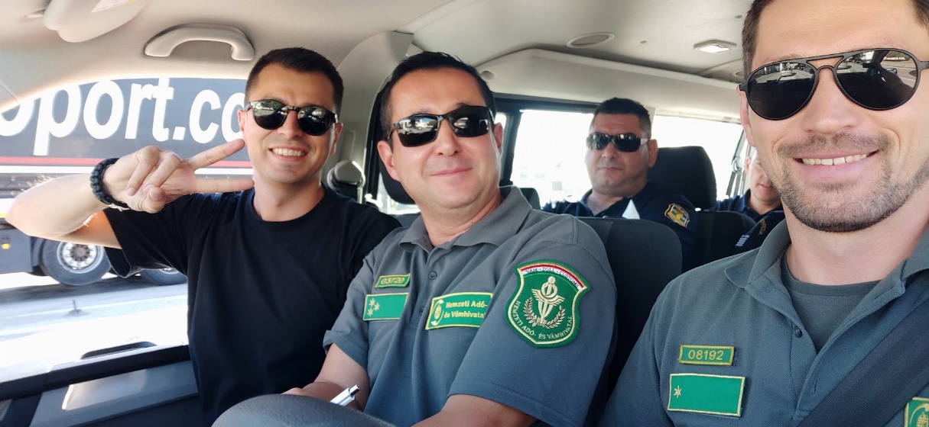
General informations Customs Control Process Training
Give opportunity for trainees to become trainers.
Ambition
Choose a Preferable topic
Motivation for national implementation
Risk Analysis, Interviewing, Profiling, Specialized in some Control Method or Means of transport

Slide 5
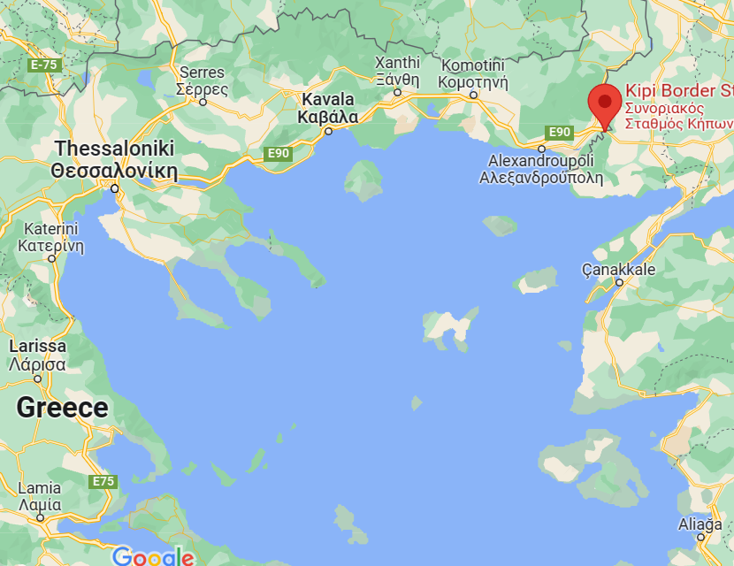
CELBET Customs control process training
Greece, 6-8 Septemeber 2022
06-08. 09.2022. Kipi BCP
16 participants
3 CELBET trainers (2 HUN, 1 BG)
Greek customs officers
From BCPs with Albania, N.Macedonia, Turkey
Sniffer dog handlers + X-Ray operators included

Slide 6
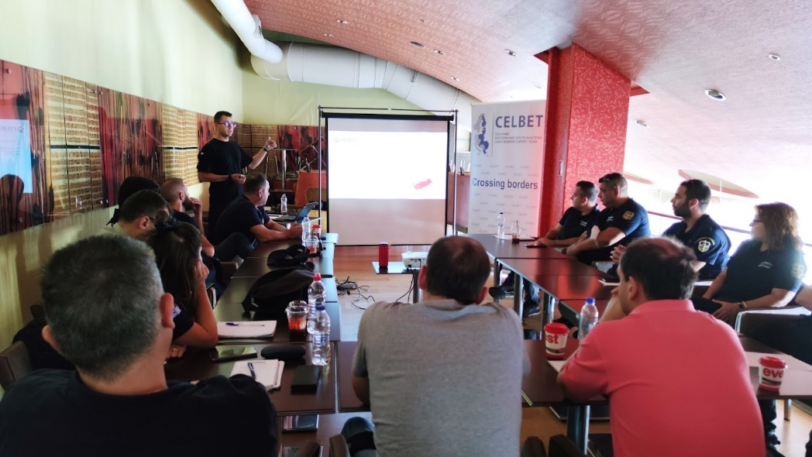
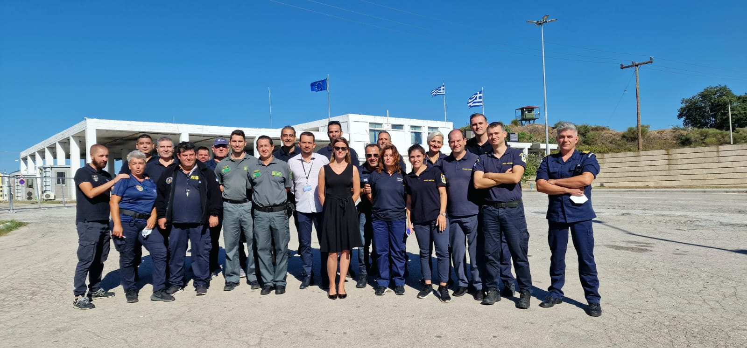
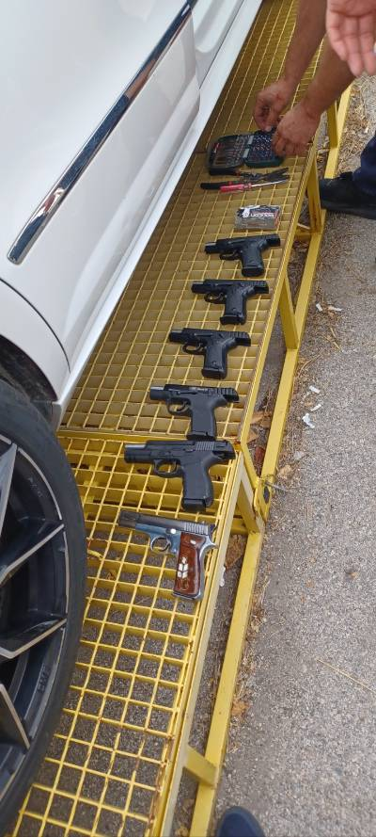
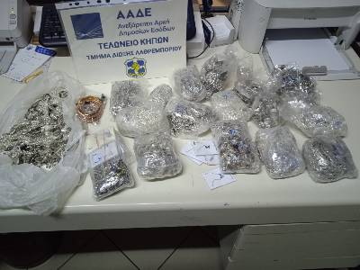
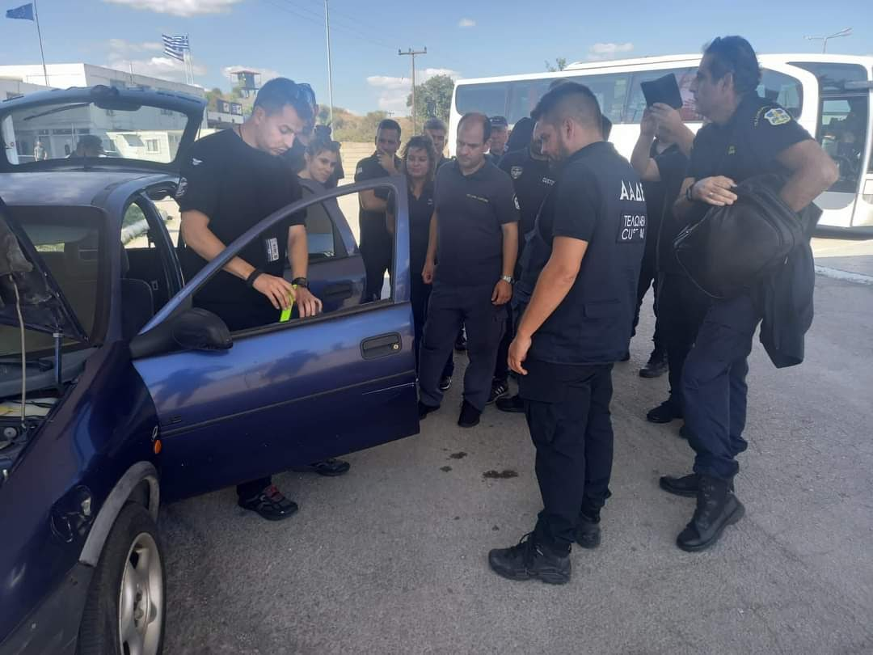
Notes:
Usefull basic for all type of Cumtoms officers (sniffer dog, x-ray, shiftleader)

Slide 7
CELBET Customs control process training
MOLDOVA, 7-8, 9-10 NOVEMBER 2022
Cooperation with EUBAM
07-08. 11.2022. Crivia BCP
09-10. 11.2022. Palanca BCP
2x 16 participants
Moldovan + Ukrainian customs officers + EUBAM officers
2 CELBET trainers

Slide 8
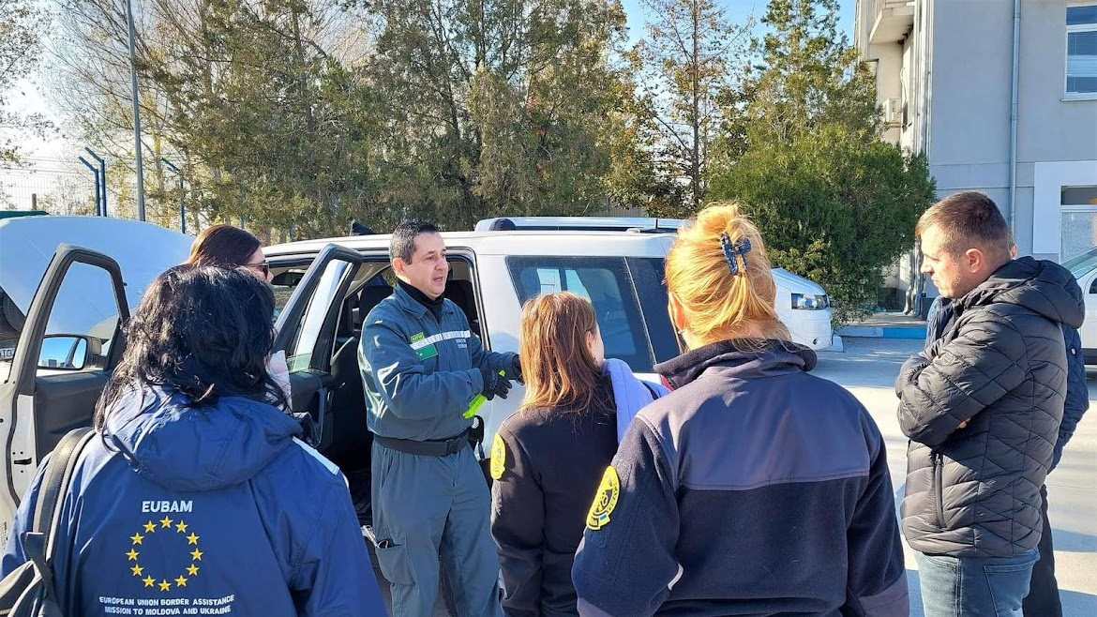

Slide 9
Thank you for attention!

