Slide 1
EU e-Learning development
Tamás Tóth Lt., Hungarian Tax & Customs
BCP Röszke, Customs Control Skills Development Centre of Expertise

Slide 2
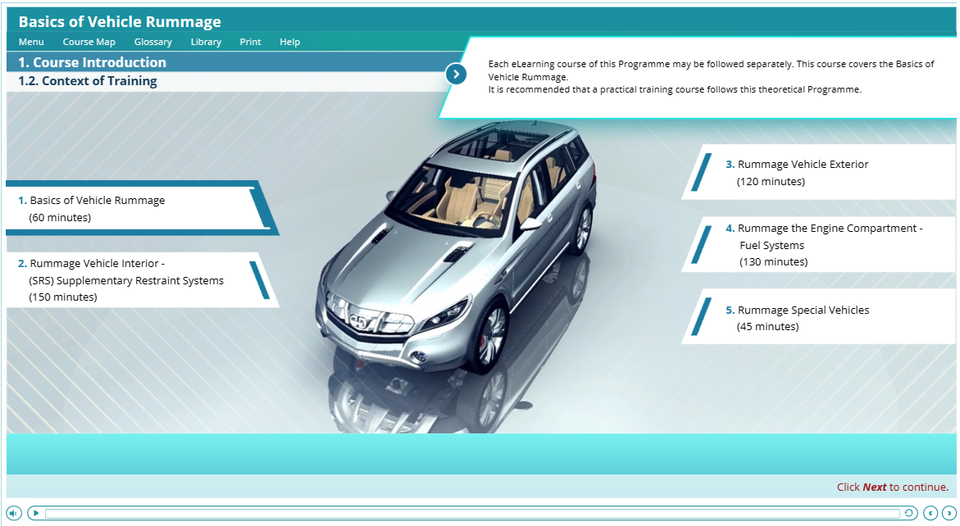
Car Search e-learning development
Customs & Tax EU Learning Portal
5 Modules
Master version in EN
2019.04. – 2020.07.
1 kickoff meeting in Brussels
Content revision from 2007
Content creation (text, photos, videos)
New content revision, 2nd-3rd-4th revision
Apx. 600 hours of work in Freetime (per person)
For free of charge (service)
Notes:
Online meetings
Phone calls
Emails
TeamWork (chain revision)

Slide 3
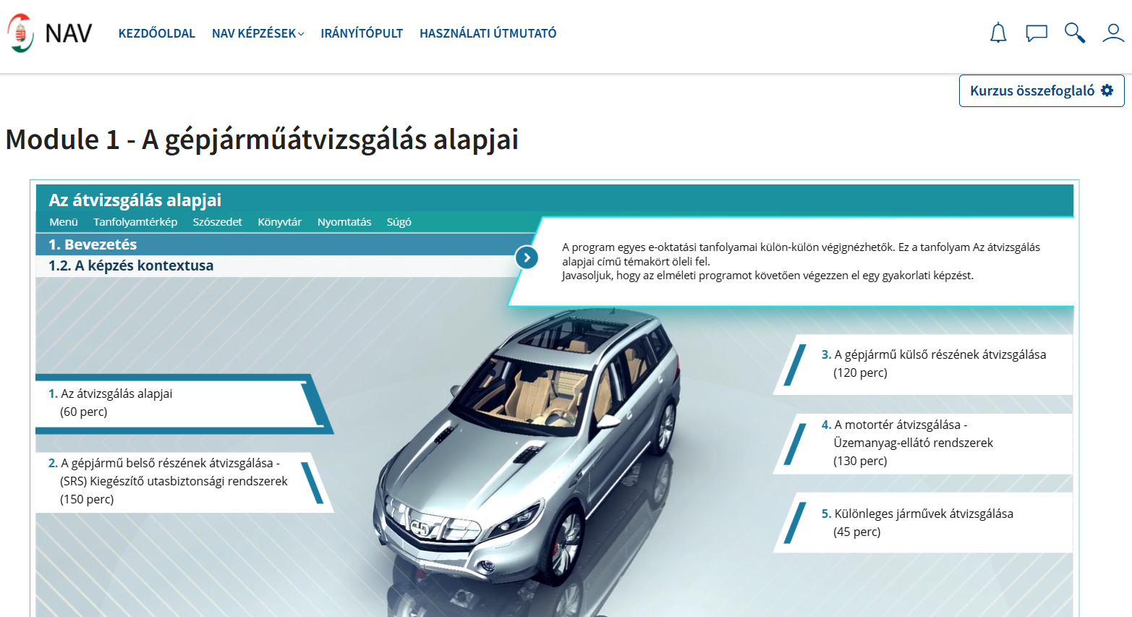
Car Search e-learning localisation
NTCA Moodle portal
5 Modules
2020.01. – 2020.06.
Content translation revision from basic translation
Translated content revision
Apx. 100 hours of work in Freetime (per person)
For free of charge (service)
Notes:
specialist language
correct technical terminology

Slide 4
Thank you for attention!

