Slide 1
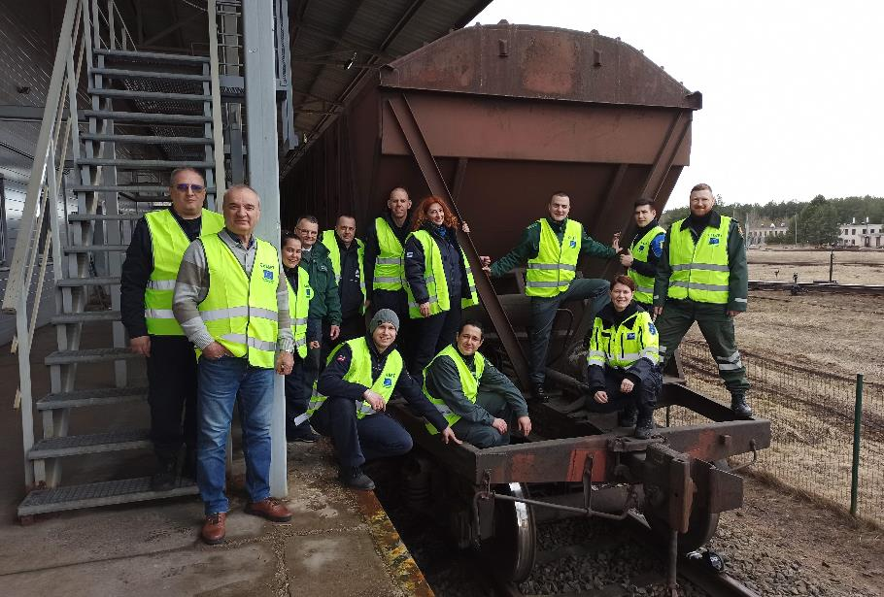
CELBET TRAININGS IN LATVIA
Oļegs Jerofejevs
Igors Gorenko
Sindija Bērziņa

Slide 2
X-ray image analysing | Delivered
Customs control process | Not planned
Car search | Delivered
Bus search | Webinar – delivered Face-to-face - under preparation
Train search | Delivered
Risk analysis - profiling and document control | Planned
Sniffer dogs training | Webinar - delivered
Profiling and interviewing | Delivered
Truck search | Webinar – delivered Face-to-face - under preparation
GENERAL INFORMATION

Slide 3
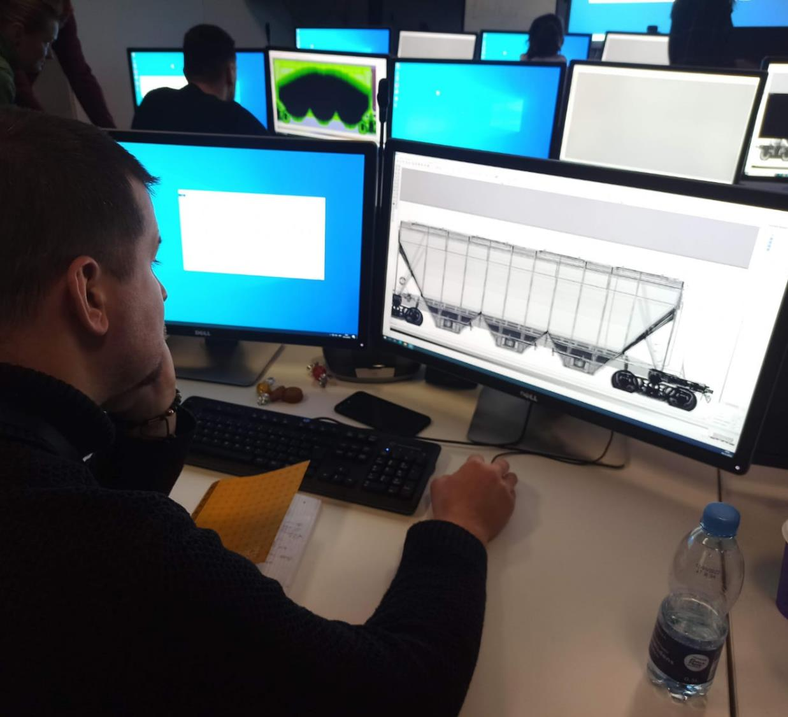
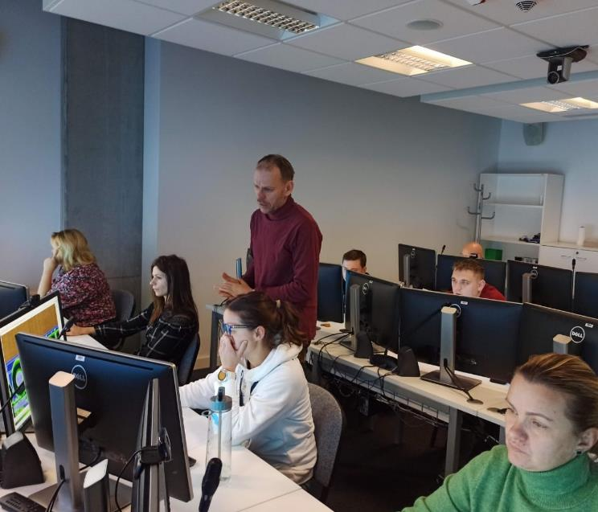
X-ray image analysing
Face-to-face
Riga
12 X-Ray image analyses experts

Slide 4
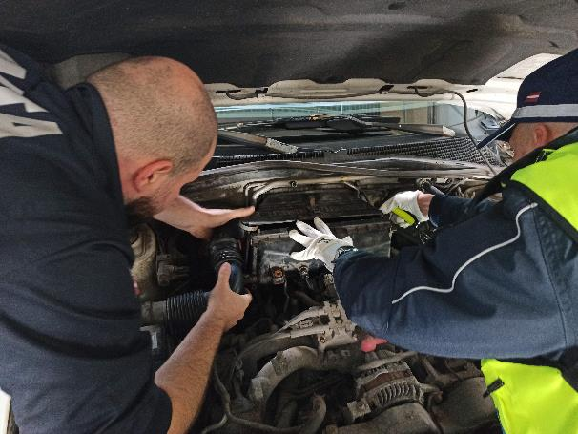
Car search
Webinar (62 new customs officer)
Face-to-Face (30 BCP customs officers)
BCP «Grebneva»

Slide 5
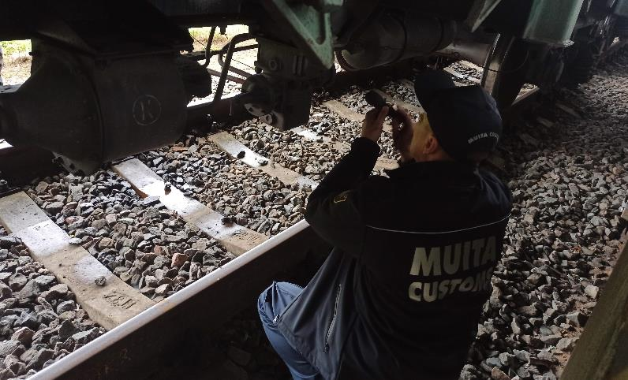
Train search
Webinar (62 new customs officers)
Face-to-Face (44 BCP customs officers)
Daugavpils

Slide 6
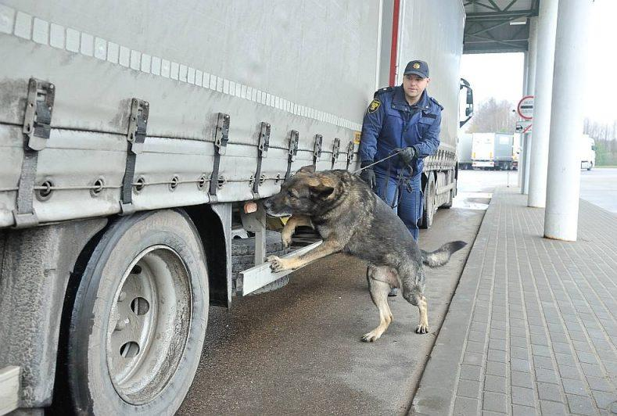
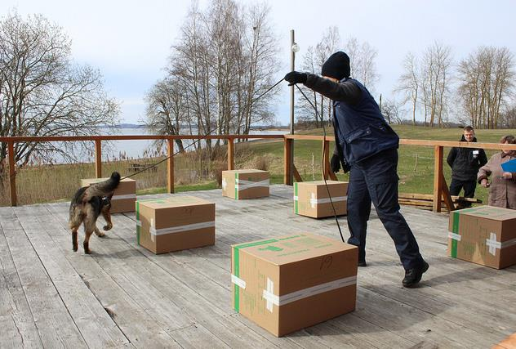
Webinar (60 new customs officers)
Face-to-Face (30 dog handlers)
Rezekne training center and any BCP
Sniffer dogs training

Slide 7
Bus search Face-to-Face planned…
Webinar – 62 new customs officer

Slide 8
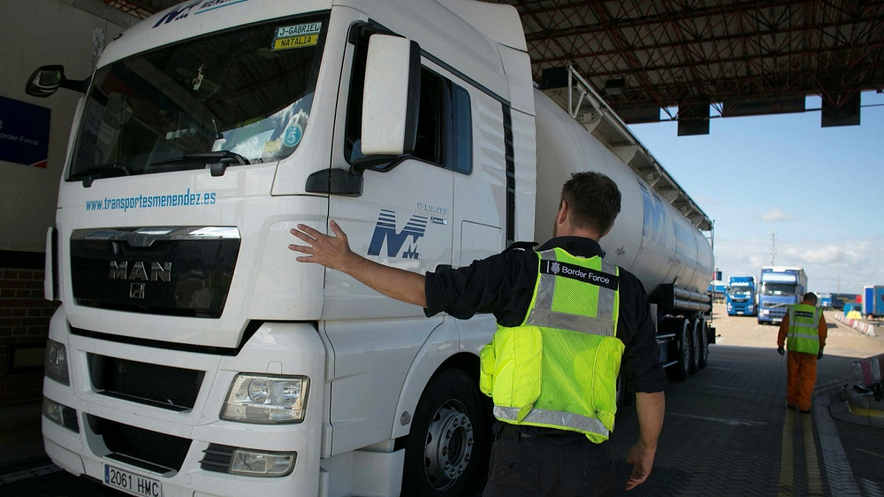
Truck search planned…
Webinar – 60 new customs officers

Slide 9
“Interviewing and profiling” one day training

Slide 10
Thank you for you attention!
Olegs Jerofejevs
Igors Gorenko
Sindija Bērziņa

