Slide 1
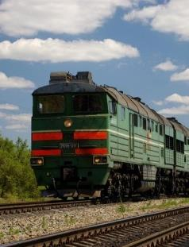
TRAIN SEARCH
Latvia, Daugavpils
5.-7. April 2022

Slide 2
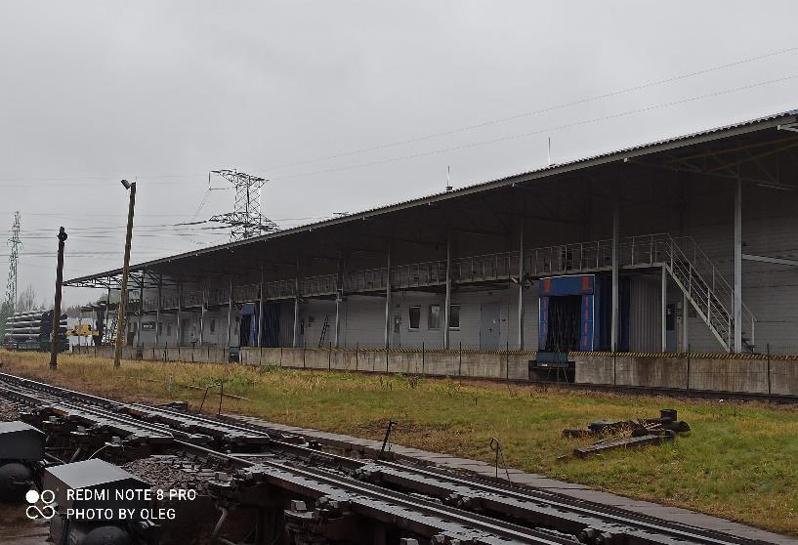
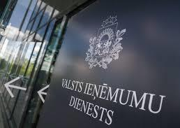
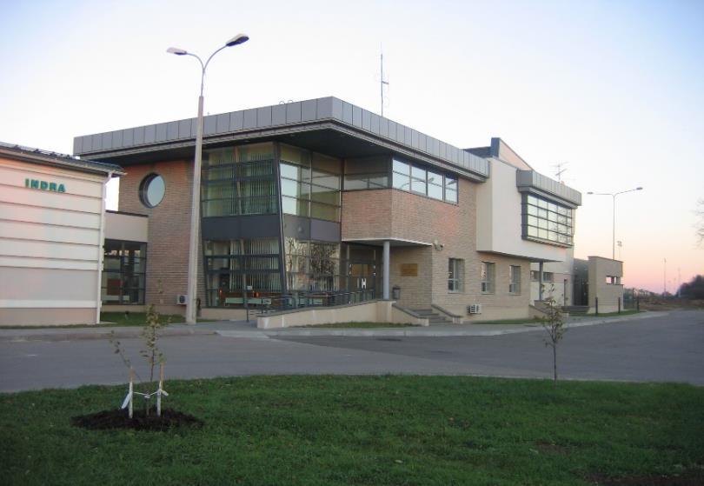
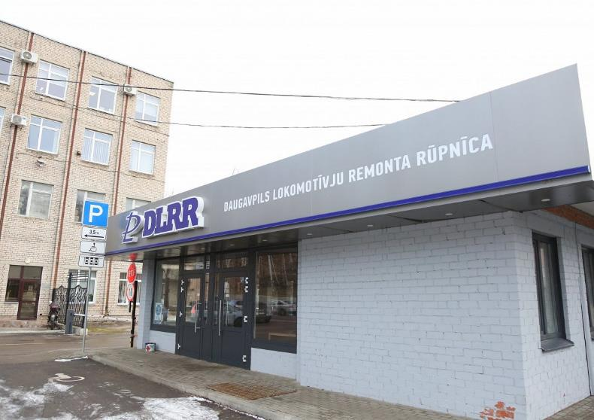
DAUGAVPILS BCP
CUSTOMS OFFICE
Duration – 3 days
Hungary
Romania
Estonia
Poland
Lithuania
Finland
Greece
Bulgaria
Latvia
Trainees from:
INDRA BCP
DAUGAVPILS LOCOMOTIVE REPAIR FACTORY
Latvia
Lithuania
Hungary
Trainers from:

Slide 3
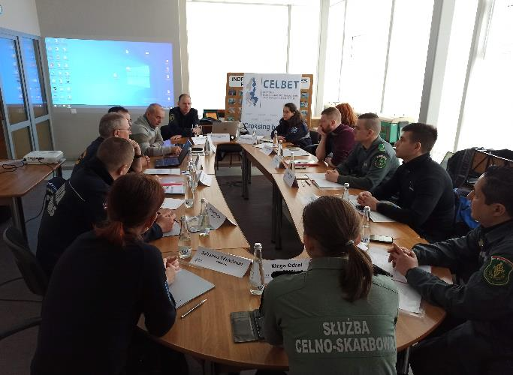
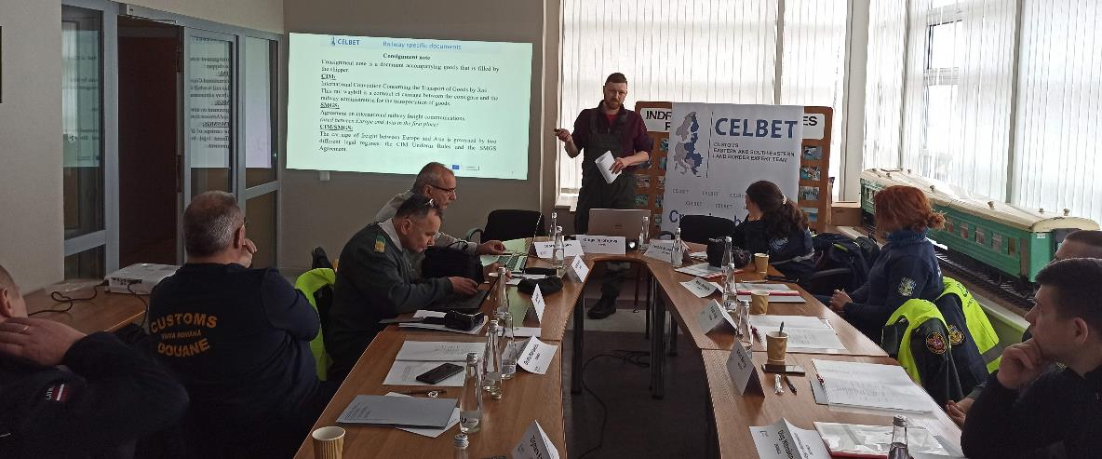
The first training day at «Indra BCP»
Topics:
Introduction with Indra BCP
Safety rules
Railway specific documents
Risk assesement
Technical equipement

Slide 4
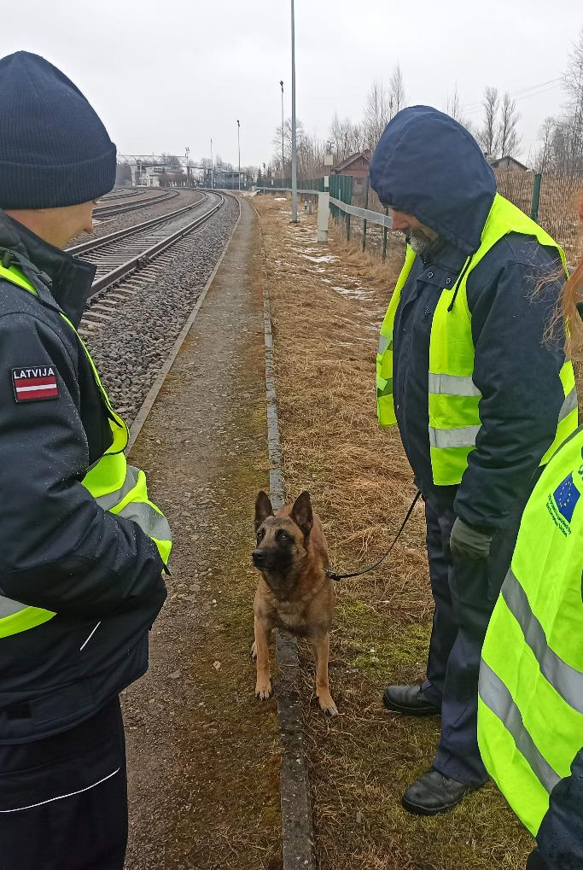
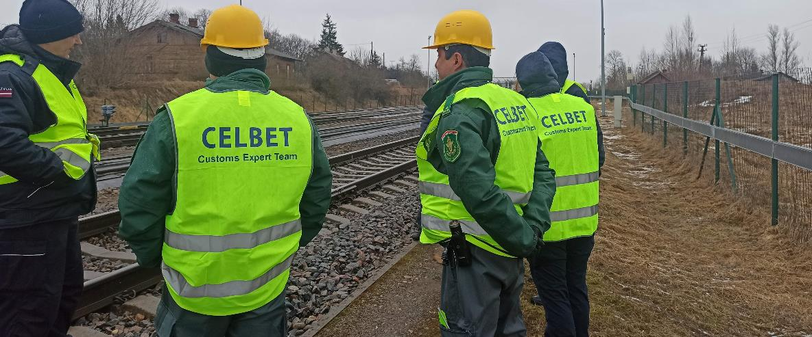
Physical inspection of arrival train
Locomotive control group
Wagons control group
X-RAY image analyses group

Slide 5
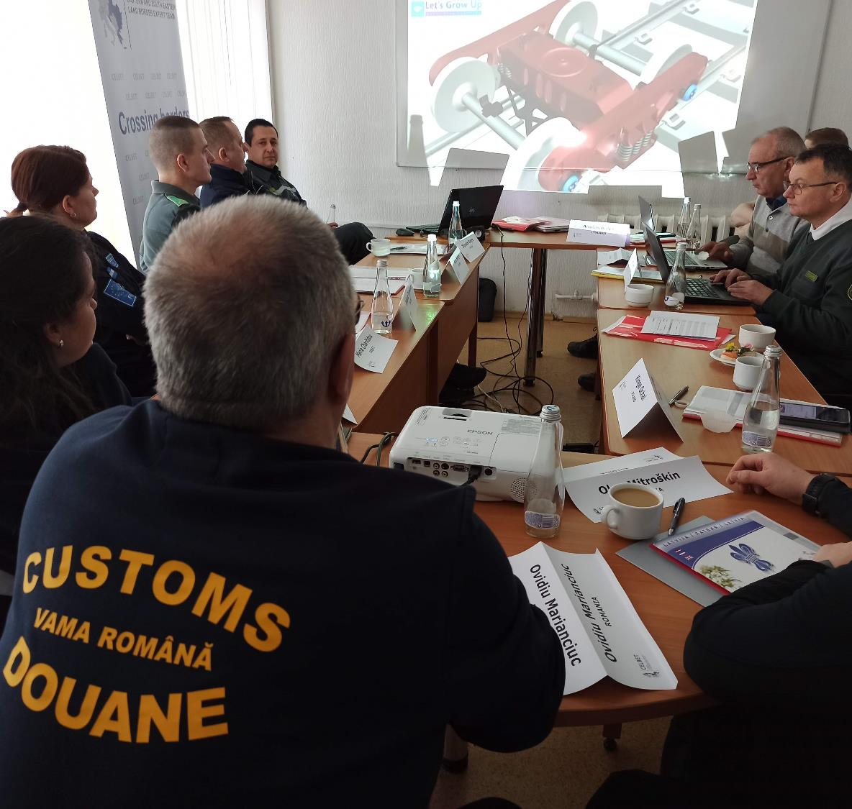
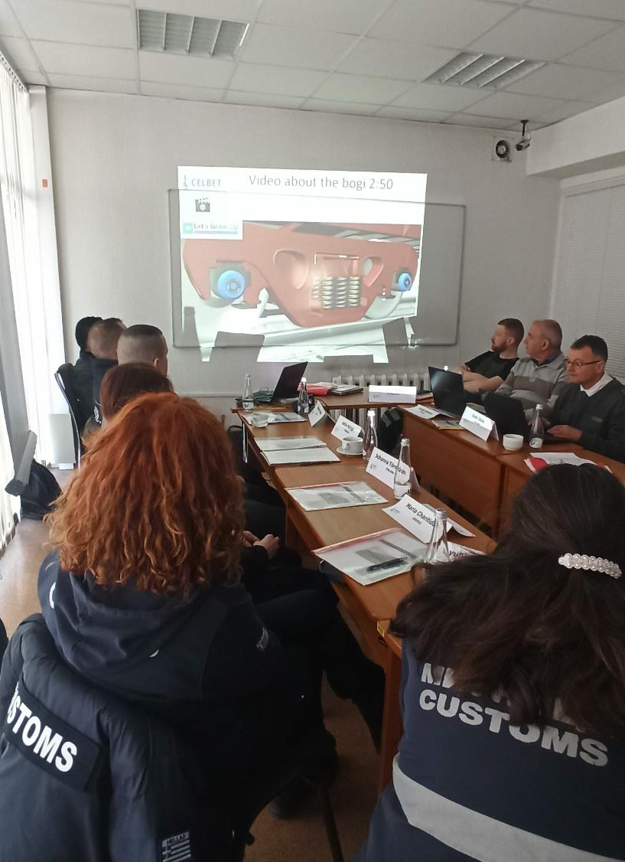
Second training day in customs office
Topics:
Train structure, control, potential concealments
Searching techniques and teamwork

Slide 6
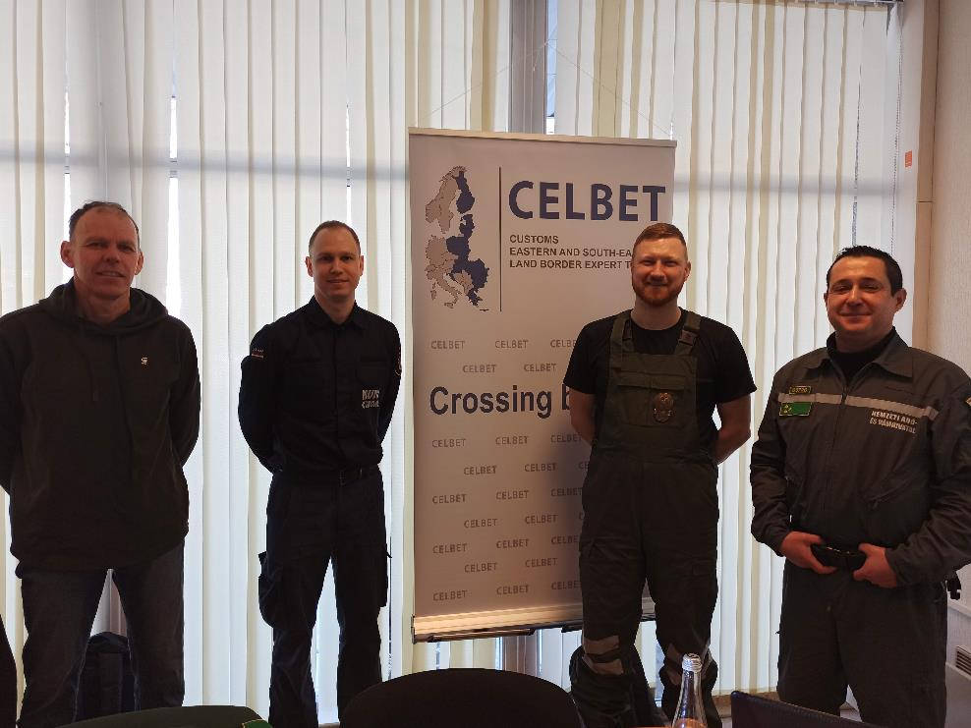
«Train search» trainers
Igors Gorenko (LV)
Oļegs Jerofejevs(LV)
Arūnas Bolys (LT)
Jeno Csaba Csaki (HU)

Slide 7
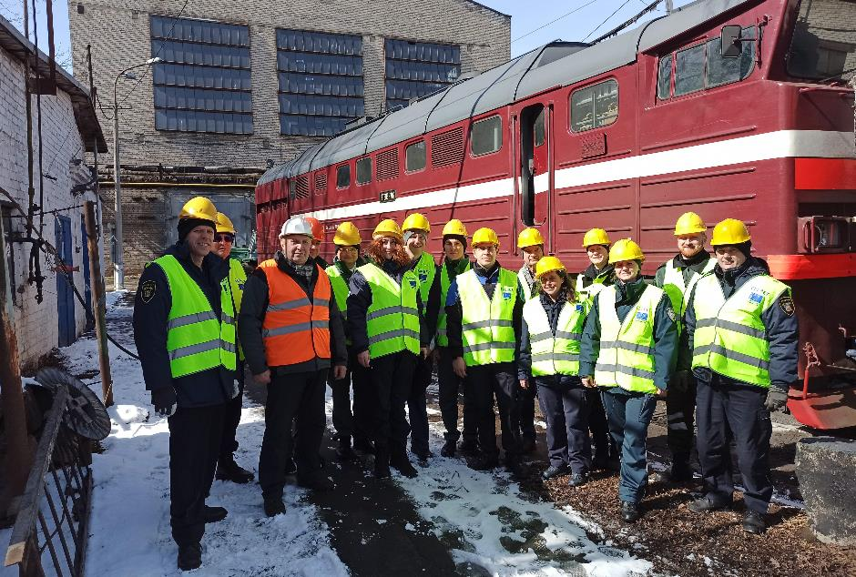
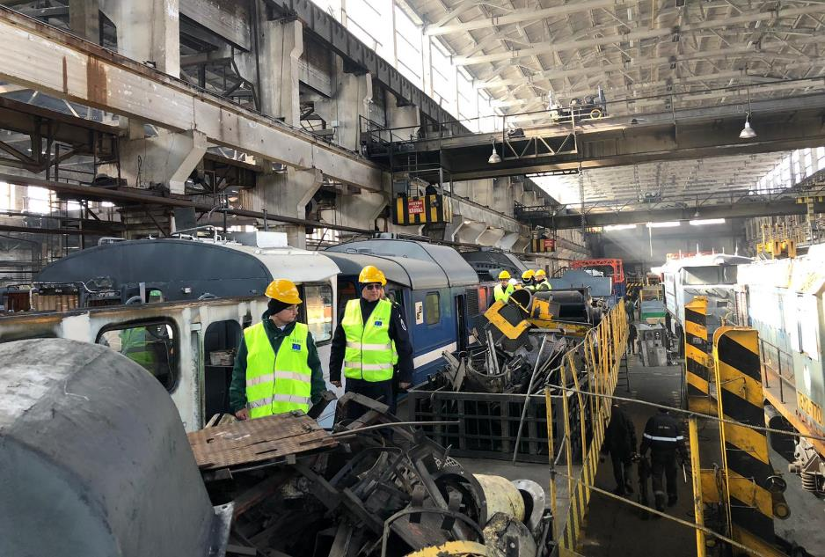
Daugavpils Locomotive Repair Factory
Where it was possible to get acquainted with the structure of the locomotive, types and possibilities for potential hiding places in the locomotive structure

Slide 8
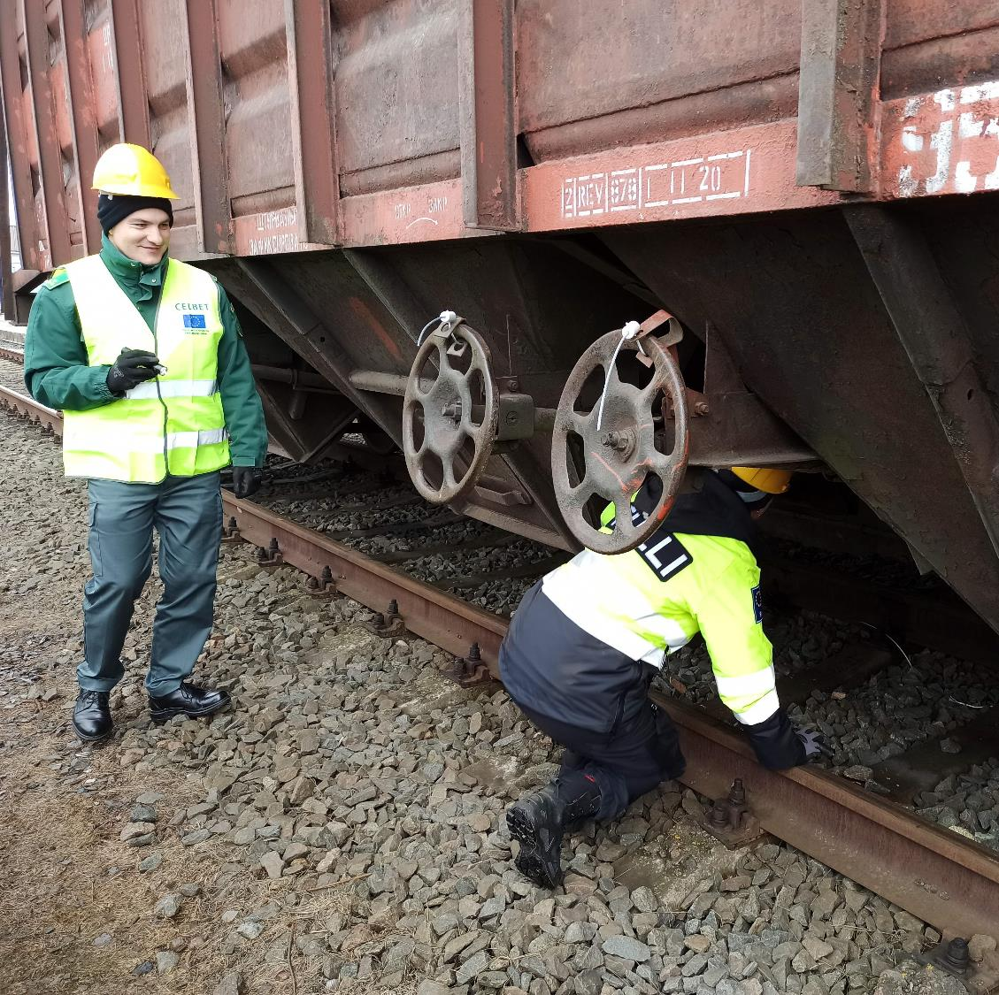
Third training day at Daugavpils BCP
The trainers prepared in advance «cigarette» blocks and hid them in the structure of the wagon and in the cargo. The participants try to find the hidden "illegal goods" with the acquired knowledge

Slide 9
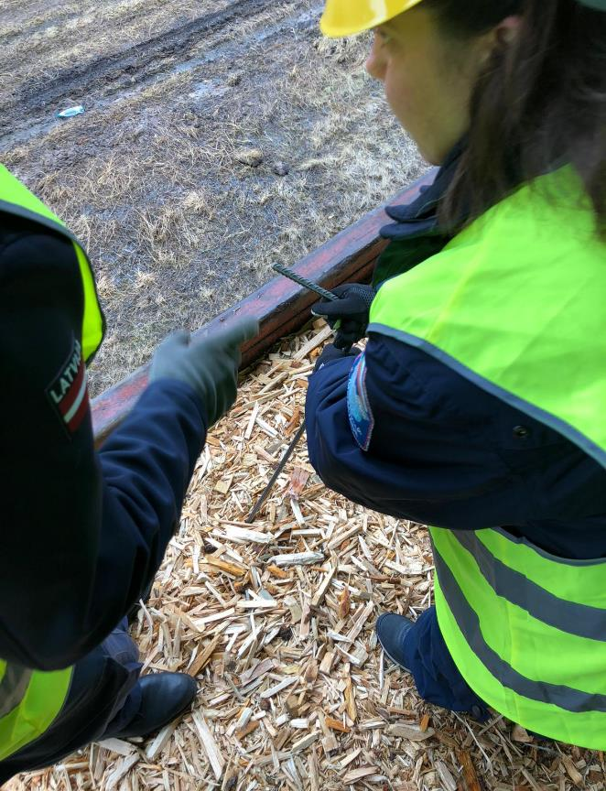
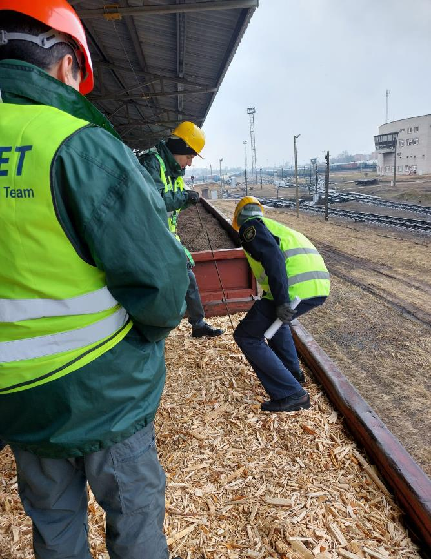
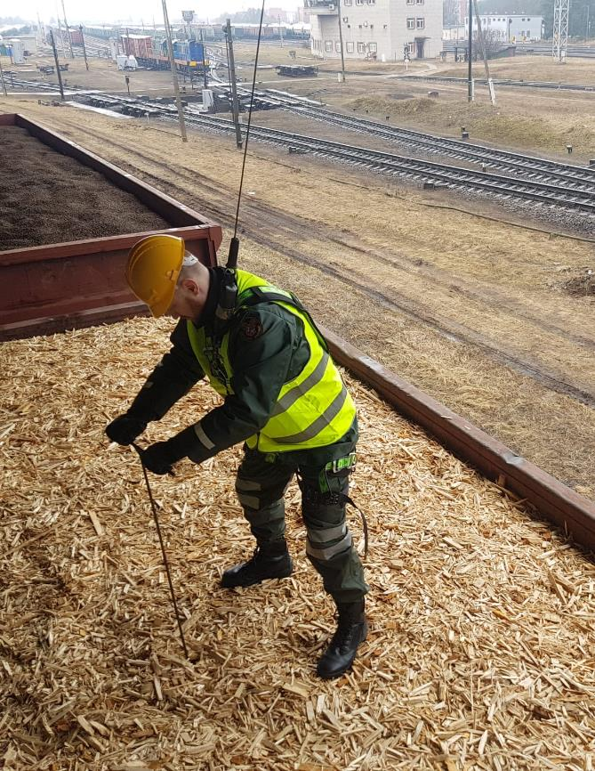
Trying to find the cigarettes in sawdust cargo

Slide 10
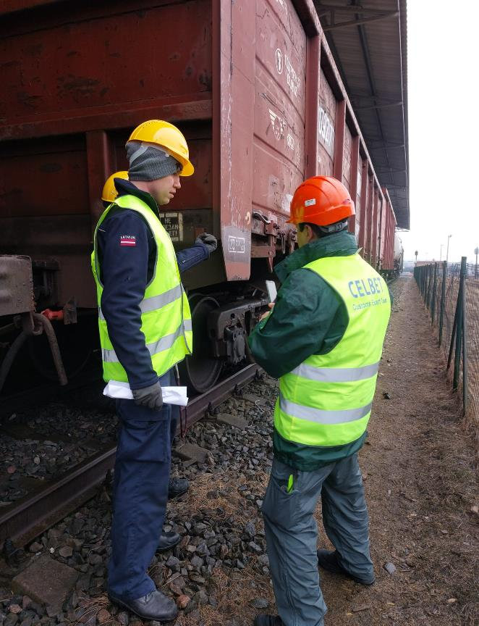
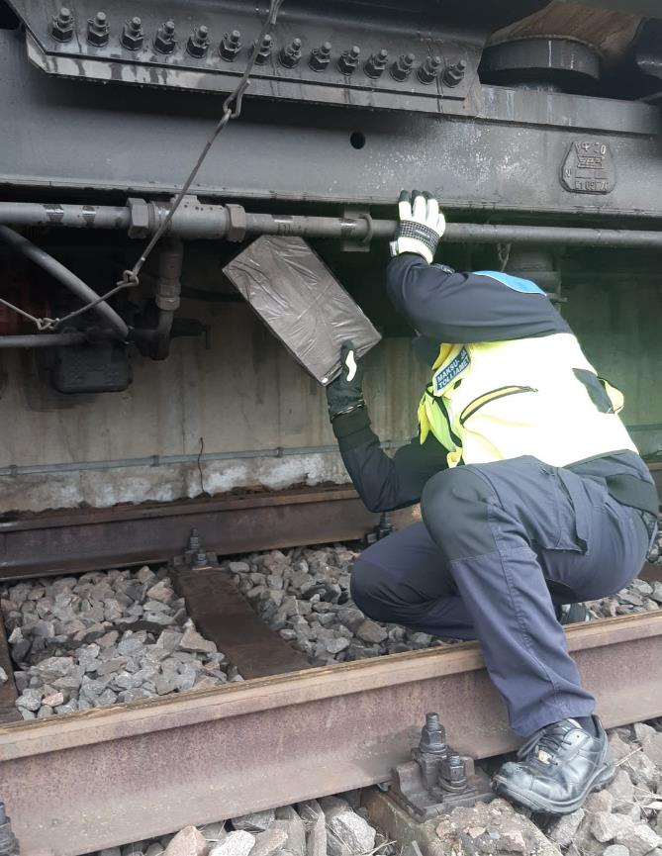
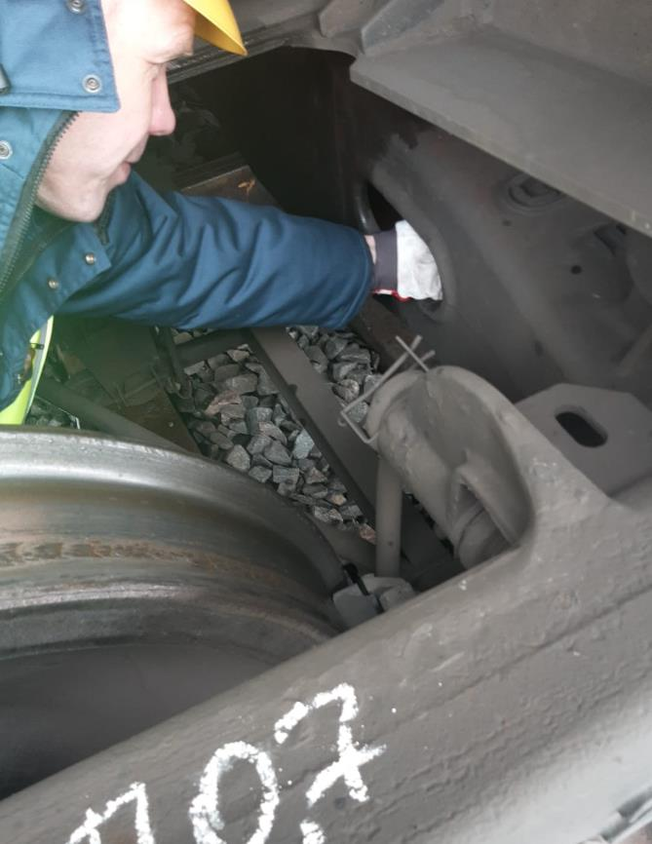
Potential concealments in wagon construction

Slide 11
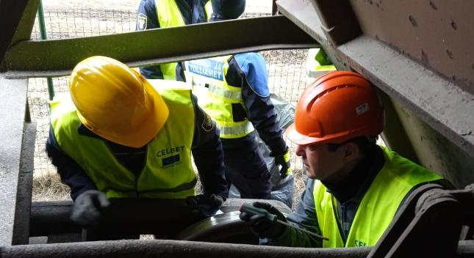
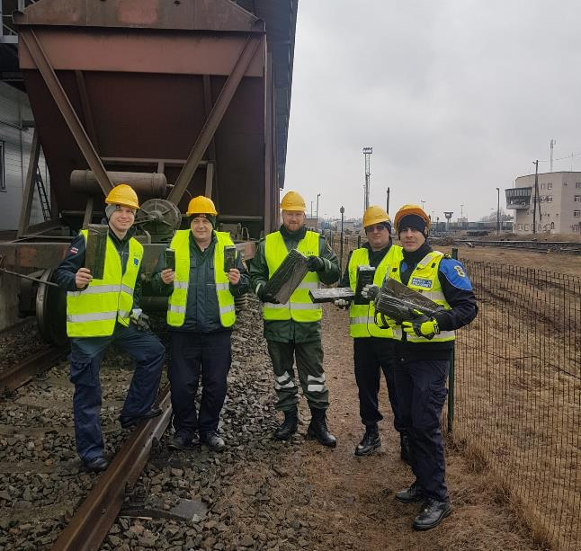
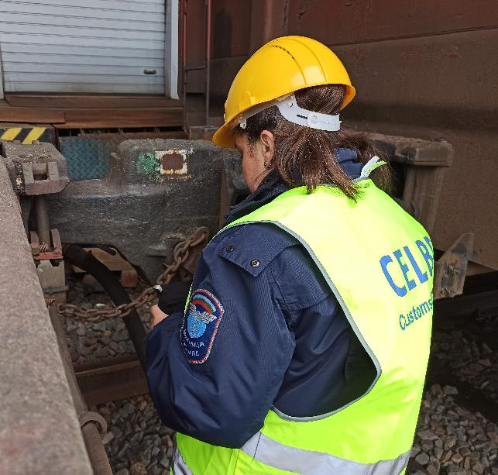
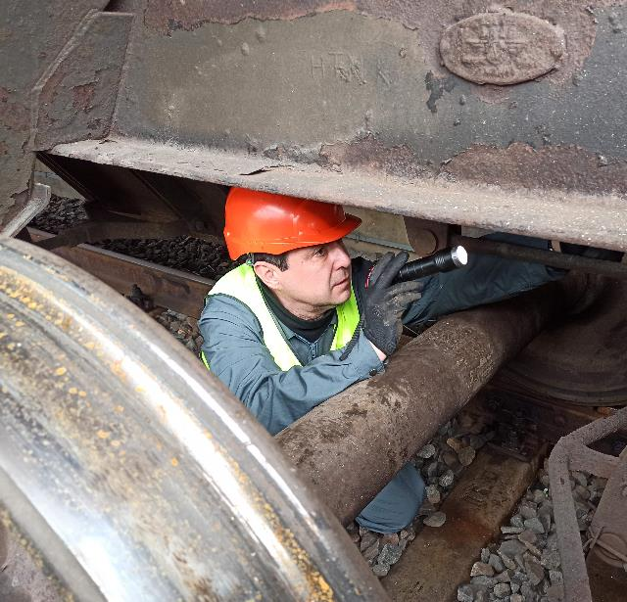
Participants found all the hidden cigarettes and the training ended

Slide 12
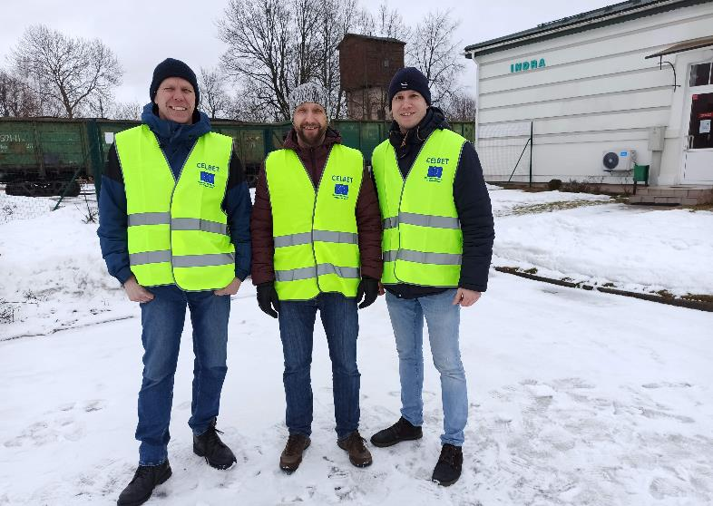
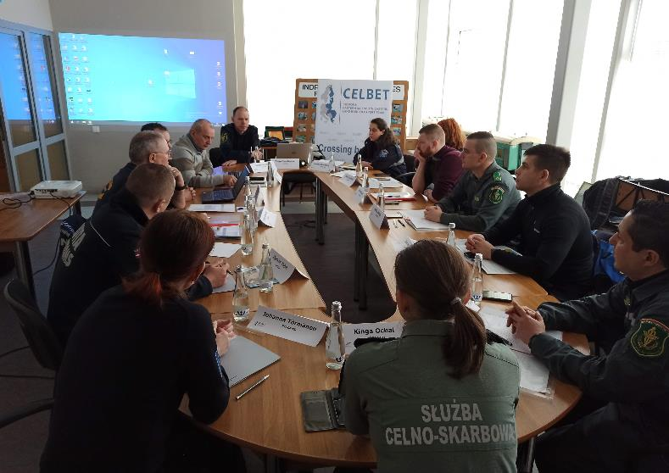
Preparation for being a CoE
We sent filled and signed application form to the head of CELBET.

Slide 13
The possibility of physical control
Popular type of cargo
Local trainers
Working class (theoretical part)
Popular type of wagons and locomotives
Real- time movement of freight cargo
Safety first
Technical equipment
Dog handlers
POTENTIAL PARTNERS CoE

Slide 14
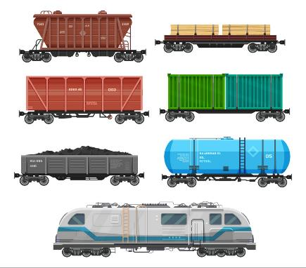
Individual/collective safety equipment
Helmets, gloves
Infrastructure (ramp)
Presentation + real practice
Practice with popular type of wagons
Do You need it?
BASIC (MINIMUM) CONDITIONS TO ORGANIZE THE TRAINING IN LOCAL LEVEL

Slide 15
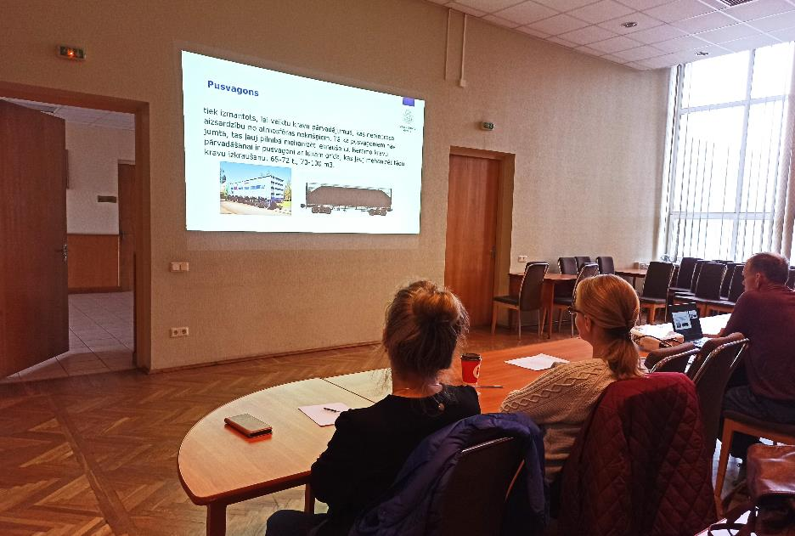
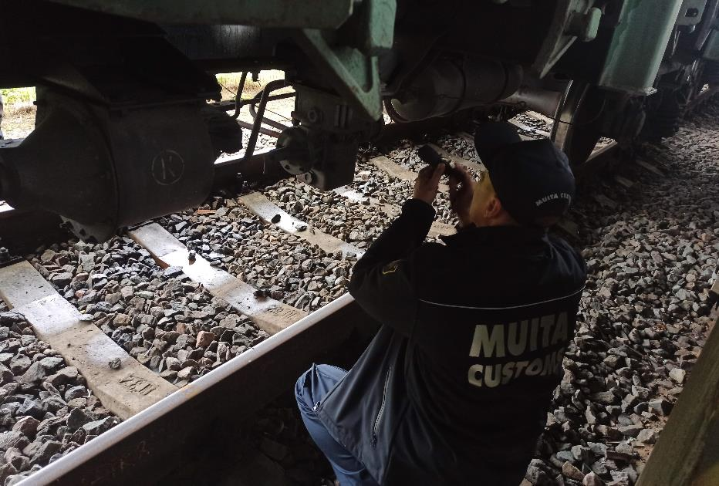
National «Trains search» training
After CELBET training, we integrate the train search training at national level and from September 2022 we realized 5 face-to-face trainings for 44 Customs officials.

Slide 16
Thank you for you attention!
Olegs Jerofejevs
Igors Gorenko
Sindija Bērziņa

