Slide 1
Webinar experience
Tamás Tóth Lt., Hungarian Tax & Customs
BCP Röszke, Customs Control Skills Development Centre of Expertise

Slide 2
Webinar as a various tool
Presenting an uploaded PPT
Verbal communication only
Not seenable reactions, interactions
body language is invisible
„Teacher speking to the wall” effect
communication a bit harder
participants are less willing to share their ideas, to start conversation
they are not motivated to speak, easy to „hide” behind the screen
no noticeable attention
Using interactive tools
Verbal comm. + digital gestures
Observable reactions, interactions
body language is gesture, movement speed
communication interactive
participants more willing to share their ideas using the interactive tools
Bit more motivated to speak, but prefer to use the interactive tools
noticeable attention
Everything depends on the Teacher !!!!
Notes:
1 or 2 way comminication
Different perspective needed for the teacher
Learnin the use of interactive Tools

Slide 3
Using interactive tools
Don’t ask, make a poll
Discuss the Results

Slide 4
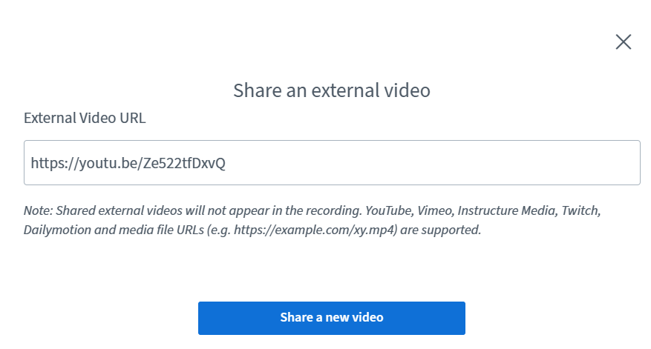
Using interactive tools
Use multi-user whiteboard
Watch uploaded videos together

Slide 5
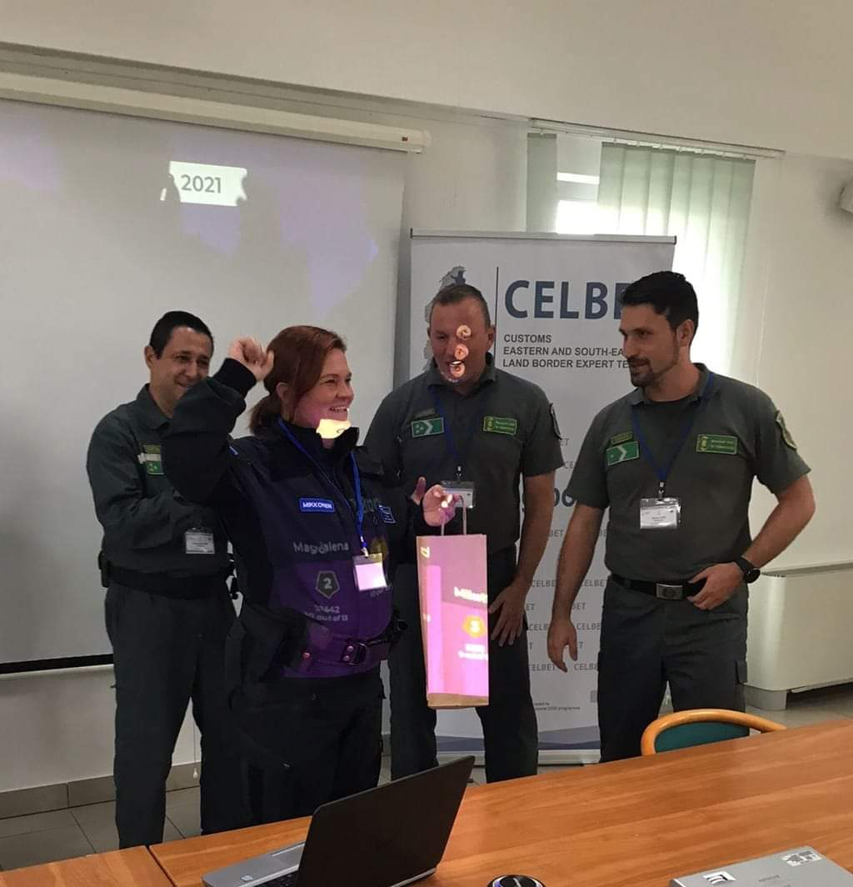
Using interactive tools
Games, challanges
Notes:
- Gamification

Slide 6
Summary

