Slide 1

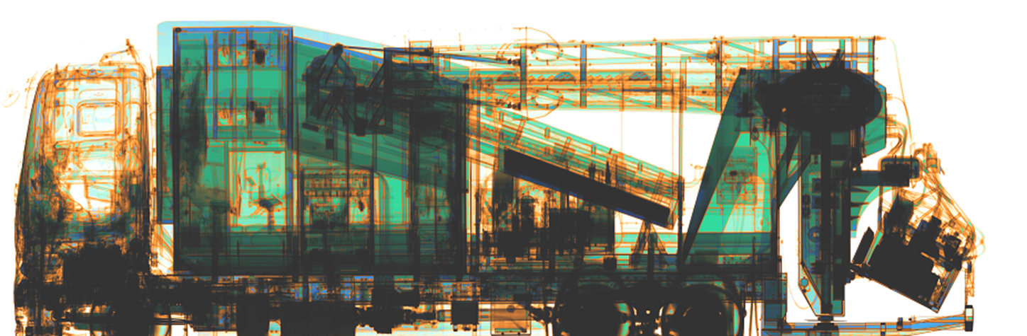

X-ray Centre in Gdańsk as a Centre of Expertise (CoE) for training purposes on the „X-ray image analyzing”

Slide 2

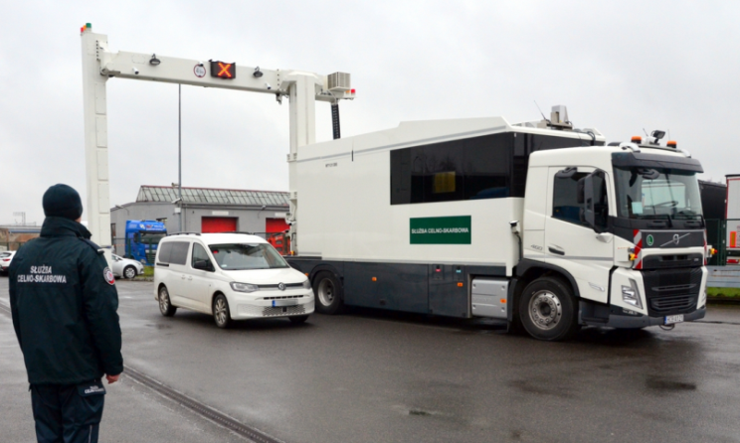
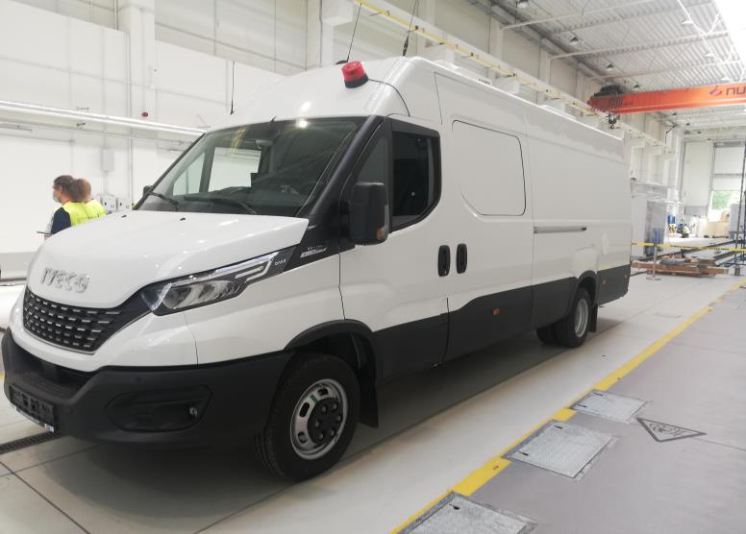
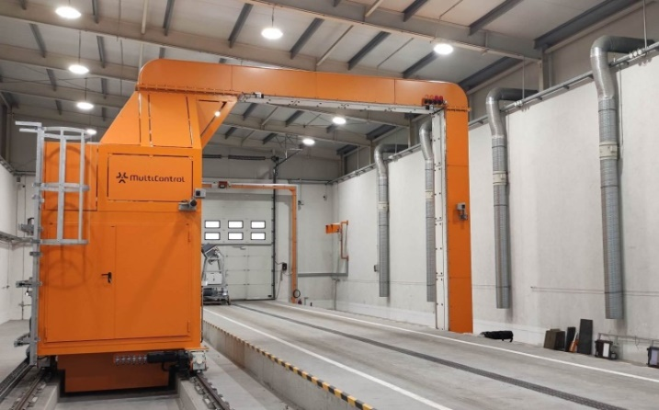
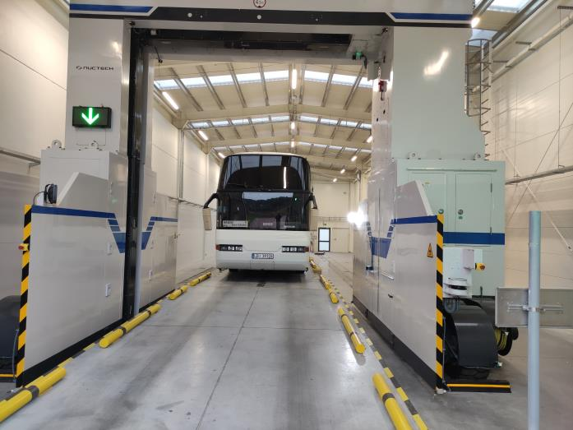
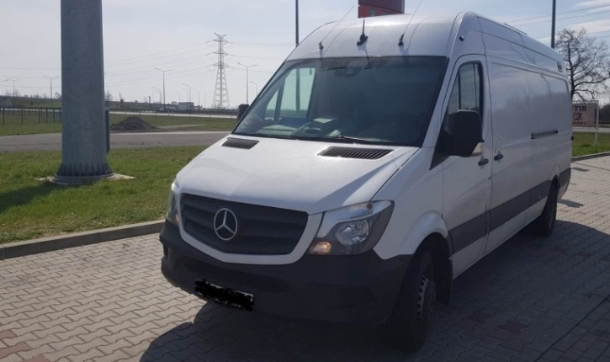
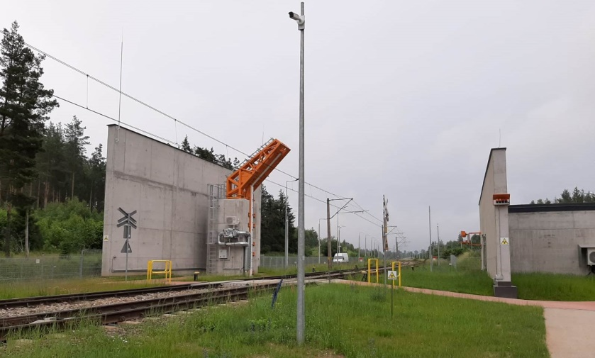

X-ray equipment is the most expensive tool used by customs agencies during customs control duties.
Without very well prepared staff x-ray device is ineffective.
Notes:
2

Slide 3
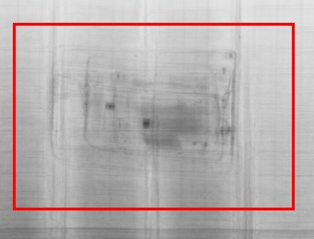
The crucial skill of x-ray operators is correct analysis of x-ray images
Notes:
3

Slide 4
X-ray Centre Unit located in Gdańsk (PL) is responsible for:
complex coordination and efficient monitoring of the use of x-ray devices in Poland
x-ray control data gathering (PL)
periodical post analysis of x-ray images
organization of national and international trainings on x-ray image analysing
intranet x-ray portal (PL)
intranet x-ray image recognition training tools
cooperation with the European customs administrations / CELBET
participation in the H2020 projects
CELBET Centre of Expertise (CoE) for training purposes on the „X-ray image analyzing”
Notes:
4

Slide 5
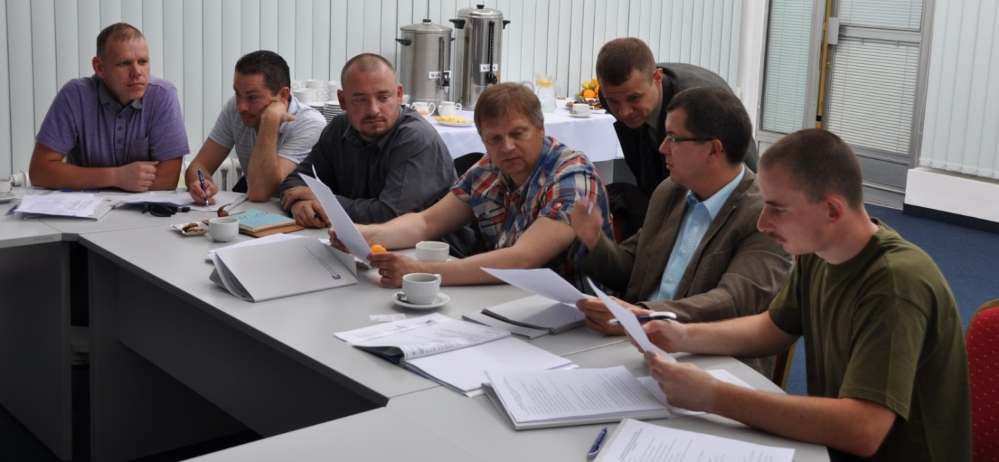
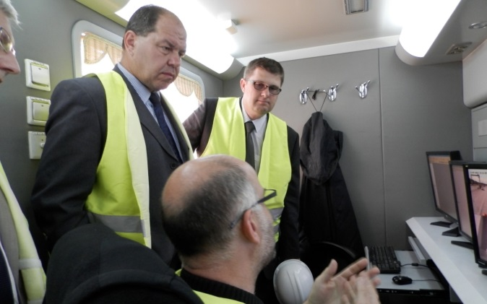
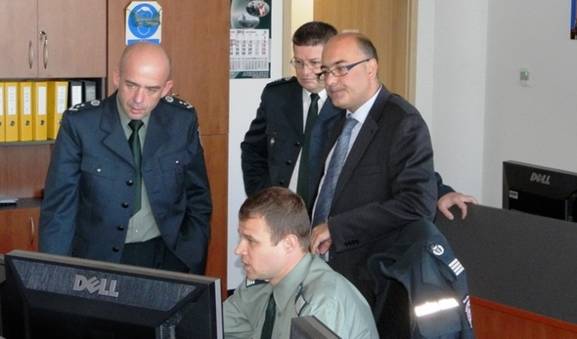
International working visits
In the period 2013-2022 visited by representatives from: Czech Republic, Slovakia, Germany, Spain, Greece, Lithuania, Latvia, Estonia, Bulgaria, Finland, Denmark , Switzerland, UK, Ireland, Korea, UK, CELBET, EXBS coordinator, US CBP representatives.
Notes:
5

Slide 6
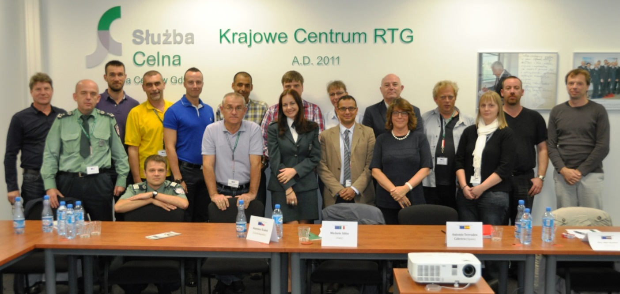
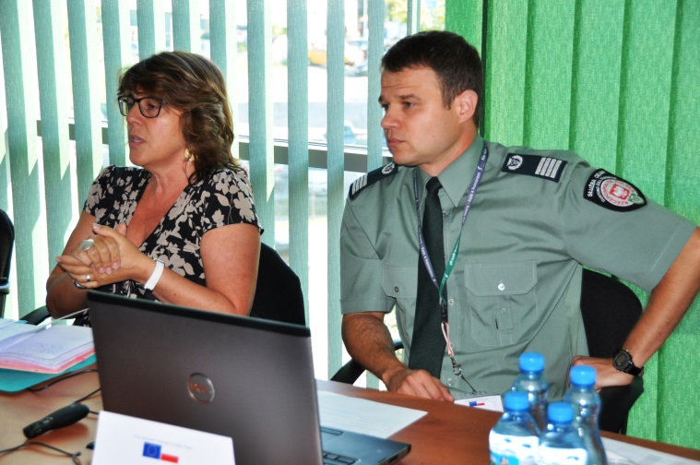
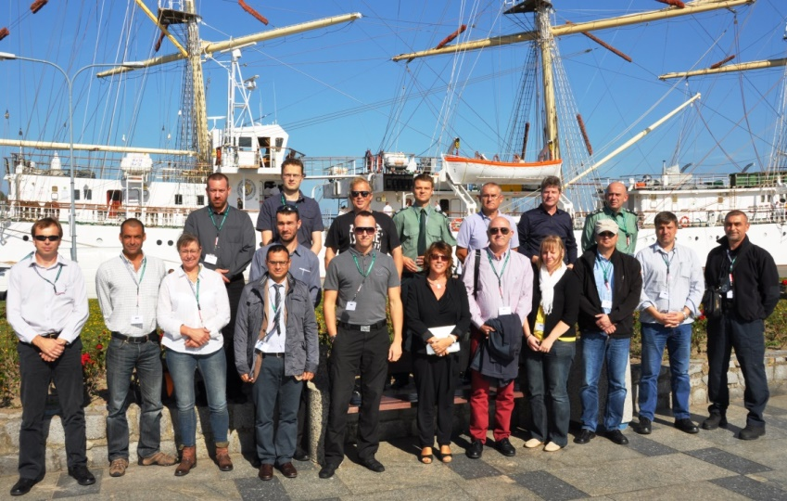
X-ray Inspection workshop (Gdańsk 2014):
Notes:
6

Slide 7
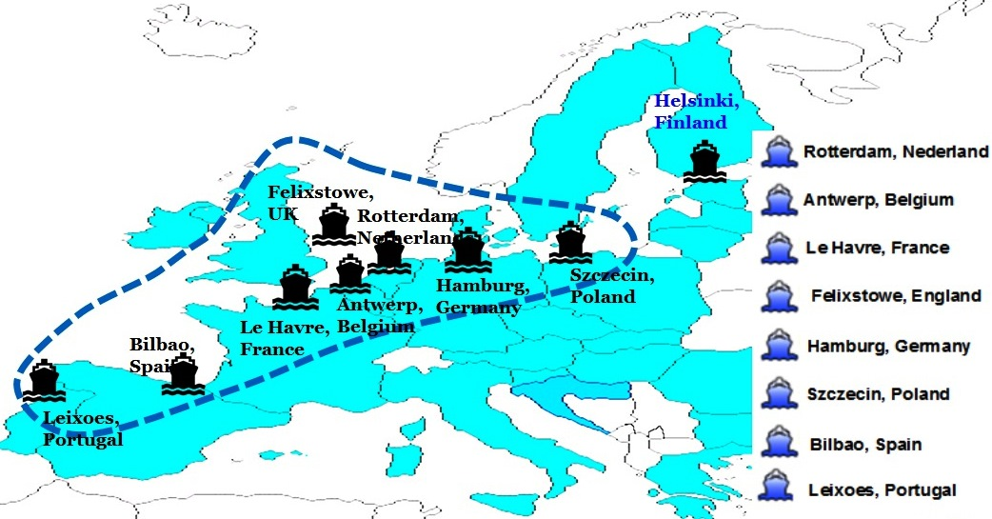
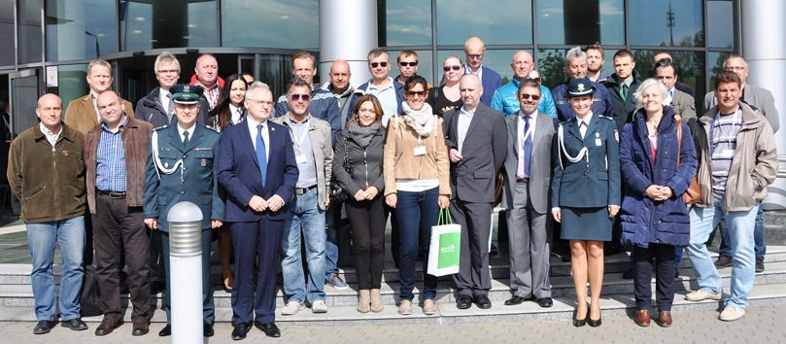
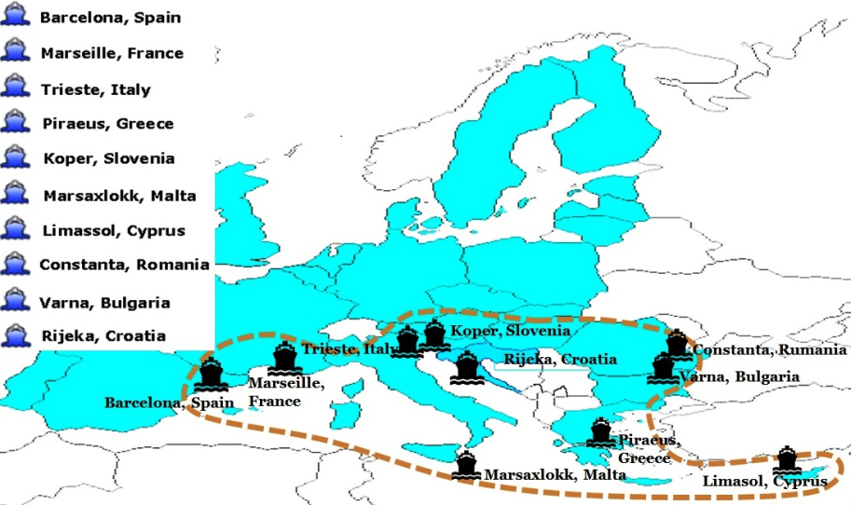
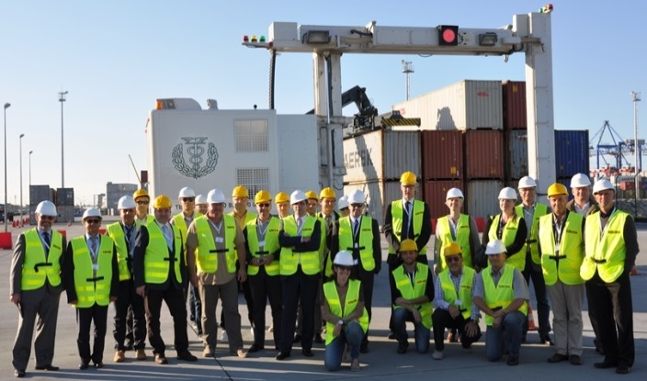
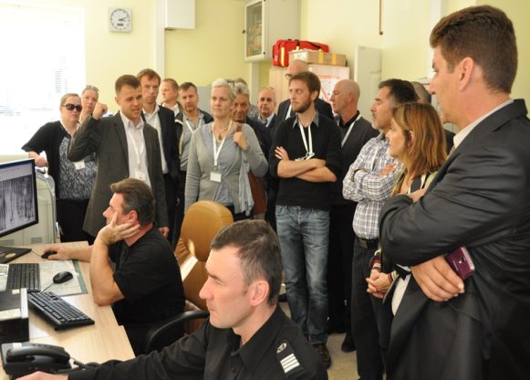
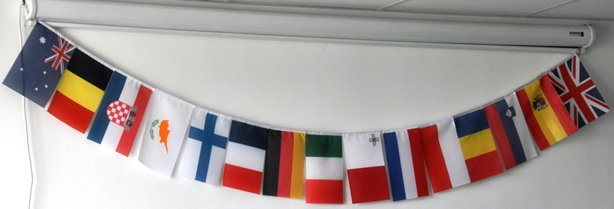
WORKSHOP ON X-RAY CONTROL OF SEA CONTAINERS
Notes:
7

Slide 8
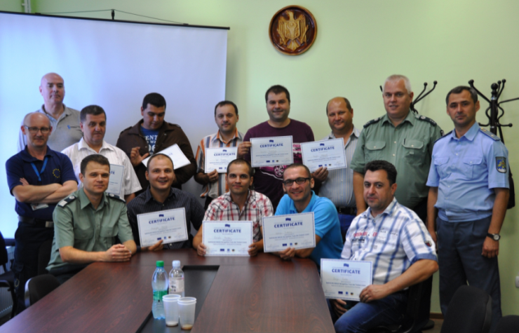
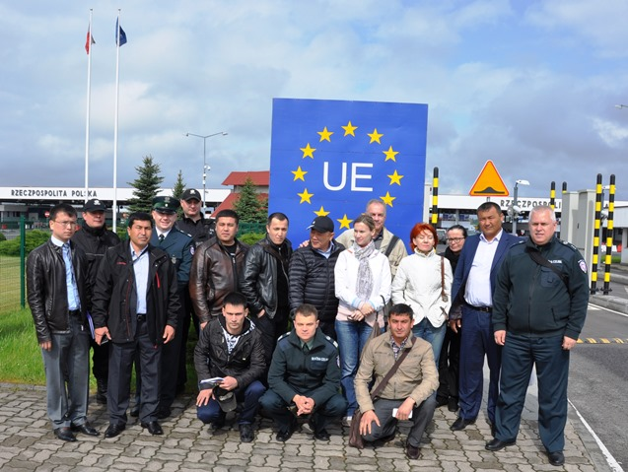
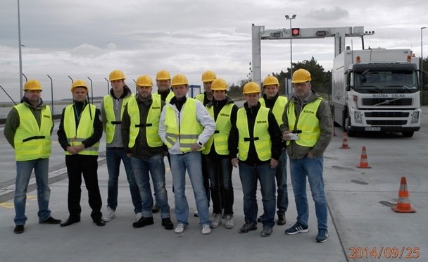
International x-ray trainings
In the period 2013-2022 National X-ray Inspection Centre in Gdańsk organized international trainings for representatives:
of Moldova and Ukraine (EUBAM),
of Uzbekistan and Croatia (EXBS),
of Georgia (ICMBD Austria),
of Germany, Finland, Bulgaria, Spain, Malta (Customs 2020),
of Moldova, Ukraine, Belarus, Azerbaijan, Georgia, Armenia (FRONTEX)
of V4 countries Czech Republic, Hungary, Slovakia,
of representatives demanded by CELBET
Notes:
8

Slide 9
X-ray Centre as as a Centre of Expertise (CoE) for training purposes on the „X-ray image analyzing”:
visit of CELBET experts in Gdańsk
preparatory meeting in Gdańsk (January 2019)
Train the trainer course (May 2019)
Partnership Agreement on establishing CELBET CoE for training purposes on X-ray image analyzing between PL administration CELBET and EC (August 2019)
international stationary trainings (2019-2022)
international webinars devoted to x-ray image recognition (2021-2022)
Notes:
9

Slide 10
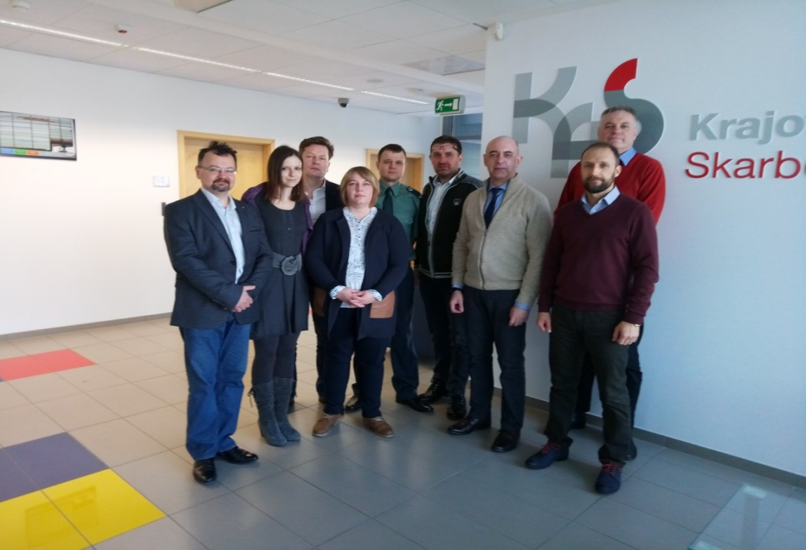
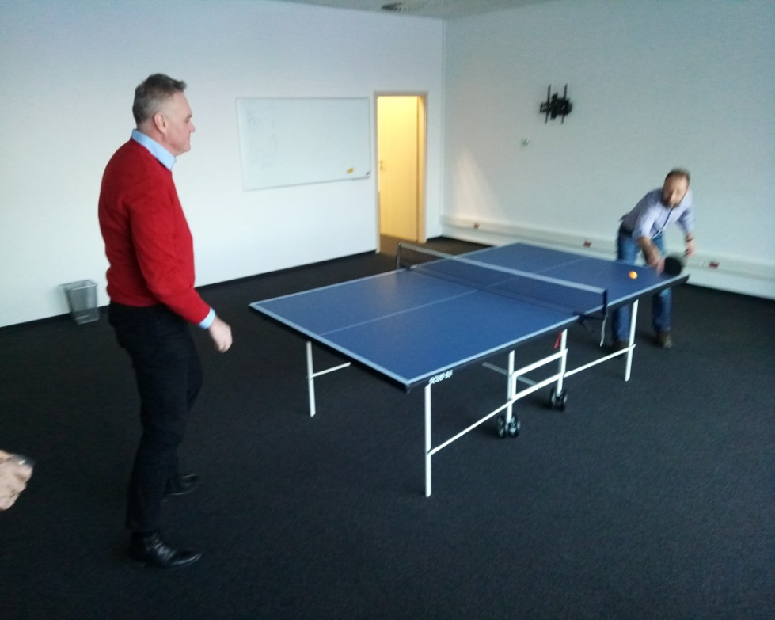
Preparatory meeting: (22-24.01.2019 Gdańsk)
Experts from CEBET Training Team and selected trainers on x-ray image analysis met in Gdańsk to prepare future train the trainer training.
Notes:
10

Slide 11
Preparatory meeting: (22-24.01.2019 Gdańsk)
Summary:
During meeting selected trainers from PL, SK, LT prepared theoretical presentations which seems to be valid nowadays
Mentioned material should be used by CELBET/local trainers during CELBET x-ray trainings
Notes:
11

Slide 12
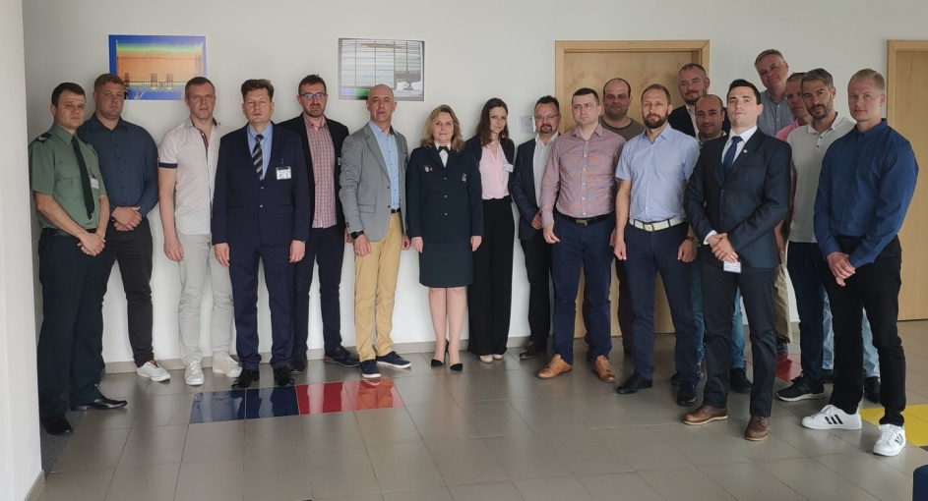
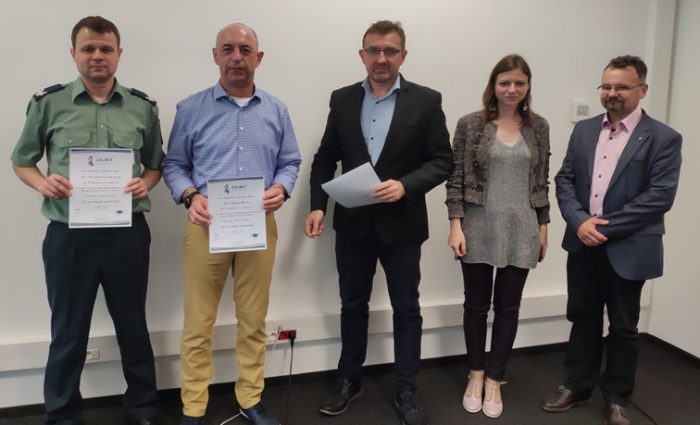
Train the trainer (21-23.05.2019 Gdańsk)
10 participants from 9 CELBET MS
during training participants have been equipped with theorethical materials and have met the rules of teaching of x-ray operators
at the end trainees received appropriate certificates
Notes:
12

Slide 13
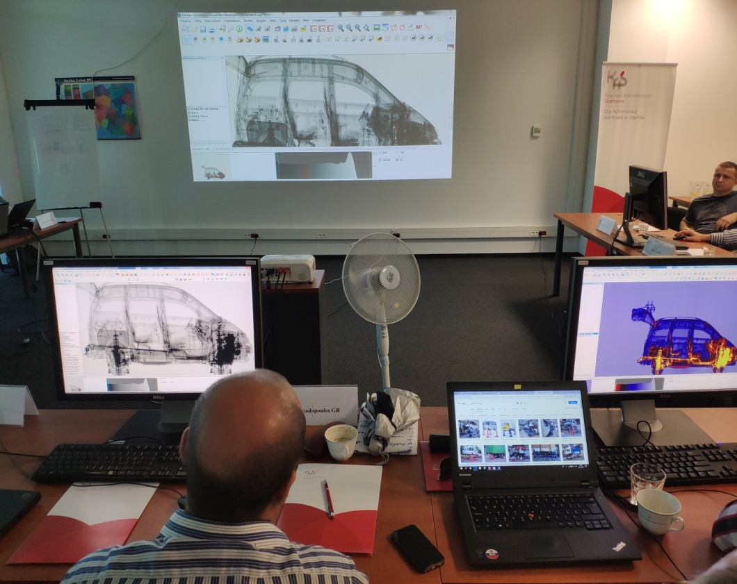
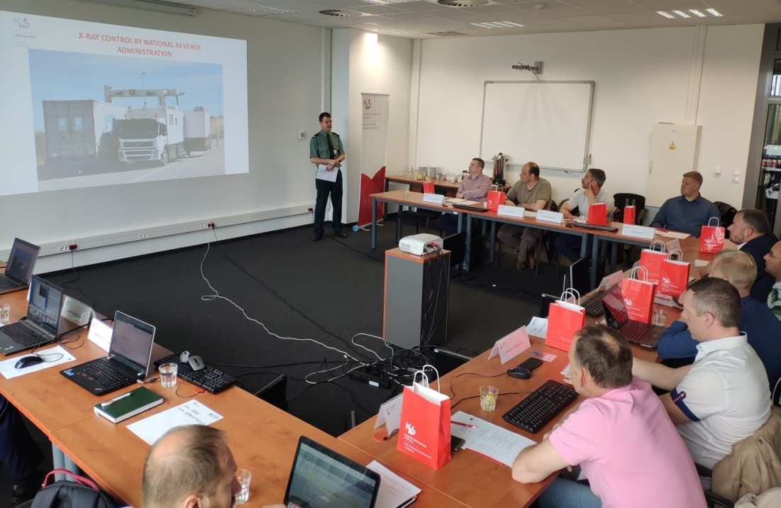
Train the trainer course (21-23.05.2019 Gdańsk)
Notes:
13

Slide 14
Train the trainer course (21-23.05.2019 Gdańsk)
Summary:
The purpose of the training was the preparation of local CELBET trainers to provide such a training in the future and selecting the best willing trainers to represent CELBET CoE during international trainings
Unfortunately it turned out that there is lack of experts in that field – appropriate experience, knowledge and data for practical trainings
CELBET member states besides PL, SK, LV, LT are not equipped with appropriate external software to display x-ray images from Nuctech and Rapiscan (regarding Smiths – no country is prepared)
As we noticed in the near future only trainers from PL, SK, HU and LV fulfilled all characteristics to be a trainer – experience/data base etc based of their active participationin webinars and stationary trainings
Rest of trainers since 2019 still not ready to reprsent CoE as a trainer
Notes:
14

Slide 15
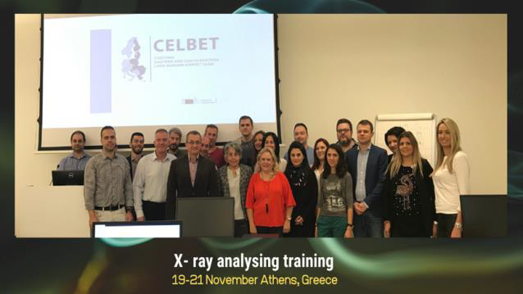
Stationary CELBET x-ray trainings:
Estonia (22-24.10.2019) – 3 one day trainings in 3 different locations
Greece (19-21.11.2019 Athens) – provided by experts from PL
Moldova (21-25.10.2022 – Chishinau) – provided by experts from PL
Lithuania (9-12.01.2023 Vilnus) - devoted to railway x-ray devices – 2 two-days trainings – provided by experts from PL and LV
Finland (6-9.01.2023 Vaalimaa) – devoted to railway x-ray devices – provided by experts from PL and LV
Notes:
15

Slide 16
Stationary CELBET x-ray trainings:
Summary:
Based on completed stationary trainings:
it seems that training shorter than 3 days is not efficient (only statistical success and waste of EU founds)
clasroom should be equipped with the possibility /host should provide laptops/computers with free acess to usb ports for trainers who bring x-ray images on pendrives
only trainers, trainees, translators, authorized representative of host are allowed to participate the training because presented data should be treated as sensitive
Notes:
16

Slide 17
Stationary CELBET x-ray trainings:
Based on completed stationary trainings there is a plan to set rules as:
training for each group should last at least 4 days (theoretical part half a day)
maximum 2 trainers per traininig
trainers should have practical knowledge from the field – not only theoretical
host should provide laptops/computers with free acess to usb ports for trainers who bring x-ray images on pendrives
only trainers, trainees, translators, authorized representative of organizer can are allowed to participate the training
Notes:
17

Slide 18
Online webinars:
1st : (24.02.2021), CELBET3 Webinar X-ray image analysing – review of selected seizures from 2020/2021 - provided by experts from PL, EST, HU.
2nd : (28.05.2021), CLEP training webinar on x-ray image analysing’ - provided by experts from PL, SK, HU
3rd: (27.01.2022) ‚CLEP –X-ray image analysing webinar’ - provided by experts from PL, LV, DE, ES
4th: (27.01) X-Ray image analysis CLEP webinar, - provided by experts from PL, DE, ES
5th: (26.07) – x-ray image analysis webinar for Moldova – provided by expert from PL
6th: (16.11) – X-ray image analysis webinar for Ukraine – provided by expert from PL
Notes:
18

Slide 19
Online webinars:
Summary:
durring pandemy only method to share knowledge
webinar never replace stationary training – very limited contact between trainer and participants
webinar is easy to perform for non limited audience but should be recomended rather for experienced operators who would like to meet new methods of smuggling /new types of anomalies
Notes:
19

Slide 20
Future plans:
Continuation of online webinars (easy to perform)
Continuation of stationary international trainings/events in Gdańsk or somewhere in CELBET MS according tho the needs gather by CELBET Training Team
Start to organize local trainings by CELBET trainers using materials from CELBET and images from X-ray exchange library / CRMS2 Detection Corner
September 2023 - organization of international 4 days training in Gdańsk for 10 x-ray operators from EU MS (Nuctech/Rapiscan) provided by expert from PL – put to the callendar as an yearly obligatory event
Notes:
20

Slide 21
Challenges:
to increase number of trainers cooperating with CoE in Gdańsk – for today 4 PL trainers available, 1 trainer from LV , 1 trainer from HU
to create international training teams (2 members) ready to provide trainings
acquisition of external software by EU MS for training purposes – especially Smiths software in GR and BL
to force MS to share x-ray images presenting seizures
Notes:
21

Slide 22
Thank you for your attention
Notes:
22

