Slide 1
„Other International trainings”
Capt. Jenő Csáki
National Tax and Customs Administration of Hungary
Szabolcs-Szatmár-Bereg County Tax and Customs Directorate Border Control Division
Special Anti-Smuggling Unit
csaki.jeno@nav.gov.hu

Slide 2
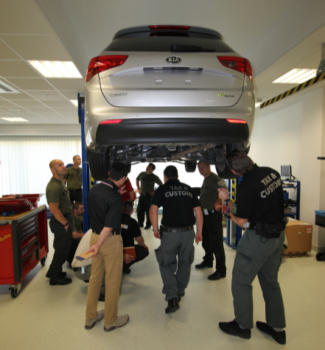
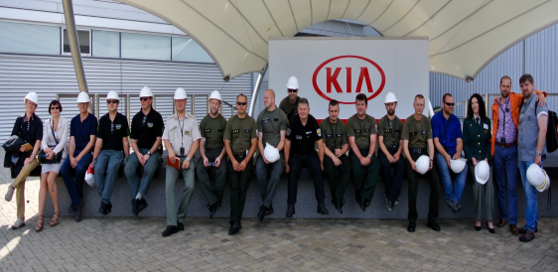
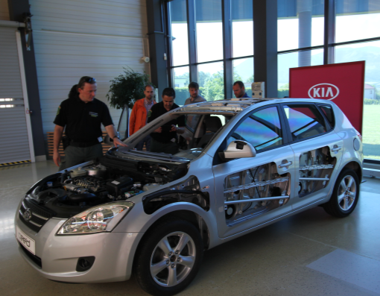
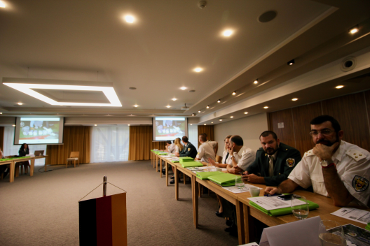
2016 june / october Slovakia, Ziline , OLAF Hercule Training focused on increasing the effectivness of Customs Control
Notes:
Német cseh spanyol szlovákokat oktattunk elmélet gyakorlat

Slide 3
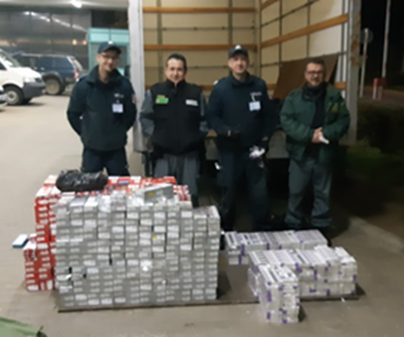
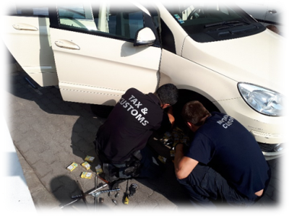
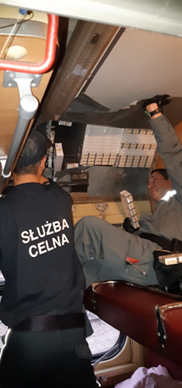
2018/2019 OLAF Hercule III
Anti-Cigarette Smuggling Staff Exchange Program

Slide 4
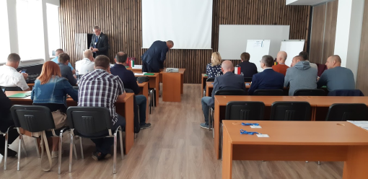
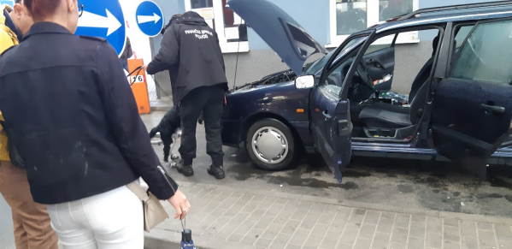
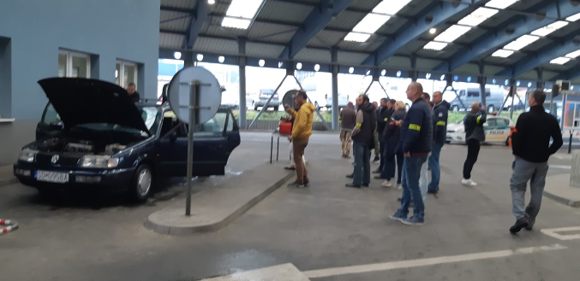
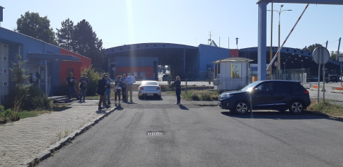
2019 september/2019 november Slovakia,
Vysne Nemecé/Mojmirovce , OLAF
Training focused on X-ray scanner image interpretation and customs comtrol process
Notes:
Német cseh spanyol szlovákokat oktattunk elmélet gyakorlat

Slide 5
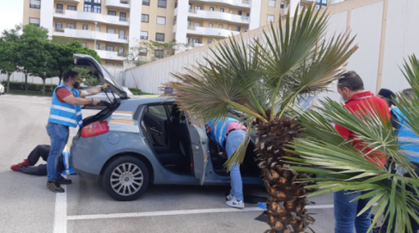
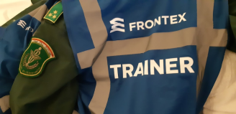
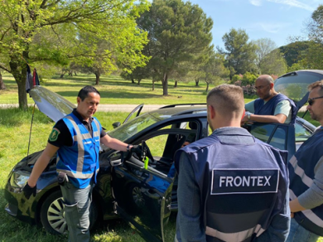
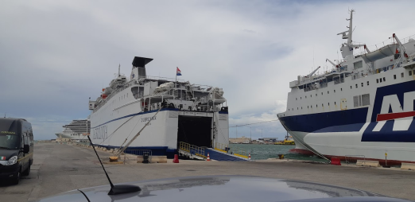
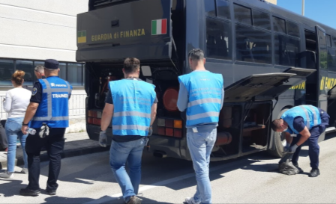
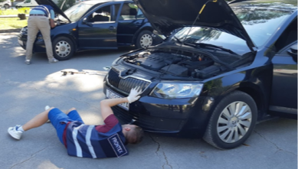
FRONTEX CBCDO trainings /since 2019
Cross Border Crime Detection Officer Course
Notes:
5 days training 4 time a years

Slide 6
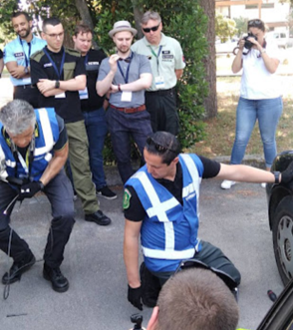
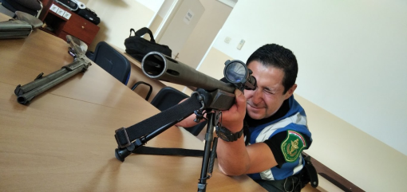
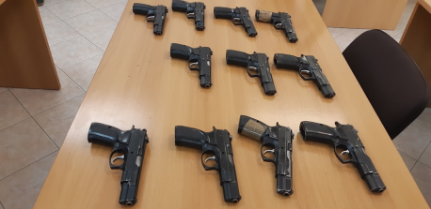
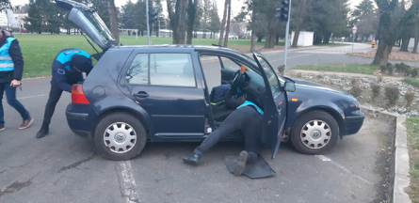
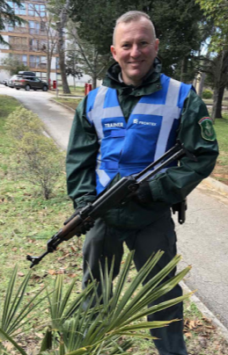
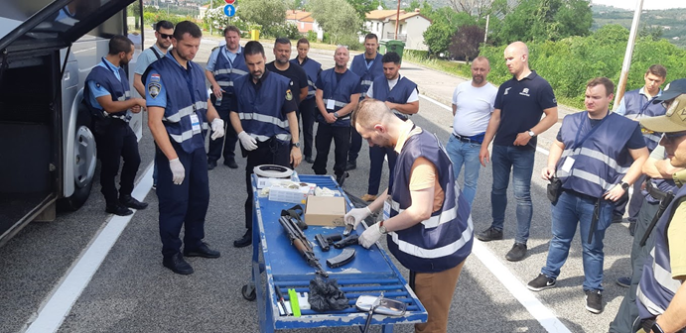
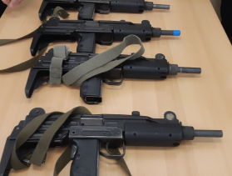
FRONTEX Firearms Detection Course/ since 2021

Slide 8
Thank you for your kind attention!

