Slide 1


CELBET Training Workshop
21-23 March 2023
Athens, Greece

Slide 2

About CELBET in general
András

Slide 3
CELBET training activities
Norbert

Slide 4
Anenda of the WS, Day 1
Time | Topic | By
9:00-9:10 | Welcome and introduction | CELBET MGT COM
9:10-9:30 | Welcome and presentation of the Greek administration and the Academy | Host admin
9:30-9:45 | CELBET in general | Mr. András Bartha HoC
9:45-10:00 | CELBET TT and presenting the agenda | Mr. Norbert Jakus TT leader
10:00-10:15 | Elevator speech | all
10:15-10:35 | WS 1 expectation | all
10:35-10:50 | Coffee break
10:50-11:00 | Introduction to VR demonstration | Mr. Immo Kilpinen
11:00-11:40 | Presentation of Centres of Expertise, section 1, X-ray, Customs control process | Mr. Wojciech Gesikowski, Mr. Tamás Tóth
11:40-12:00 | Discussion | all
12:00-12:40 | Presentation of Centres of Expertise, section 2 Sniffer dogs, Car search | Ms. Dana Borghouts Mr. Teijo Tarvainen

Slide 5
Anenda of the WS, Day 1
14:30-15:10 | Presentation of Centres of Expertise, section 3 Bus search, Train search | Mr. Wojciech Narkun Mr. Olegs Jerofejevs
15:10-15:30 | Discussion | all
15:30-16:00 | Video about JCA 10 - implementation and mission in Hungary, 2022 (coffee included) | Mr. Jenő Csáki
16:00-16:40 | WS2 Discussion between experts from CoE, positive outcomes and challenges | all
16:40-16:55 | Kahoot challenge | all
16:55-17:00 | Closing the day | Mr. András Bartha Mr. Norbert Jakus
19:00 | Social dinner

Slide 6
Anenda of the WS, Day 2
Time | Topic | By
9:00-10:00 | Feedback from CoE representatives | CoE representatives
10:00-10:30 | Learning Management System, the way forward | Ms. Laura Gil Rodriguez COM Mr. Tomas Polak Mr. George Bucnaru
10:30-10:45 | coffee break
10:45-11:05 | EU e-learning development | COM and Car search experts
11:05-11:35 | Special training solutions (e-learning, webinars, training videos) | Mr. Zoltán Nagymihály Mr. Tamás Tóth Mr. Zsolt Dézsi
11:35-12:15 | WS3 EU LMS: how can better support the training activities and national trainers | all

Slide 7
Anenda of the WS, Day 2
13:30-14:00 | WS4 Workshop on language trainings | Ms. Sylvia Bellusova
14:00-14:20 | Training methodologies – sharing practical experiences | Mr. Tamás Tóth Mr. Zsolt Kovács
14:20-15:10 | WS5 Working in groups per training topics In parallel National Training Contact Point meeting Part1 | all
15:10-15:25 | coffee break
15:25-16:15 | WS5 Working in groups per training topics In parallel National Training Contact Point meeting Part2
16:15-17:00 | Feedback on each topics | all

Slide 8
Anenda of the WS, Day 3
Time | Topic | By
9:00-9:40 | Success stories - Trainers’ presentations | Mr. Wojciech Narkun Mr. Jenő Csáki Mr. Olegs Jerofejevs Mr. Teijo Tarvainen
9:40-10:30 | WS6 Workshop on National implementation support | Mr. Zeljko Milkovic Ms. Anna Grabowska Mr. Zsolt Dézsi
10:30-10:45 | coffee break
10:45-11:15 | Standard for trainers | Mr. George Bucnaru
11:15-11:45 | WS7 VR possibilities in training | Mr. Immo Kilpinen
11:45-12:00 | coffee break
12:00-13:00 | Evaluation of the WS | all
13:00-13:20 | Future of CELBET | Mr. András Bartha Mr. Norbert Jakus
13:20-13:30 | Closing the event

Slide 9
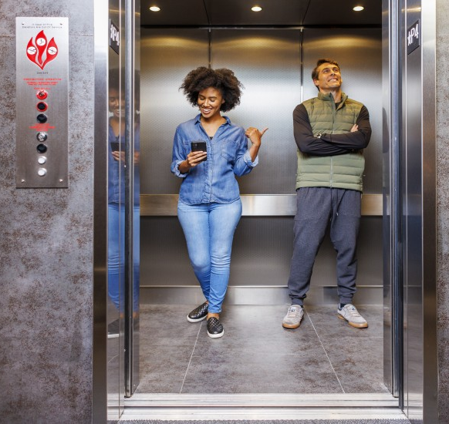
Elevator speech
Basic rules
Please stand up and choose 1-2 partners (in the first round not from your country)
You will have max. 60 seconds in each rounds to speak with each others
There will be 5 rounds (5 different questions on the screen)

Slide 10

Elevator speech, question 1
How do you say good morning in your language?

Slide 11

Elevator speech, question 2
What do you like in Greece?

Slide 12

Elevator speech, question 3
What do you like in CELBET the most?

Slide 13
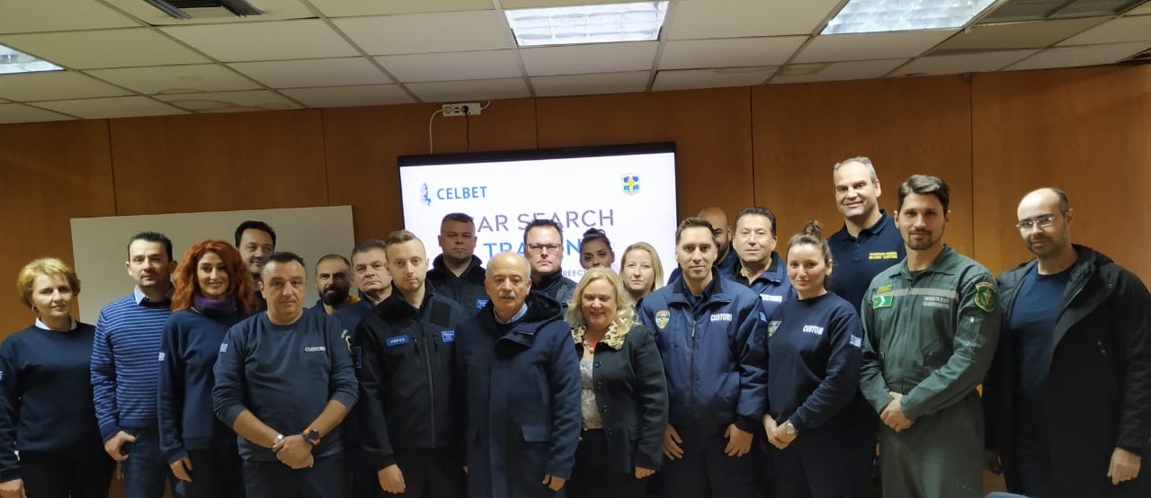
Elevator speech, question 4
Why is it good to be a CELBET trainer/expert?

Slide 14
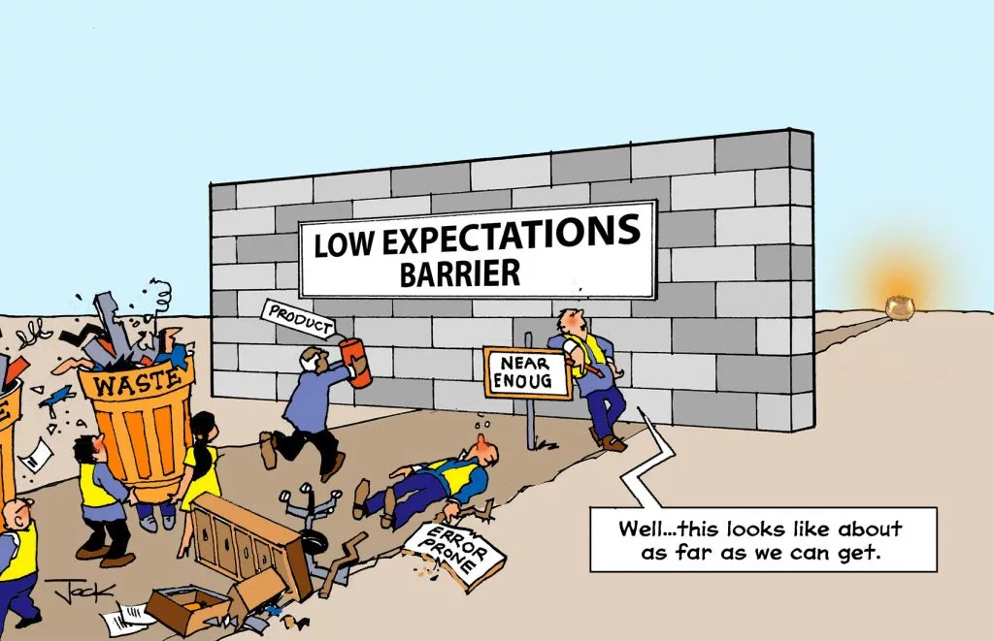
Elevator speech, question 5
If you would be a participant on a CELBET training, what would be your expectations?

Slide 15

Workshop 1
Expectations
What can you bring to CELBET?
What would you like to take away from this event?
What are your expectations from the Training Team?

Slide 16


Slide 17
Introduction to VR demonstration

Slide 18
Presentation of Centres of Expertise, Section 1
Presentation of:
X-ray Center (PL) and
Customs control skills development (HU)
How trainers from other countries can be involved?
How the national training support can be managed?

Slide 19

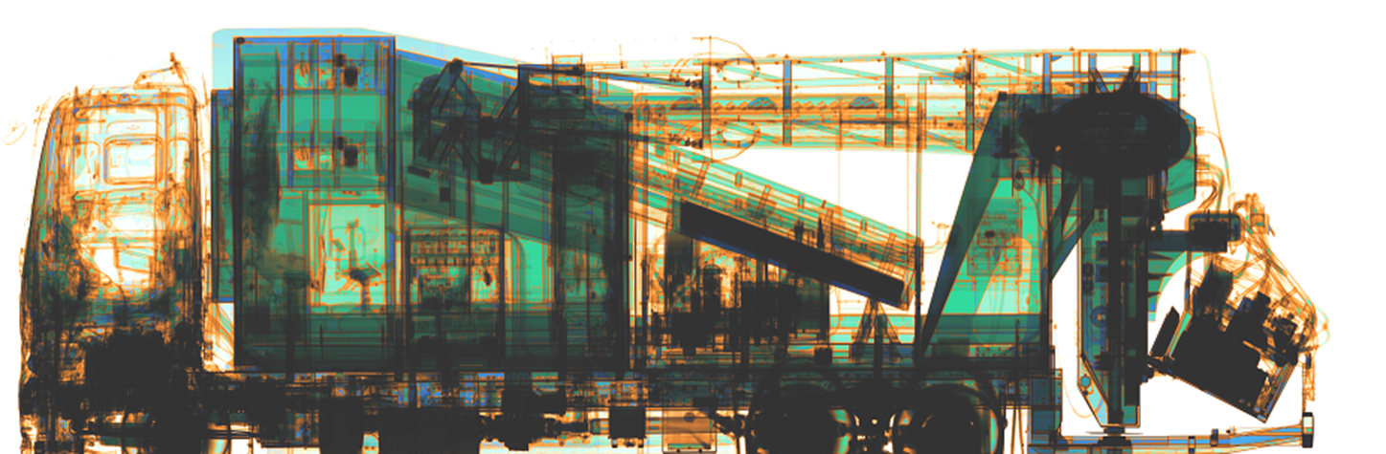
X-ray Centre in Gdańsk as a Centre of Expertise (CoE) for training purposes on the „X-ray image analyzing”

Slide 20

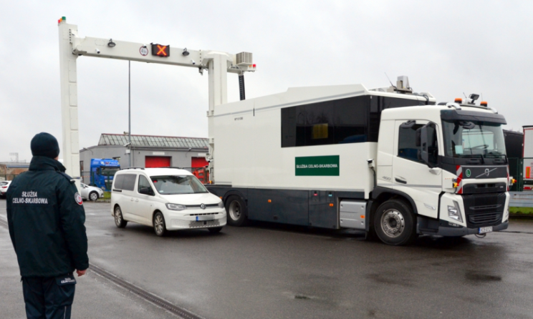
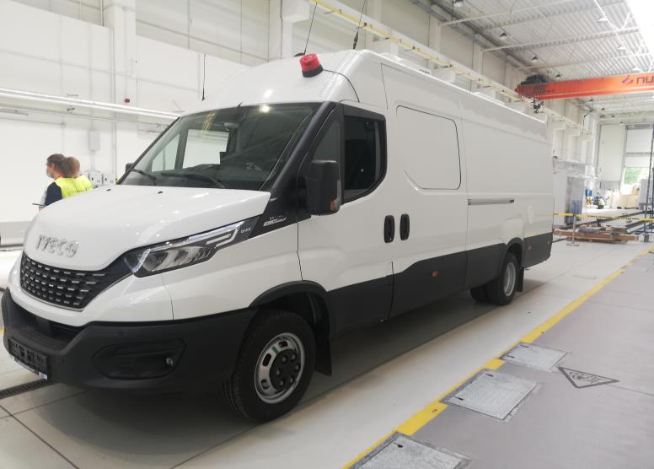
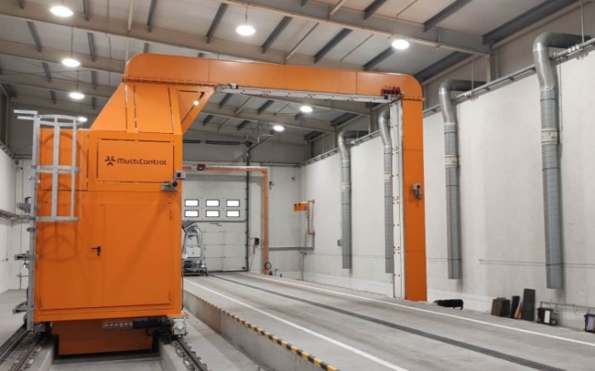
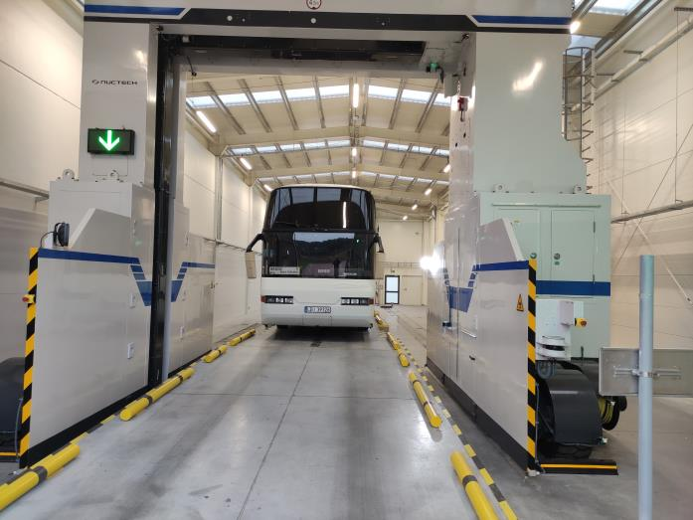
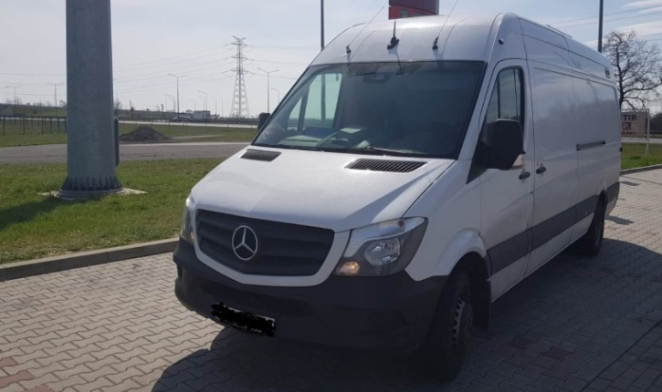
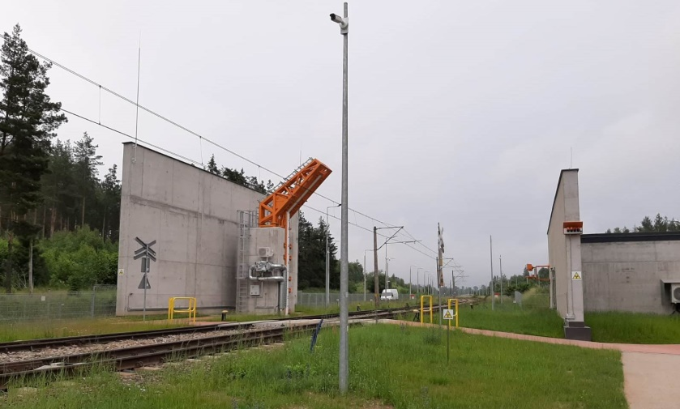

X-ray equipment is the most expensive tool used by customs agencies during customs control duties.
Without very well prepared staff x-ray device is ineffective.
Notes:
20

Slide 21
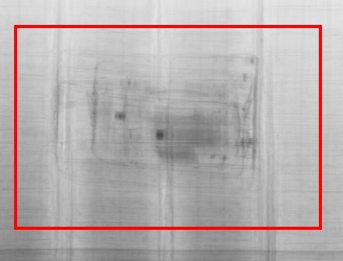
The crucial skill of x-ray operators is correct analysis of x-ray images
Notes:
21

Slide 22
X-ray Centre Unit located in Gdańsk (PL) is responsible for:
complex coordination and efficient monitoring of the use of x-ray devices in Poland
x-ray control data gathering (PL)
periodical post analysis of x-ray images
organization of national and international trainings on x-ray image analysing
intranet x-ray portal (PL)
intranet x-ray image recognition training tools
cooperation with the European customs administrations / CELBET
participation in the H2020 projects
CELBET Centre of Expertise (CoE) for training purposes on the „X-ray image analyzing”
Notes:
22

Slide 23
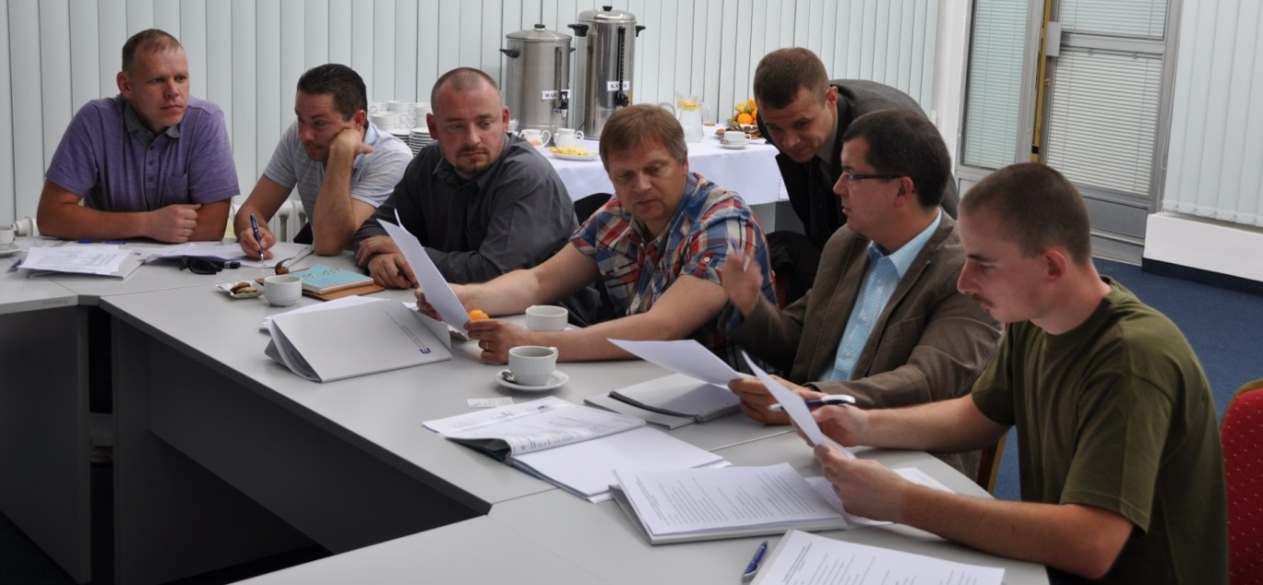
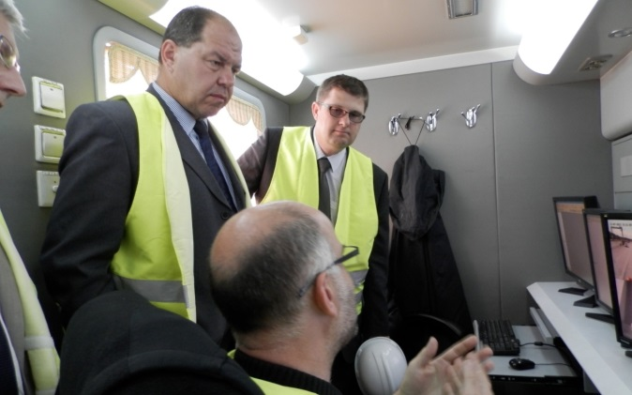
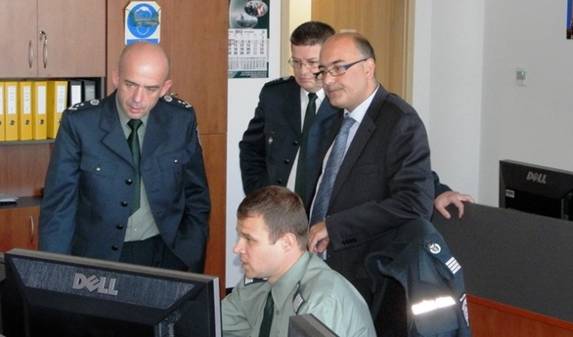
International working visits
In the period 2013-2022 visited by representatives from: Czech Republic, Slovakia, Germany, Spain, Greece, Lithuania, Latvia, Estonia, Bulgaria, Finland, Denmark , Switzerland, UK, Ireland, Korea, UK, CELBET, EXBS coordinator, US CBP representatives.
Notes:
23

Slide 24
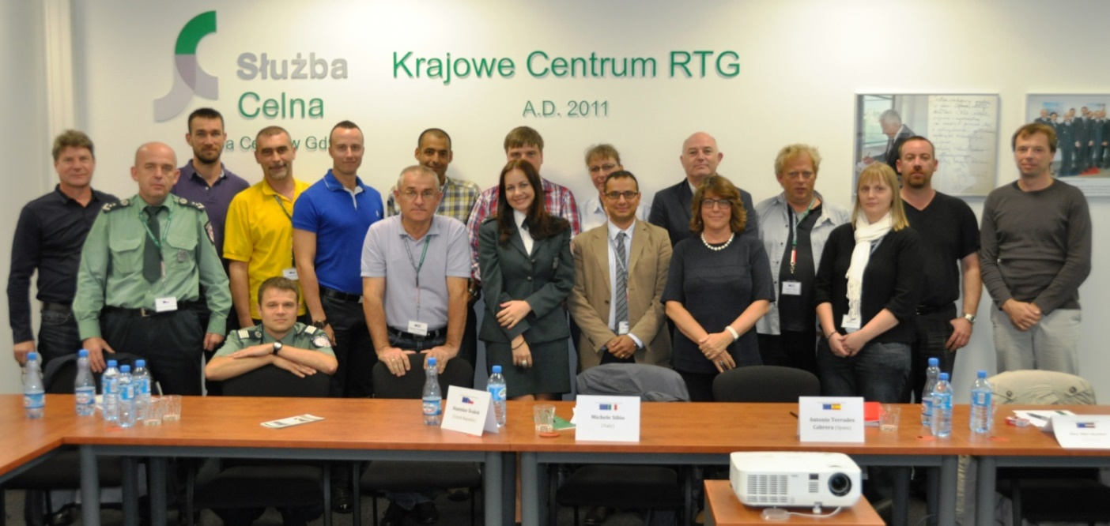
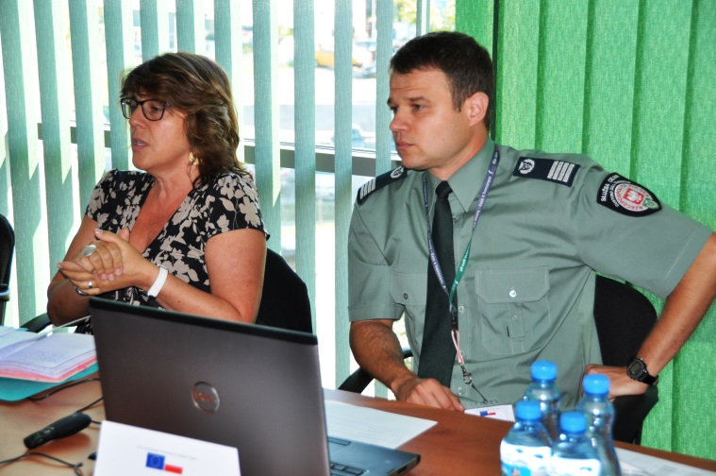
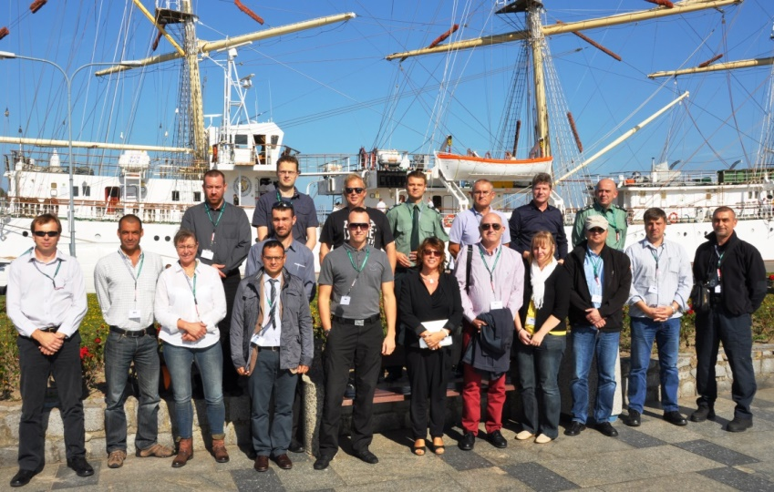
X-ray Inspection workshop (Gdańsk 2014):
Notes:
24

Slide 25
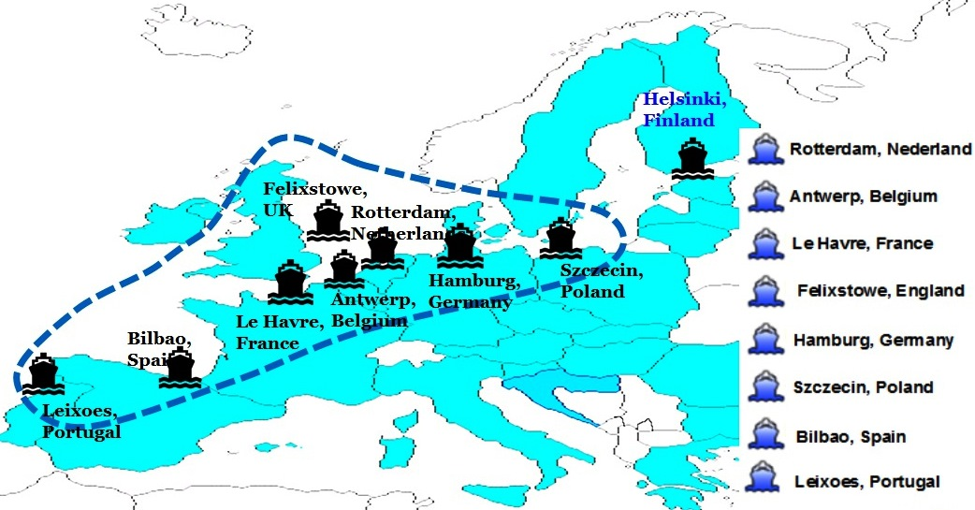
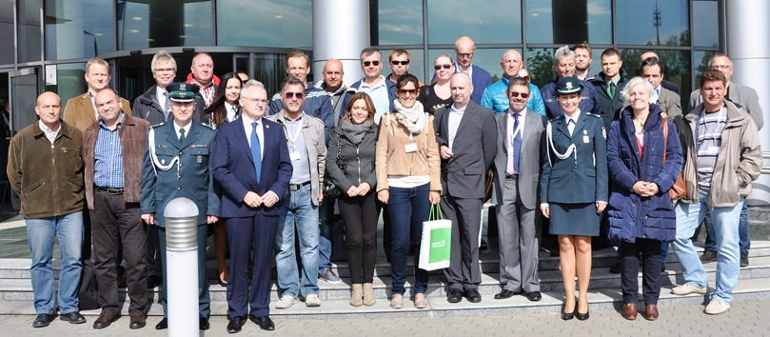
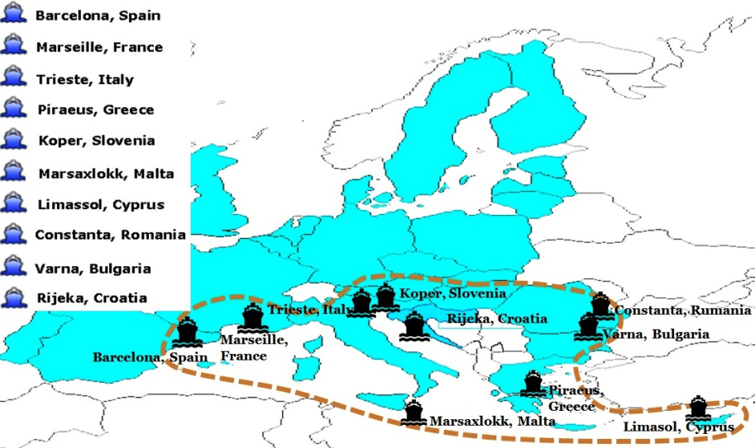
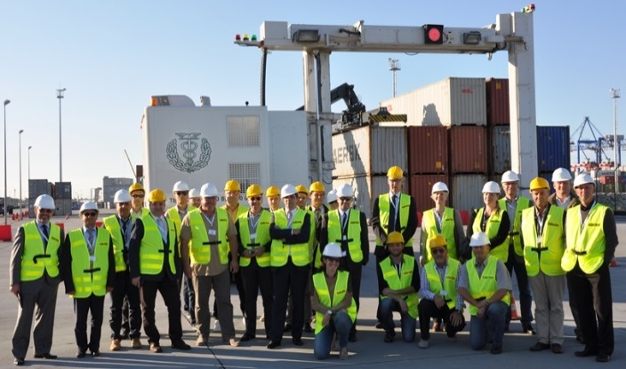
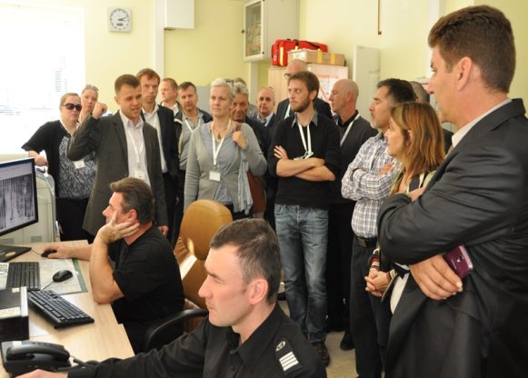
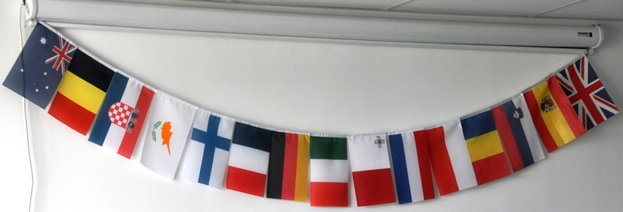
WORKSHOP ON X-RAY CONTROL OF SEA CONTAINERS
Notes:
25

Slide 26
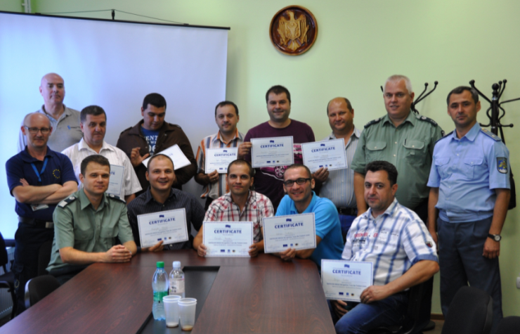
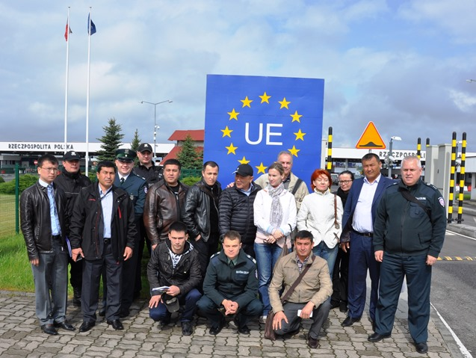
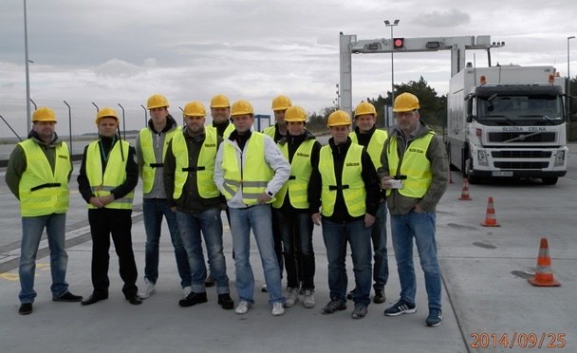
International x-ray trainings
In the period 2013-2022 National X-ray Inspection Centre in Gdańsk organized international trainings for representatives:
of Moldova and Ukraine (EUBAM),
of Uzbekistan and Croatia (EXBS),
of Georgia (ICMBD Austria),
of Germany, Finland, Bulgaria, Spain, Malta (Customs 2020),
of Moldova, Ukraine, Belarus, Azerbaijan, Georgia, Armenia (FRONTEX)
of V4 countries Czech Republic, Hungary, Slovakia,
of representatives demanded by CELBET
Notes:
26

Slide 27
X-ray Centre as as a Centre of Expertise (CoE) for training purposes on the „X-ray image analyzing”:
visit of CELBET experts in Gdańsk
preparatory meeting in Gdańsk (January 2019)
Train the trainer course (May 2019)
Partnership Agreement on establishing CELBET CoE for training purposes on X-ray image analyzing between PL administration CELBET and EC (August 2019)
international stationary trainings (2019-2022)
international webinars devoted to x-ray image recognition (2021-2022)
Notes:
27

Slide 28
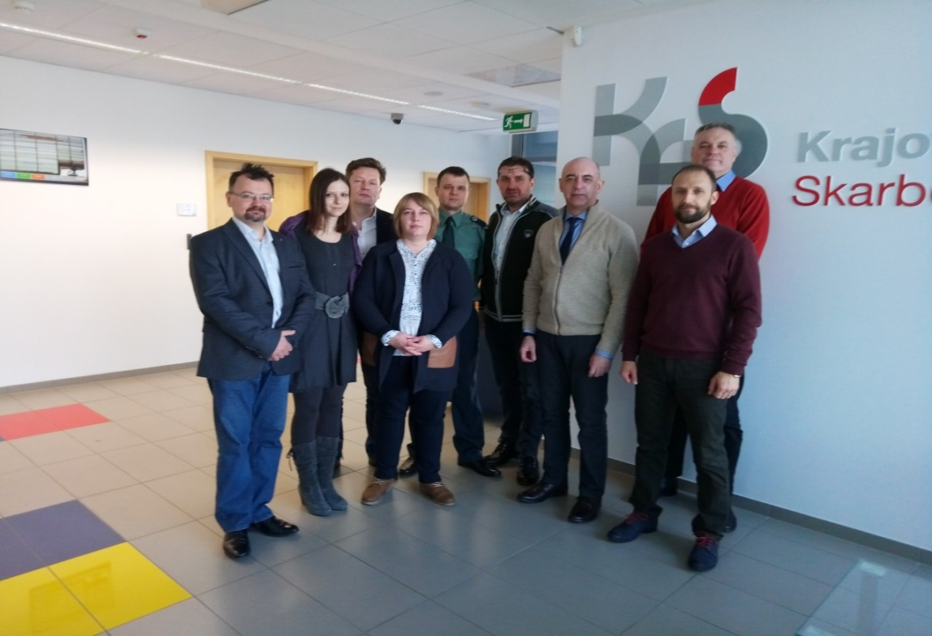
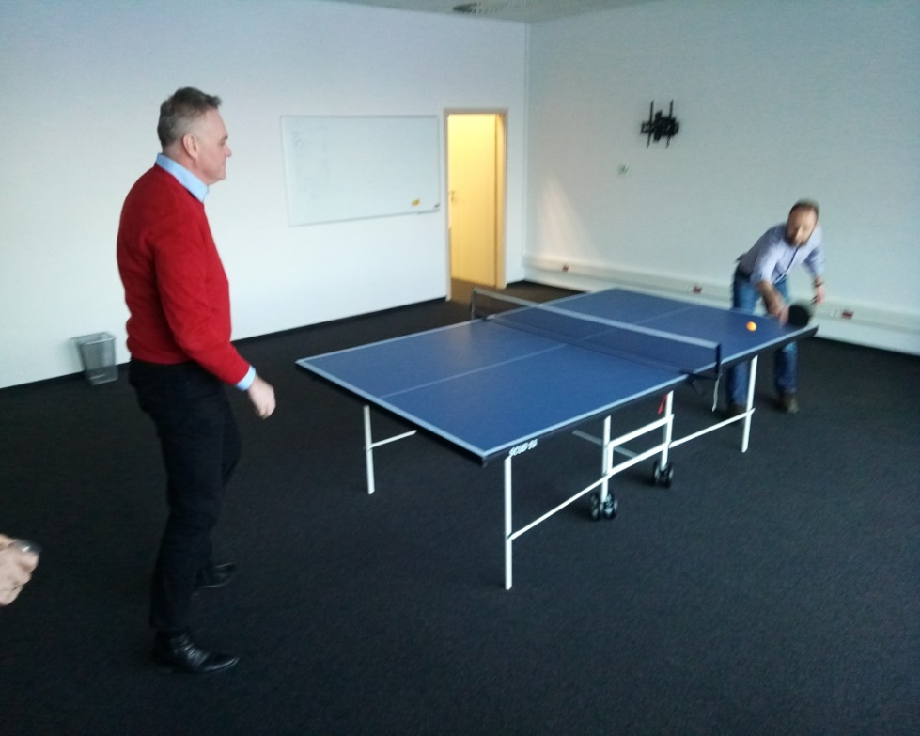
Preparatory meeting: (22-24.01.2019 Gdańsk)
Experts from CEBET Training Team and selected trainers on x-ray image analysis met in Gdańsk to prepare future train the trainer training.
Notes:
28

Slide 29
Preparatory meeting: (22-24.01.2019 Gdańsk)
Summary:
During meeting selected trainers from PL, SK, LT prepared theoretical presentations which seems to be valid nowadays
Mentioned material should be used by CELBET/local trainers during CELBET x-ray trainings
Notes:
29

Slide 30
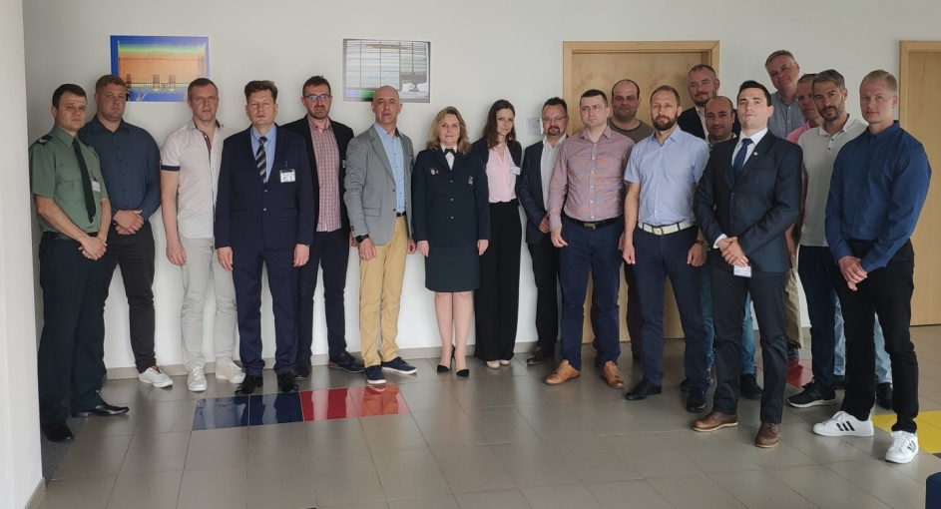
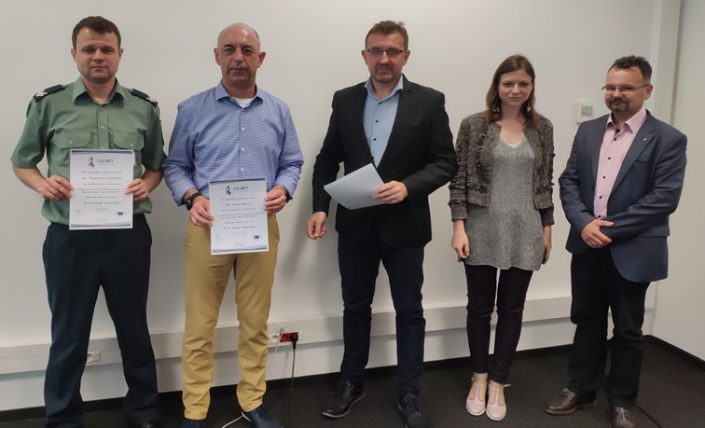
Train the trainer (21-23.05.2019 Gdańsk)
10 participants from 9 CELBET MS
during training participants have been equipped with theorethical materials and have met the rules of teaching of x-ray operators
at the end trainees received appropriate certificates
Notes:
30

Slide 31
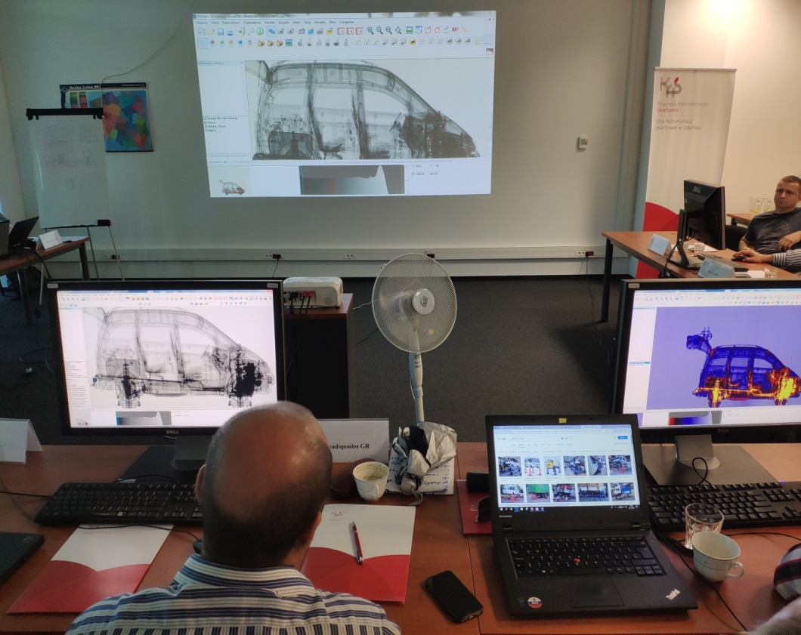
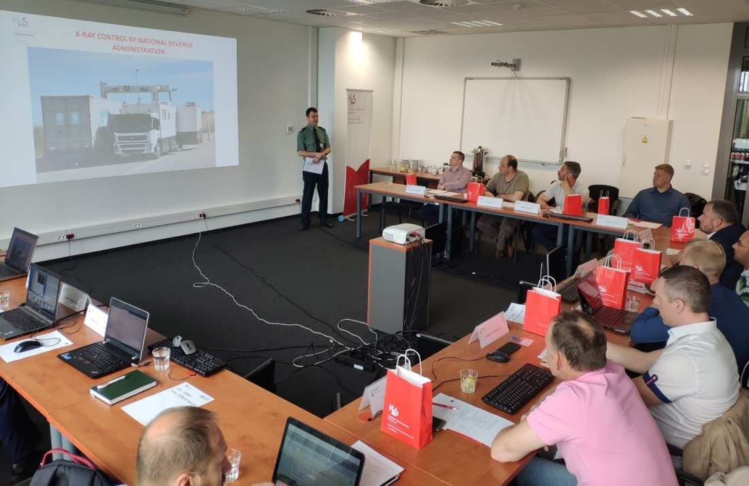
Train the trainer course (21-23.05.2019 Gdańsk)
Notes:
31

Slide 32
Train the trainer course (21-23.05.2019 Gdańsk)
Summary:
The purpose of the training was the preparation of local CELBET trainers to provide such a training in the future and selecting the best willing trainers to represent CELBET CoE during international trainings
Unfortunately it turned out that there is lack of experts in that field – appropriate experience, knowledge and data for practical trainings
CELBET member states besides PL, SK, LV, LT are not equipped with appropriate external software to display x-ray images from Nuctech and Rapiscan (regarding Smiths – no country is prepared)
As we noticed in the near future only trainers from PL, SK, HU and LV fulfilled all characteristics to be a trainer – experience/data base etc based of their active participationin webinars and stationary trainings
Rest of trainers since 2019 still not ready to reprsent CoE as a trainer
Notes:
32

Slide 33
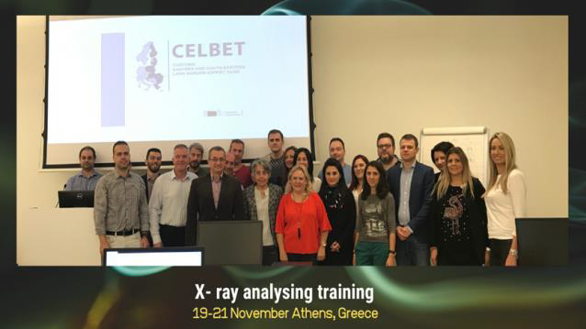
Stationary CELBET x-ray trainings:
Estonia (22-24.10.2019) – 3 one day trainings in 3 different locations
Greece (19-21.11.2019 Athens) – provided by experts from PL
Moldova (21-25.10.2022 – Chishinau) – provided by experts from PL
Lithuania (9-12.01.2023 Vilnus) - devoted to railway x-ray devices – 2 two-days trainings – provided by experts from PL and LV
Finland (6-9.01.2023 Vaalimaa) – devoted to railway x-ray devices – provided by experts from PL and LV
Notes:
33

Slide 34
Stationary CELBET x-ray trainings:
Summary:
Based on completed stationary trainings:
it seems that training shorter than 3 days is not efficient (only statistical success and waste of EU founds)
clasroom should be equipped with the possibility /host should provide laptops/computers with free acess to usb ports for trainers who bring x-ray images on pendrives
only trainers, trainees, translators, authorized representative of host are allowed to participate the training because presented data should be treated as sensitive
Notes:
34

Slide 35
Stationary CELBET x-ray trainings:
Based on completed stationary trainings there is a plan to set rules as:
training for each group should last at least 4 days (theoretical part half a day)
maximum 2 trainers per traininig
trainers should have practical knowledge from the field – not only theoretical
host should provide laptops/computers with free acess to usb ports for trainers who bring x-ray images on pendrives
only trainers, trainees, translators, authorized representative of organizer can are allowed to participate the training
Notes:
35

Slide 36
Online webinars:
1st : (24.02.2021), CELBET3 Webinar X-ray image analysing – review of selected seizures from 2020/2021 - provided by experts from PL, EST, HU.
2nd : (28.05.2021), CLEP training webinar on x-ray image analysing’ - provided by experts from PL, SK, HU
3rd: (27.01.2022) ‚CLEP –X-ray image analysing webinar’ - provided by experts from PL, LV, DE, ES
4th: (27.01) X-Ray image analysis CLEP webinar, - provided by experts from PL, DE, ES
5th: (26.07) – x-ray image analysis webinar for Moldova – provided by expert from PL
6th: (16.11) – X-ray image analysis webinar for Ukraine – provided by expert from PL
Notes:
36

Slide 37
Online webinars:
Summary:
durring pandemy only method to share knowledge
webinar never replace stationary training – very limited contact between trainer and participants
webinar is easy to perform for non limited audience but should be recomended rather for experienced operators who would like to meet new methods of smuggling /new types of anomalies
Notes:
37

Slide 38
Future plans:
Continuation of online webinars (easy to perform)
Continuation of stationary international trainings/events in Gdańsk or somewhere in CELBET MS according tho the needs gather by CELBET Training Team
Start to organize local trainings by CELBET trainers using materials from CELBET and images from X-ray exchange library / CRMS2 Detection Corner
September 2023 - organization of international 4 days training in Gdańsk for 10 x-ray operators from EU MS (Nuctech/Rapiscan) provided by expert from PL – put to the callendar as an yearly obligatory event
Notes:
38

Slide 39
Challenges:
to increase number of trainers cooperating with CoE in Gdańsk – for today 4 PL trainers available, 1 trainer from LV , 1 trainer from HU
to create international training teams (2 members) ready to provide trainings
acquisition of external software by EU MS for training purposes – especially Smiths software in GR and BL
to force MS to share x-ray images presenting seizures
Notes:
39

Slide 40
Thank you for your attention
Notes:
40

Slide 41
Customs Control Skills Development Centre of Expertise
CELBET Customs control process training
Zsolt Kovács Cpt., Hungarian Tax & Customs
Jenő Csáki Cpt., Hungarian Tax & Customs
Tamás Tóth Lt., Hungarian Tax & Customs
BCP Röszke, Customs Control Skills Development Centre of Expertise

Slide 42
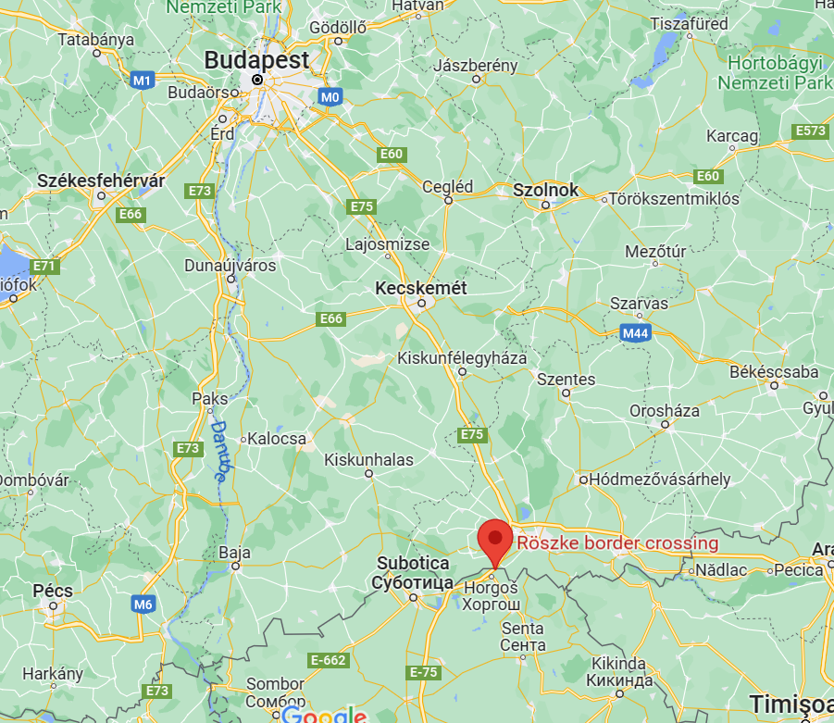
General information
Customs Control Process Training
Live training facilitated @Röszke BCP, Hungary, Röszke Centre of Expertise
Trainers: 3 from HUN + 1 from other CELBET country (PL, LV, BG)
From 2019: 4 live trainings + 2 webinars
Goal and objective:
To spread common approach in performing customs control at the EU external border by sharing working examples, best practices and methods.
To increase safety and security, protect citizens and the environment.

Slide 43
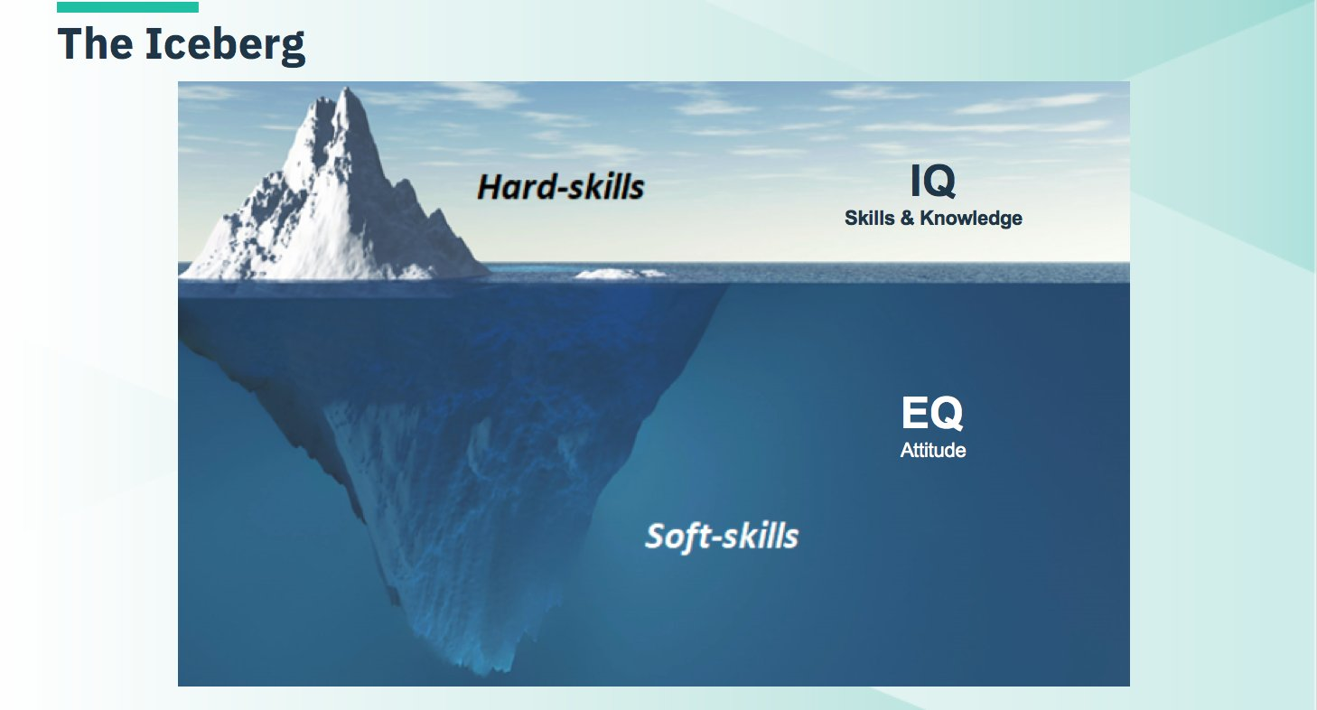

General information
Customs Control Process Training
Hard skill development
  Operational competencies
Soft skill development
  Professional competencies
New modus operandi & Training metholodogy
  Based on many scientific researches
Notes:
Professional competencies
- dealing with operational risk
- drive for results
- Teamwork
- coping with stress
- problem solving
- processing information
- communication
technological ability
Operational competencies:
customs legislation
Enforcement
risk analysis
control of goods

Slide 44

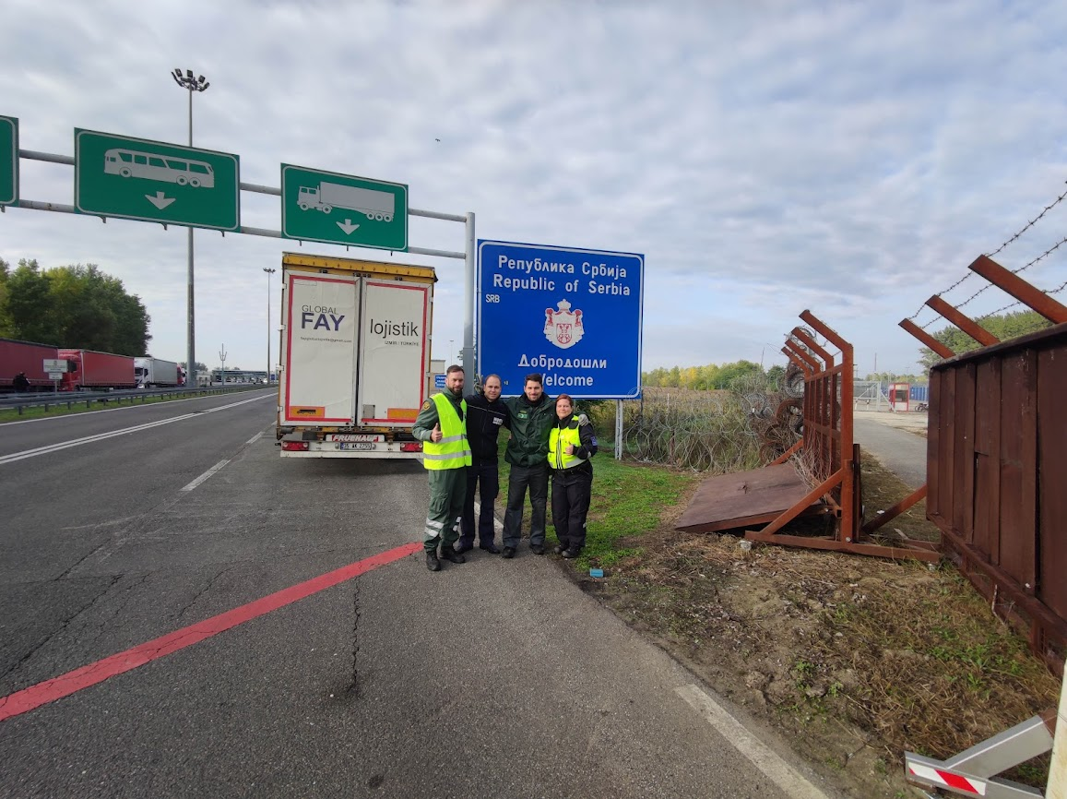
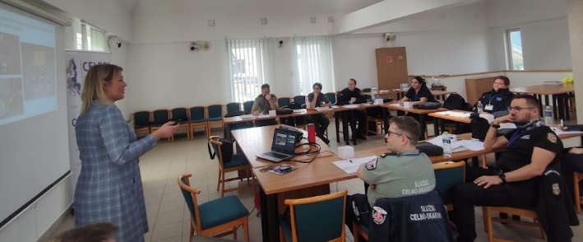
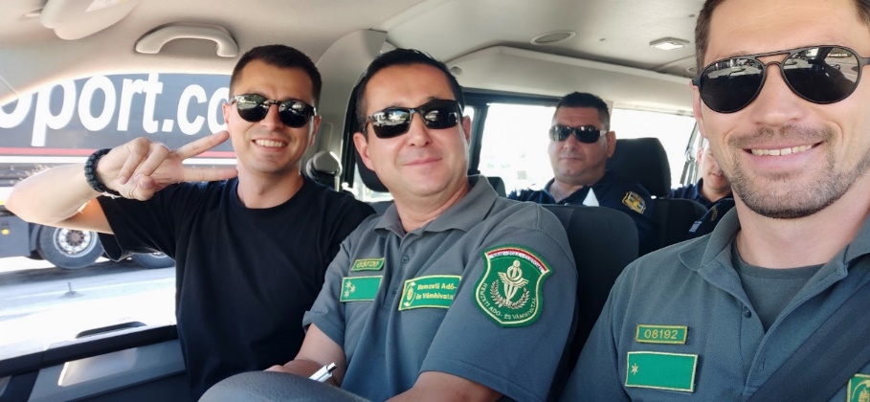
General informations
Customs Control Process Training
Give opportunity for trainees to become trainers.
  Ambition
  Choose a Preferable topic
  Motivation for national implementation
Risk Analysis, Interviewing, Profiling, Specialized in some Control Method or Means of transport

Slide 45
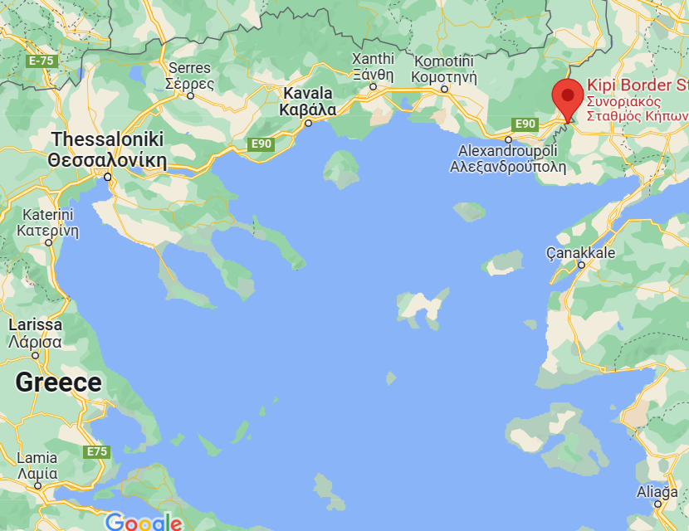
CELBET Customs control process training
Greece, 6-8 September 2022
06-08. 09.2022. Kipi BCP
16 participants
3 CELBET trainers (2 HUN, 1 BG)
Greek customs officers
  From BCPs with Albania, N.Macedonia, Turkey
  Sniffer dog handlers + X-Ray operators included

Slide 46
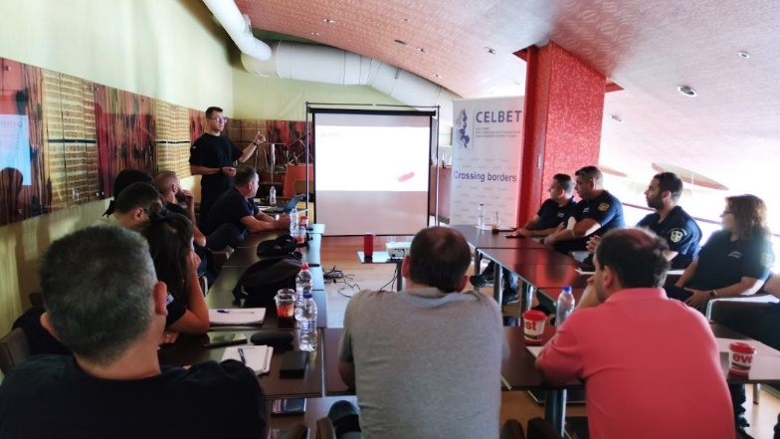
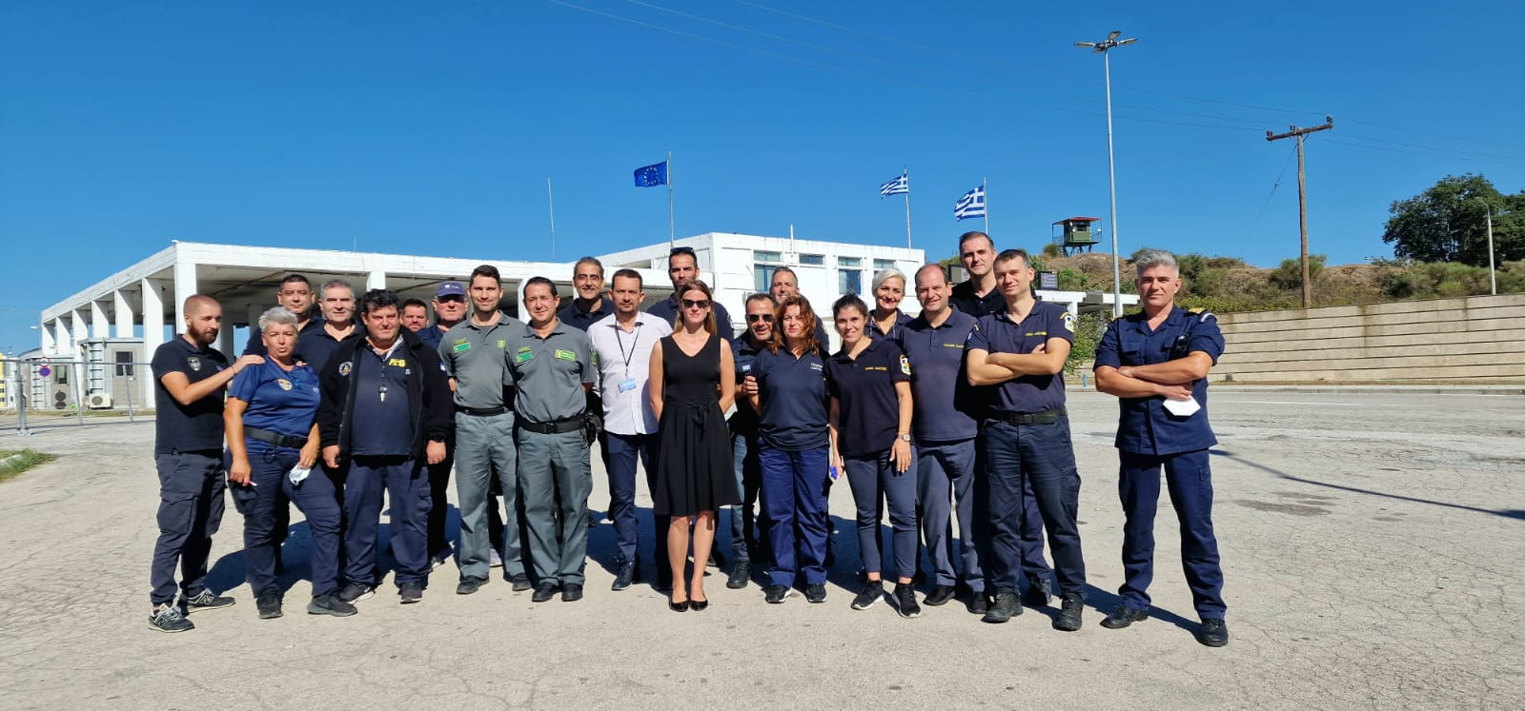
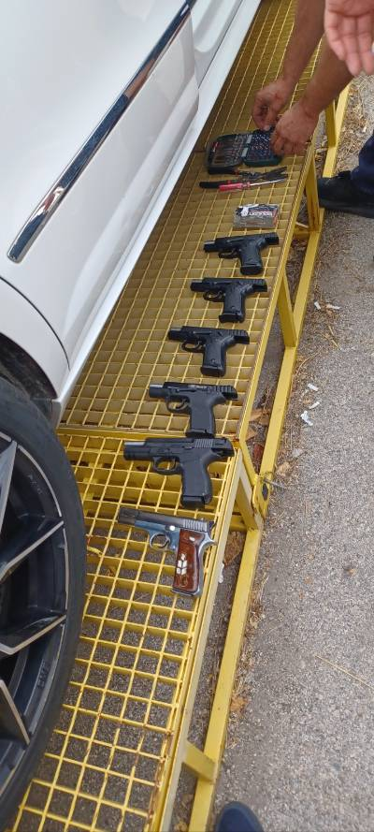
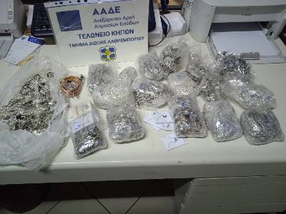
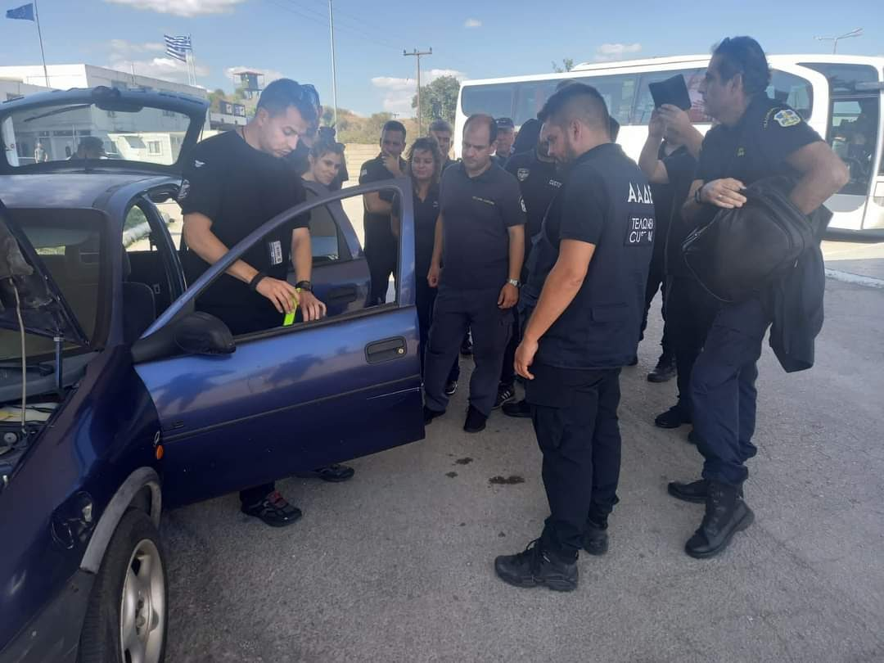
Notes:
Usefull basic for all type of Cumtoms officers (sniffer dog, x-ray, shiftleader)

Slide 47

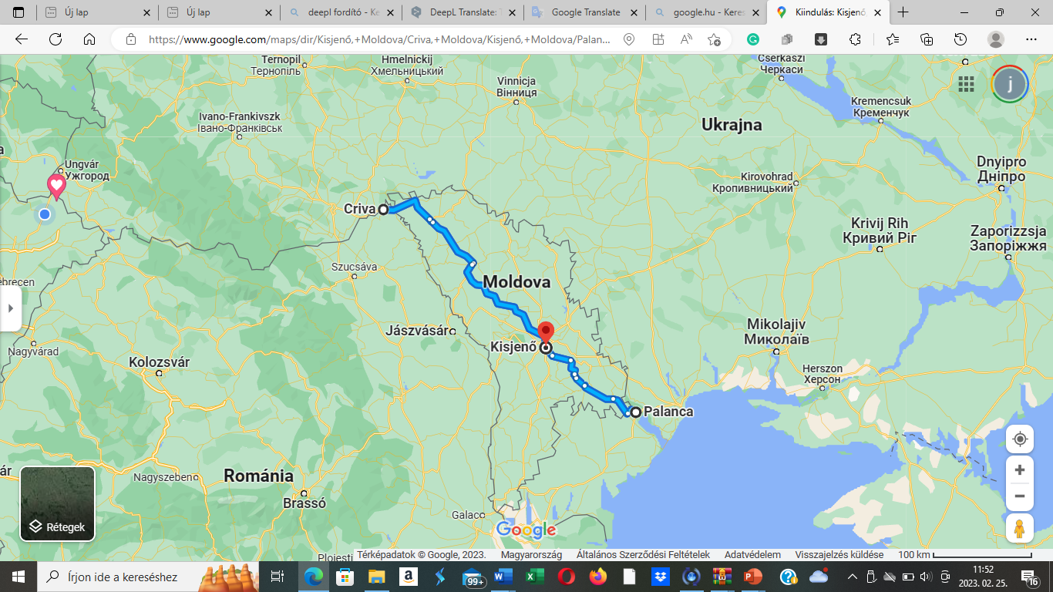
CELBET Customs control process training
MOLDOVA, 7-8, 9-10 NOVEMBER 2022
Cooperation with EUBAM
07-08. 11.2022. Crivia BCP
09-10. 11.2022. Palanca BCP
2x 16 participants
Moldovan + Ukrainian customs officers + EUBAM officers
2 CELBET trainers

Slide 48
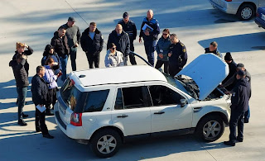
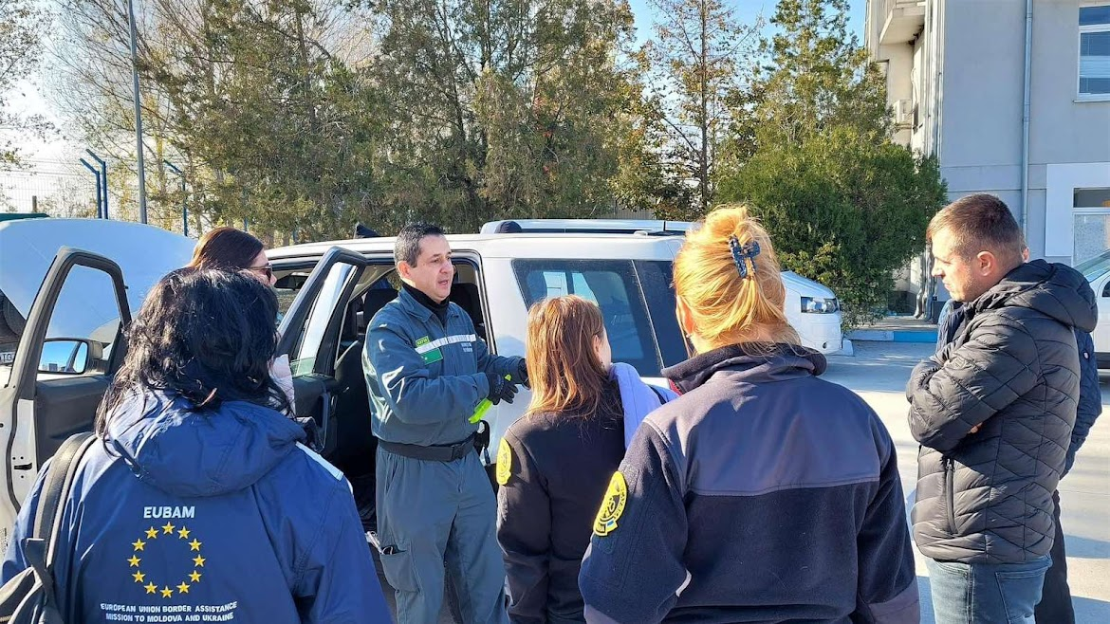
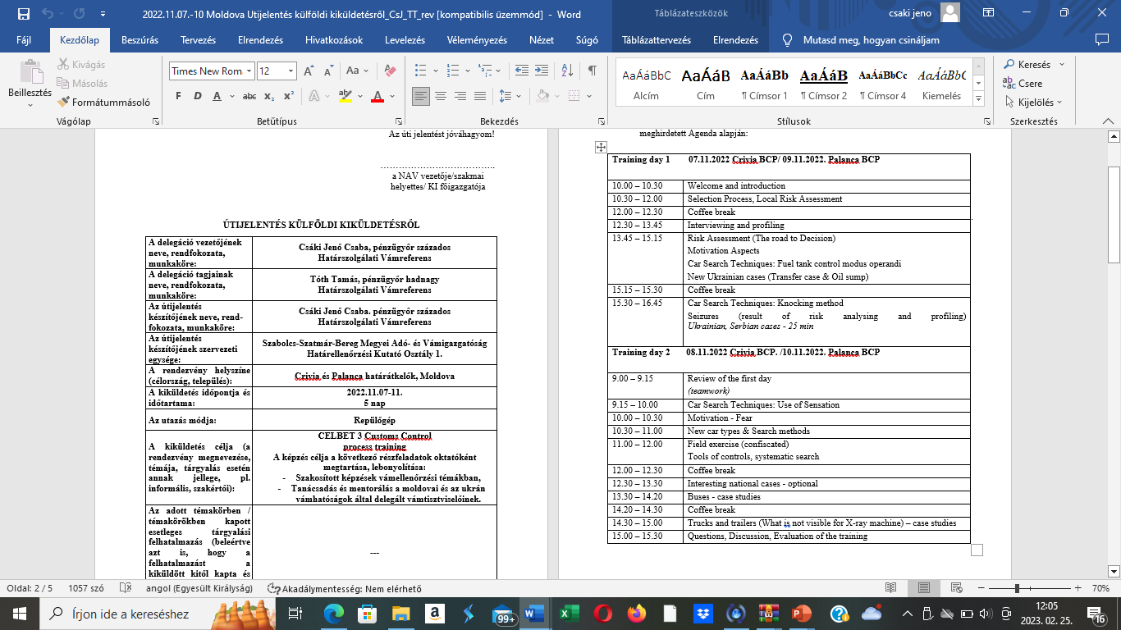
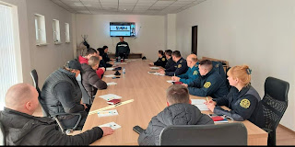
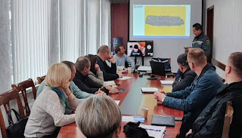




Slide 49
Thank you for attention!

Slide 50

Centres of Expertise, Section 1
How trainers from other countries can be involved?
How the national training support can be managed?

Slide 51
Presentation of Centres of Expertise, Section 2
Presentation of:
Sniffer dogs (SK) and
Car search (FI)
How it is possible to manage the trainings on different levels?
What can be the future of train the trainers method?

Slide 52
Vaalimaa CoE
Car Search Training, Basic
Train the Trainer - events

Slide 53
CAR SEARCH TRAINING (BASIC)
Background information
During 2015-2016, Customs’ national trainers received, from several vehicle importers, ( VW, Volvo, Skoda, Toyota..) a course built to meet Customs’ needs concerning car structure and technology of modern vehicles
10 Car search trainers in Finland, Vaalimaa customs is centre of expertise in car search
National trainers have also received a certificate of electrical safety for vehicles
Notes:
53

Slide 54


CAR SEARCH TRAINING (BASIC)
Training center in Vaalimaa customs
  Train the Trainer course
  2 – 4 trainings / year (EU CLEP + CELBET)
  3 trainers, 8 participants
  Key thing is modern vehicles
  Course is based in practicality and informativity
  Collection of training cars
Notes:
54

Slide 55
COURSE STRUCTURE
E-learning part before the actual event (MOODLE)
Day 1. Arrival to Finland
Day 2. Classroom day at Vaalimaa customs
Day 3. Garage day at Vaalimaa customs
Day 4. Workshop day (Arctic Trucks Finland)
Day 5. Classroom day at hotel meeting room, Kotka
Notes:
55

Slide 56

E-LEARNING
E-learning part at Moodle environment
Base information to the course
Included also preliminary task
Notes:
56

Slide 57
Day 2. Classroom day at Vaalimaa Customs
Vaalimaa Customs / X-ray scanning meeting room
Introduction, goals and practical arrangements of the course
Introduction of Finnish Customs
Main lectures:
  STRUCTURE AND TECHNOLOGY OF A MODERN VEHICLE
  SAFETY EQUIPMENT AND ALTERNATIVE FUELS
  SMUGGLING METHODS
  OCCUPATIONAL SAFETY
  INSPECTION TACTICS AND TECHNOLOGY IN FINNISH CUSTOMS, VISIT TO VAALIMAA X-RAY
Notes:
57

Slide 58


Day 3. Garage day at Vaalimaa Customs
Use of tools, refreshment of occupational safety, physical control in the car hall with demonstration, CNG-vehicle presentation
Training cars: the teams search to find the hidden packages. The training cars are re-assembled
Notes:
58

Slide 59
Day 4. Workshop day
Alternative fuels and technology
  Introduction of hybrid vehicles
Visit to a dedicated 4x4 vehicles workshop facility
  Body construction of off-road vehicles. Learning the characteristics of off-road vehicles in a practical driving session
Notes:
59

Slide 60

Day 5. Final day at hotel meeting room, Kotka
ALLDATA workshop software
PICS / CAVA
Car Search E-learning module
Course feedback, closing discussion and -ceremony
Transport to Helsinki airport
Notes:
60

Slide 61
EU- and CELBET Car Search events
Pilot course was held in june 2017 at Vaalimaa, the participating countries:
  2. Course 13. – 16.2.2018:
    3. Course 16. – 19.10.2018:
      4. Course 12. – 15.3.2019:
      5. Course 25. – 29.3.2019, CELBET – Pilot course, Basic
      6. Course 1. – 4.10.2019
      7. Course 15. – 18.10.2019, CELBET - Basic
      8. Course 10. – 12.12.2019, CELBET (GREECE)
      9. Webinar 5.5.2021, CELBET
      10. Webinar 11.11.2020, CELBET
      11. Webinar 28.10.2021
      12. Course 31.5.-3.6.2022 Nordic countries
      13. Course 23.-26.8.2022
      14. Course 20.-23.9.2022, CELBET - Advanced
Notes:
61

Slide 62
Vaalimaa CoE
Car Search Training, Advanced
Train the Trainer - events

Slide 63
CAR SEARCH TRAINING (ADVANCED)
Training center in Vaalimaa customs
  Further education for those who have completed the basic Train the Trainer course
  1 training held so far (2022)
  3 trainers, 8 participants
  Key thing is hybrid- and electric vehicles, de-energization
  VDE-insulated tools
  Cooperation with Taitotalo (specialists with electric cars)
Notes:
63

Slide 64
COURSE STRUCTURE
Pre-assignment
Day 1. Arrival to Finland
Day 2. Classroom day at Vaalimaa customs
Day 3. Garage and classroom day at Vaalimaa customs
Day 4. Workshop day (Taitotalo)
Day 5. Classroom day at hotel meeting room, Kotka
Notes:
64

Slide 65
Day 2. Classroom day at Vaalimaa Customs
Vaalimaa Customs / X-ray scanning meeting room
Introduction, goals and practical arrangements of the course
Main lectures:
  DE-ENERGIZATION OF HYBRID- AND ELECTRIC CARS
  OCCUPATIONAL SAFETY
  SMUGGLING TRENDS IN EUROPE
  PARTICIPANT PRESENTATIONS
Notes:
65

Slide 66
Day 3. Garage and classroom day at Vaalimaa Customs
Garage:
De-energization of VW PASSAT GTE demonstration
VDE-insulated tools in use
Customs controls from live traffic
Classroom:
Teamwork concerning the Car Search Training courses - 2 groups
Notes:
66

Slide 67
Day 4. Workshop day – Taitotalo, Helsinki
Classroom- and training center learning
Technical trainers from Taitotalo
Notes:
67

Slide 68
Day 4. Workshop day – Taitotalo, Helsinki
Content:
  Different hybrid- and electric vehicle types
  Working safety, high voltage component locations etc.
  Car brands and models, new car registration statistics
  Charging, types and systems, batteries etc.
  Hybrid- and electric vehicles, demonstration session at training center
  Future innovations: what to expect
  Conversation and conclusions
Notes:
68

Slide 69
Day 5. Final day at Vaalimaa Customs
ALLDATA workshop software use with de-energization
Structure- and technology of a hybrid vehicle
CAVA update
Course feedback, closing discussion and -ceremony
Transport to Helsinki airport
Notes:
69

Slide 70

Mobile car search vehicle and service
For challenging car search situations
Special expertise in electric- and hybrid vehicles
Passenger cars
Heavy vehicles
Cooperation:
Customs
Police
Border guards
Finnish defence forces
Notes:
70

Slide 71
Mobile car search vehicle, tools
Hand tools
Socket wrench set, (big + small)
Screwdriver set + Torx + Hexagon socket
Upholstery removal kit
Cordless electric tools + chargers
Impact wrench (boltgun)
Screwdriver
Grinder
Sabresaw
Special tools
VDE Insulated special tools for hybrid- and full electricity cars
Airbag removal tools
Videoscope
Fuel sensor flap removal tool
Other tools and stuff
Laptop with network (with ALLDATA)
Inverter
Exhaust jack + racks
Assortments of screw, bolt, nut, washer and upholstery clip
Headlamps + other flashlights
Personal protection, (Corona!)
First aid kit
Notes:
71

Slide 72
Finnish Trainers:
Mr. Pekka Aho, Vaalimaa Customs, pekka.aho@tulli.fi
Mr. Jukka Nokka, Vaalimaa Customs, jukka.nokka@tulli.fi
Mr. Valtteri Serola, Vaalimaa Customs, valtteri.serola@tulli.fi
Mr. Teijo Tarvainen, Nuijamaa Customs, teijo.tarvainen@tulli.fi
Notes:
72

Slide 73
Centres of Expertise, Section 2
How it is possible to manage the trainings on different levels?
What can be the future of train the trainers method?

Slide 74


Slide 75
Presentation of Centres of Expertise, Section 3
Presentation of:
Bus search (PL) and
Train search (LV)
How to get partner CoE?
Special premises for training – how it can work at national level?

Slide 76



TRAIN
SEARCH
Latvia, Daugavpils
5-7 April 2022

Slide 77





DAUGAVPILS BCP
CUSTOMS OFFICE
Duration – 3 days
Hungary
Romania
Estonia
Poland
Lithuania
Finland
Greece
Bulgaria
Latvia
Trainees from:
INDRA BCP
DAUGAVPILS LOCOMOTIVE REPAIR FACTORY
Latvia
Lithuania
Hungary
Trainers from:

Slide 78



Topics:
Introduction with Indra BCP
Safety rules
Railway specific documents
Risk assesement
Technical equipement
The first training day at «Indra BCP»

Slide 79



Physical inspection of arrival train
Locomotive control group
Wagons control group
X-RAY image analyses group

Slide 80



Second training day in customs office
Topics:
Train structure, control, potential concealments
Searching techniques and teamwork

Slide 81


«Train search» trainers
Igors Gorenko (LV)
Oļegs Jerofejevs(LV)
Arūnas Bolys (LT)
Jeno Csaba Csaki (HU)

Slide 82



Daugavpils Locomotive Repair Factory
Where it was possible to get acquainted with the structure of the locomotive, types and possibilities for potential hiding places in the locomotive structure

Slide 83


Third training day at Daugavpils BCP
The trainers prepared in advance «cigarette» blocks and hid them in the structure of the wagon and in the cargo. The participants try to find the hidden "illegal goods" with the acquired knowledge

Slide 84




Trying to find the cigarettes in sawdust cargo

Slide 85




Potential concealments in wagon construction

Slide 86





Participants found all the hidden cigarettes and the training ended

Slide 87





Preparation for being a CoE
We sent filled and signed application form to the head of CELBET.

Slide 88

The possibility of physical control
Popular type of cargo
Local trainers
Working class (theoretical part)
Popular type of wagons and locomotives
Real- time movement of freight cargo
Safety first
Technical equipment
Dog handlers
POTENTIAL PARTNERS CoE

Slide 89





Individual/collective safety equipment
Helmets, gloves
Infrastructure (ramp)
Presentation + real practice
Practice with popular type of wagons
Do You need it?
BASIC (MINIMUM) CONDITIONS TO ORGANIZE THE TRAINING IN LOCAL LEVEL

Slide 90



National «Trains search» training
After CELBET training, we integrate the train search training at national level and from September 2022 we realized 5 face-to-face trainings for 44 Customs officials.

Slide 91


Thank you for you attention!
Olegs Jerofejevs
Igors Gorenko
Sindija Bērziņa

Slide 92
Centres of Expertise, Section 3
How to get partner CoE?
Special premises for training – how it can work at national level?

Slide 93
Video about JCA 10 - implementation and mission in Hungary, 2022

Slide 94
Workshop 2
Discussion between experts from CoE, positive outcomes and challenges
How trainers from other countries can be involved?
How the national training support can be managed?
How it is possible to manage the trainings on different levels?
What can be the future of train the trainers method?
How to get partner CoE?
Special premises for training – how it can work at national level?

Slide 95

Kahoot! Challange
Please take your mobile, tablet or laptop with internet
Please search: kahoot.it
Please follow the instructions on the screen

