Slide 1
Wojciech Narkun

Slide 2
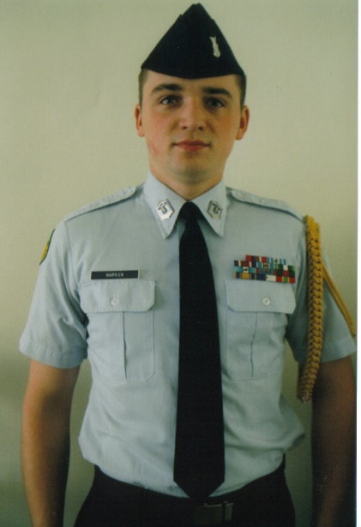
Education
SHAPE American High School, Mons, BE
University of Silesia, English Philology, Katowice, PL - BA
University of Humanities and Economics, Lodz, PL - MA
U.S. Air Force Junior Reserve Officers’ Trainig Corps (AFJROTC Cadet)

Slide 3
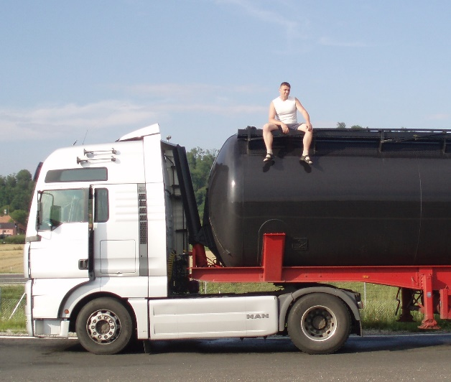
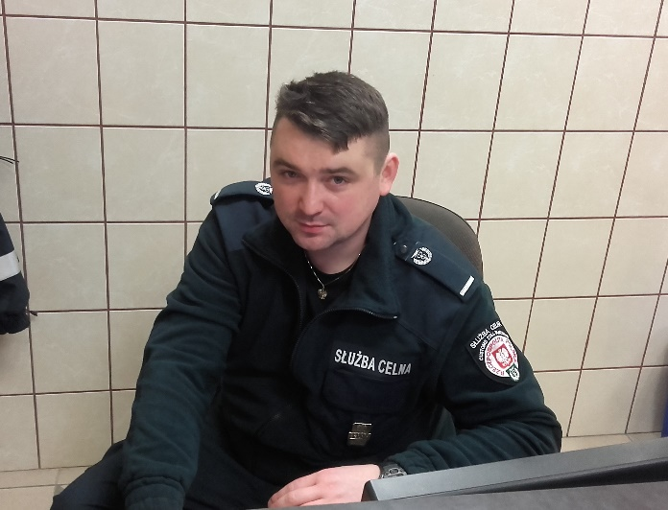
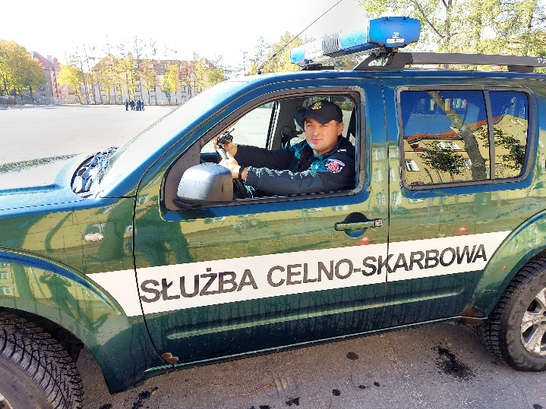
Professional background
2007 – 2011: International road transport
2011 – 2017: Customs Service of Poland
Since 2017: National Revenue Administration of Poland

Slide 4
International career
Begun in 2000 – SHAPE American High School
Between 2007 and 2011 – International freight forwarding and transport
Since 2011 as national authority officer

Slide 5
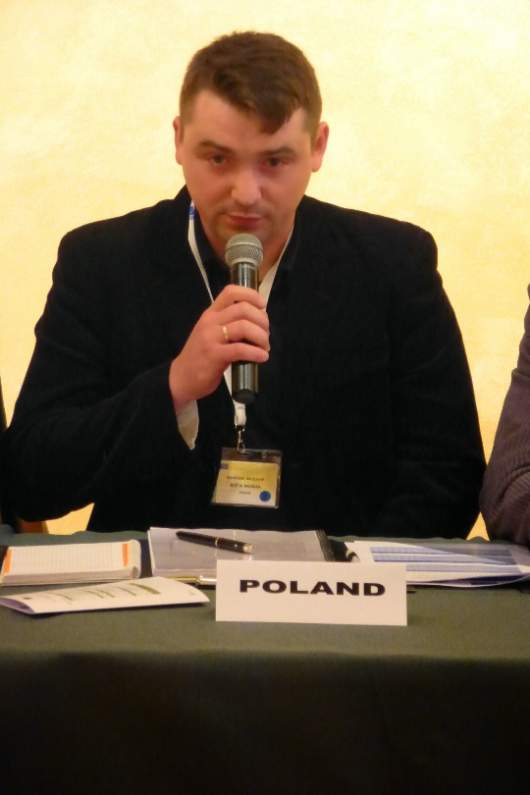
In service
International conferences and seminars
International joint exercises and cooperation
International customs representation
International trainings
International mission (EU BAM)

Slide 6
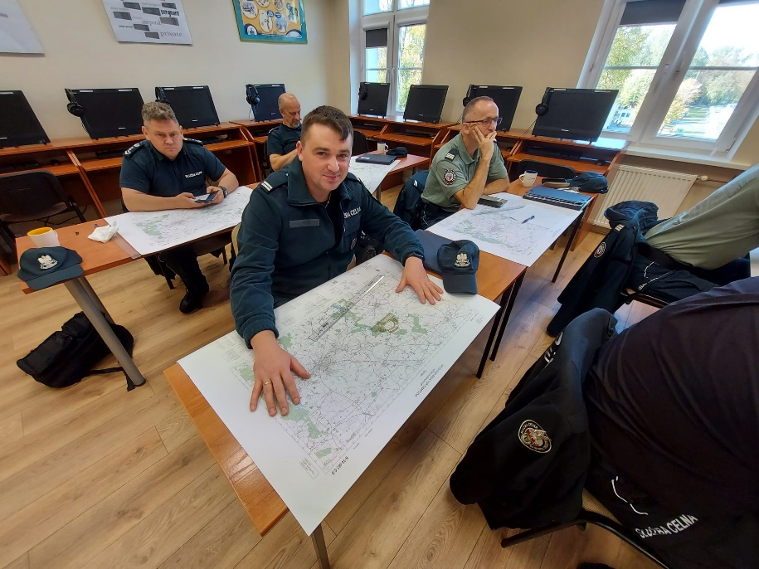
BENEFITS
First CELBET bus search training and my participation as trainee had a positive impact on:
1. Invitation for further cooperation with CELBET
2. Becoming trainer
3. New and valuable international contacts
4. Additional trainings for the needs of international events
5. Further development on various levels

Slide 7
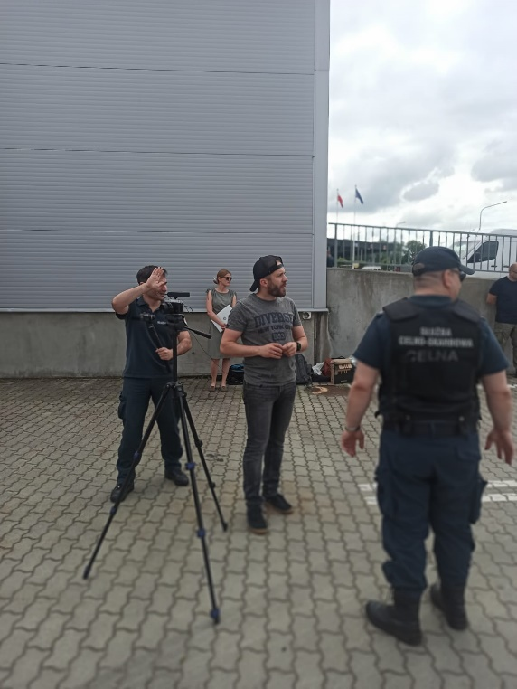
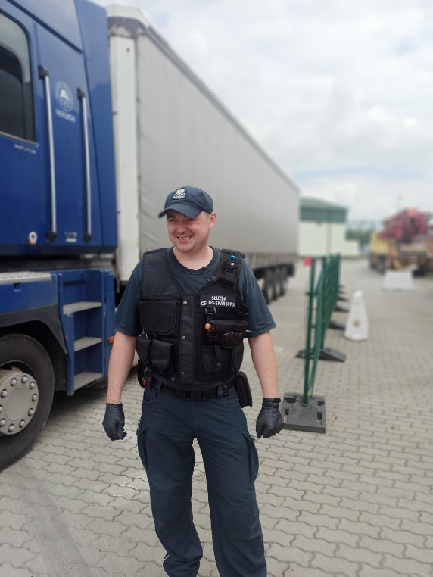
Need for initiative
More innovative solutions ( webinars)
Preparing videos for training purposes
Truck Search

Slide 8
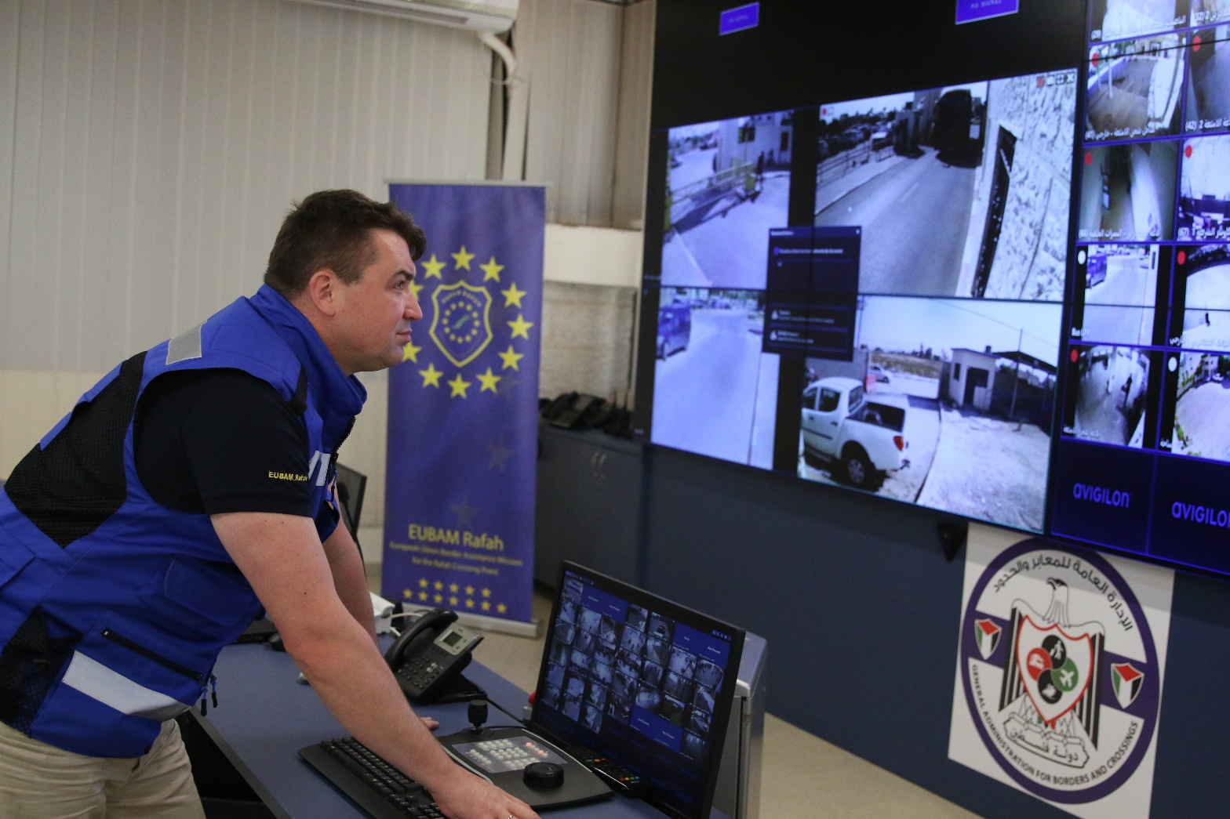
Thank you for your attention

