Slide 1
New teaching methodology at the customs control process traning and bus search traning
Zsolt Kovacs captain expert, Hungarian Tax & Cusoms

Slide 2
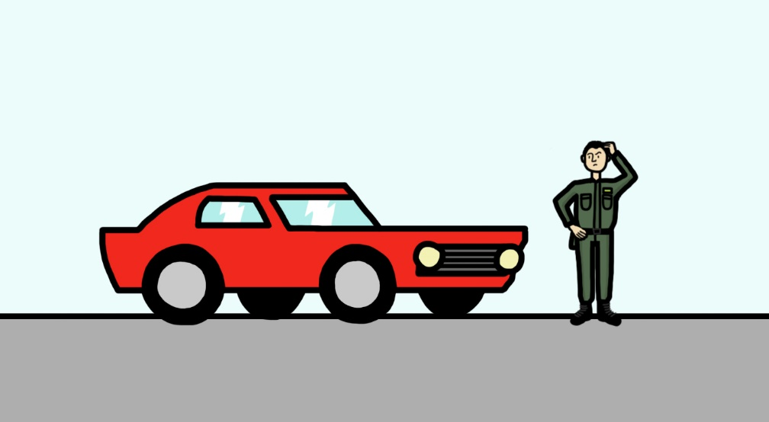
What? Where? How? Why?

Slide 3
OBSERVATION
(phisical level)
Task execution
Sense
BALACE
Risk analysis
RESAULT
PLANNING
(mental level)
MOTIVATION
(emotional level)
REALITY
Notes:
3

Slide 4
OBSERVATION
(phisical level)
physical examination
use of senses
the functioning of the human body
Notes:
4

Slide 5
mental work
gaining experience
analysis of experiences
connecting the emotional and physical levels
overcoming fear
UNDESTANDING
PLANNING
(mental level)
Notes:
5

Slide 6
Feelings
Faith
Teamwork
A sense of duty
A sense of mission
Service
MOTIVATION
(emotional level)
Notes:
6

Slide 7
OBSERVATION
(phisical level)
Task execution
Sense
BALACE
Risk analysis
RESAULT
PLANNING
(mental level)
MOTIVATION
(emotional level)
REALITY
Notes:
7

Slide 8
Physical level
Mental level
Emotional level

Slide 9
service facilities

Slide 10
human resources

Slide 11
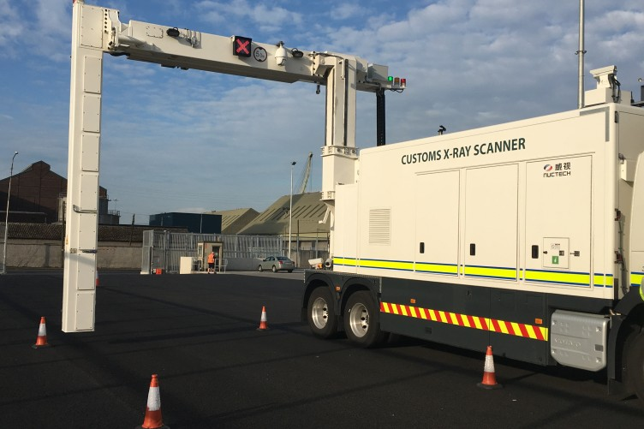
technical equipment

Slide 12
What do you think?
What is the physical level of your educational material?
What is the mental level of your educational material?
What is the emotional level of your educational material?

Slide 13
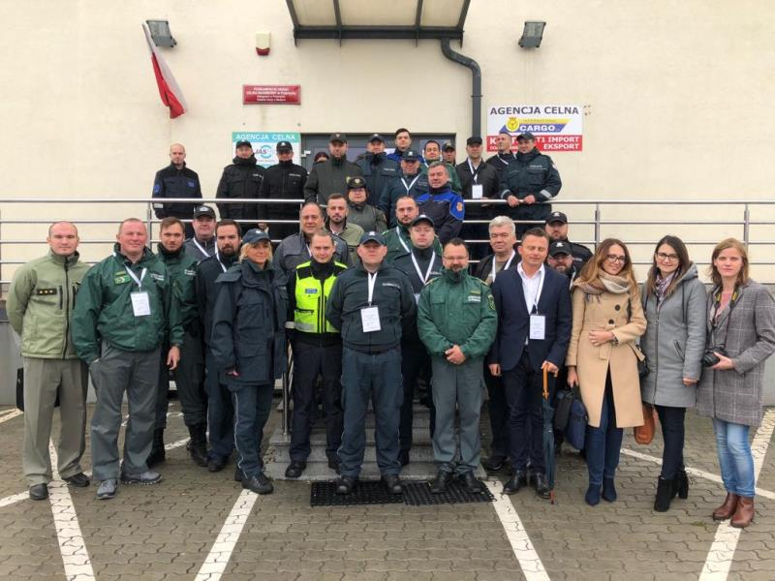
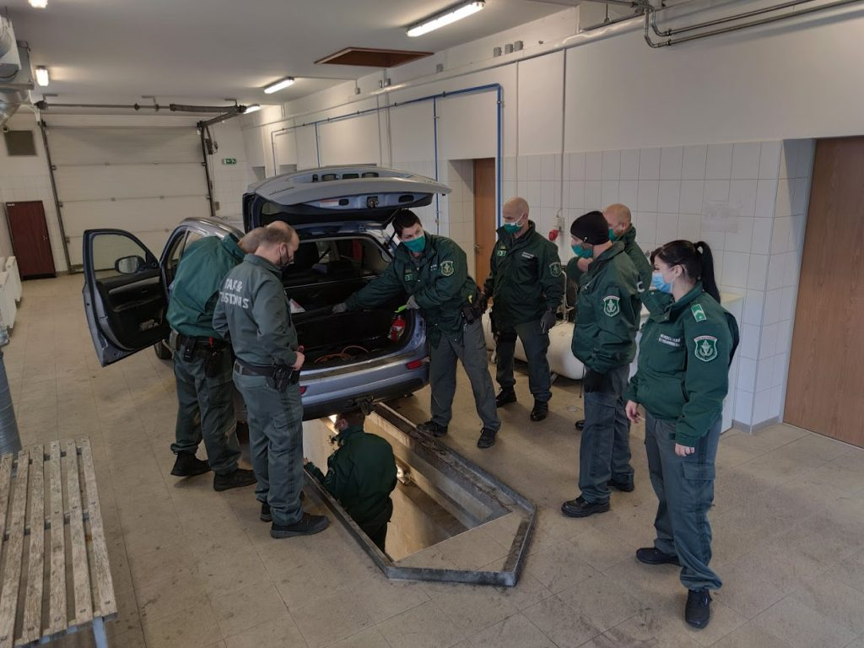
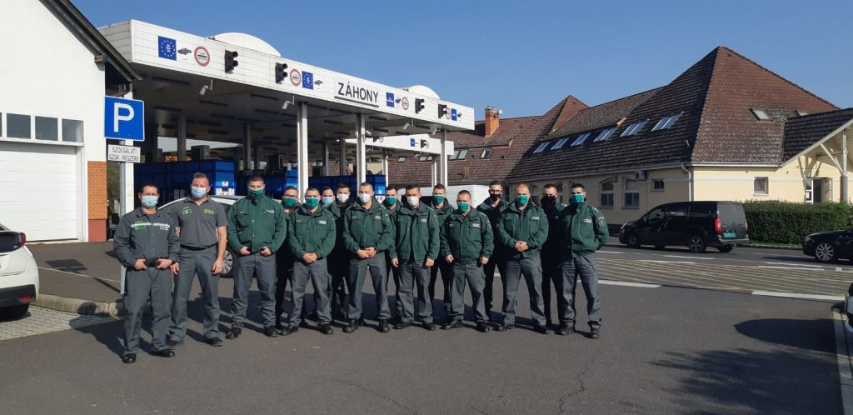
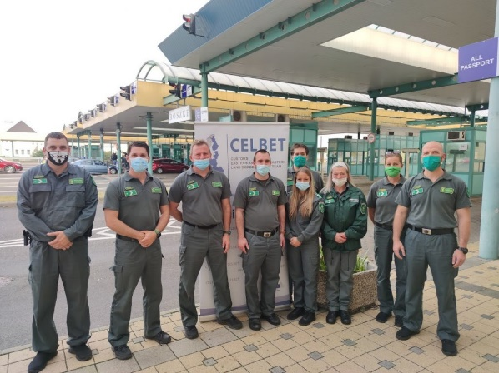
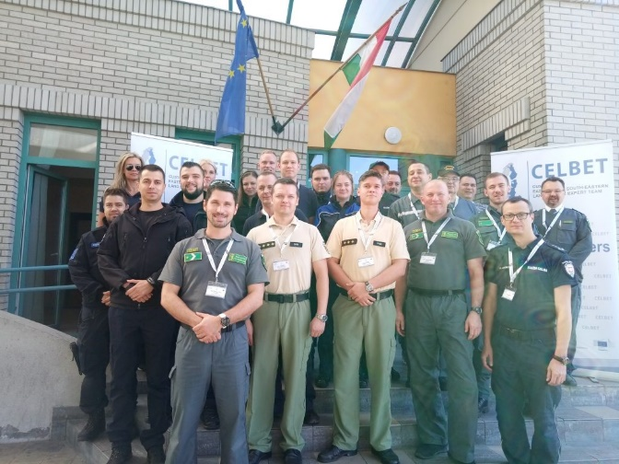
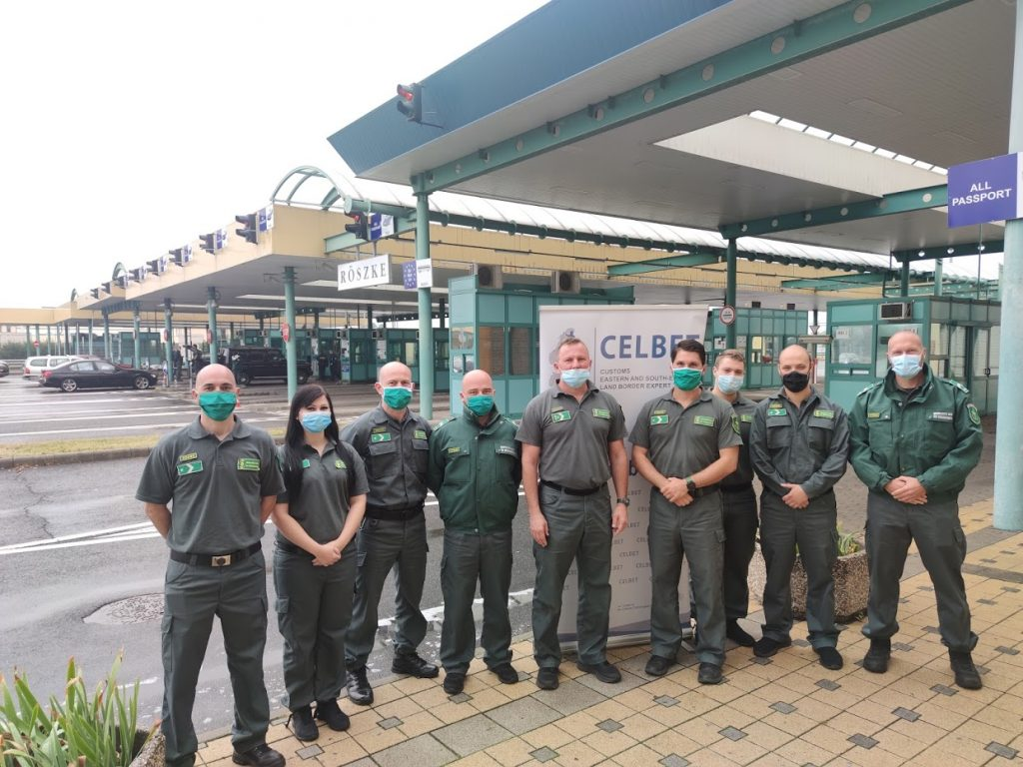
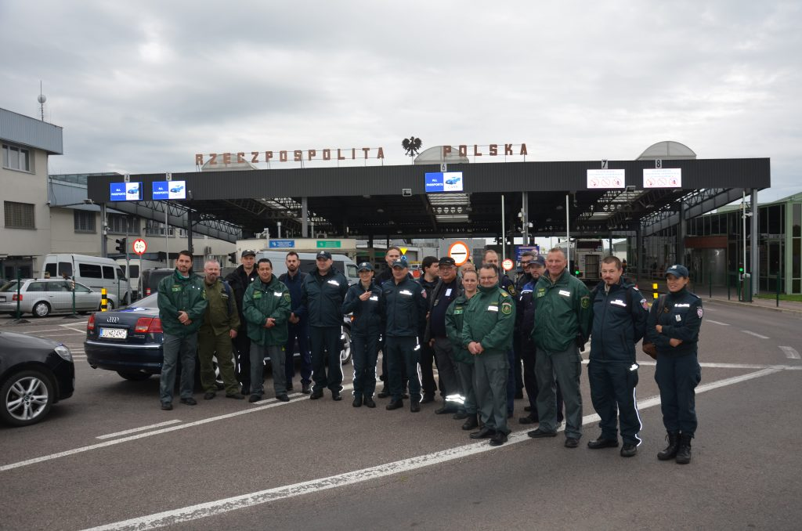
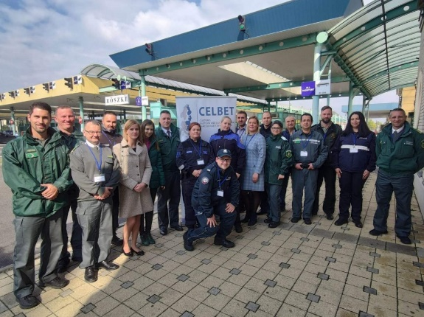
Thank you!

