Slide 1
Autumn trainings Bus search Integrity and professional ethics Truck search

Slide 2
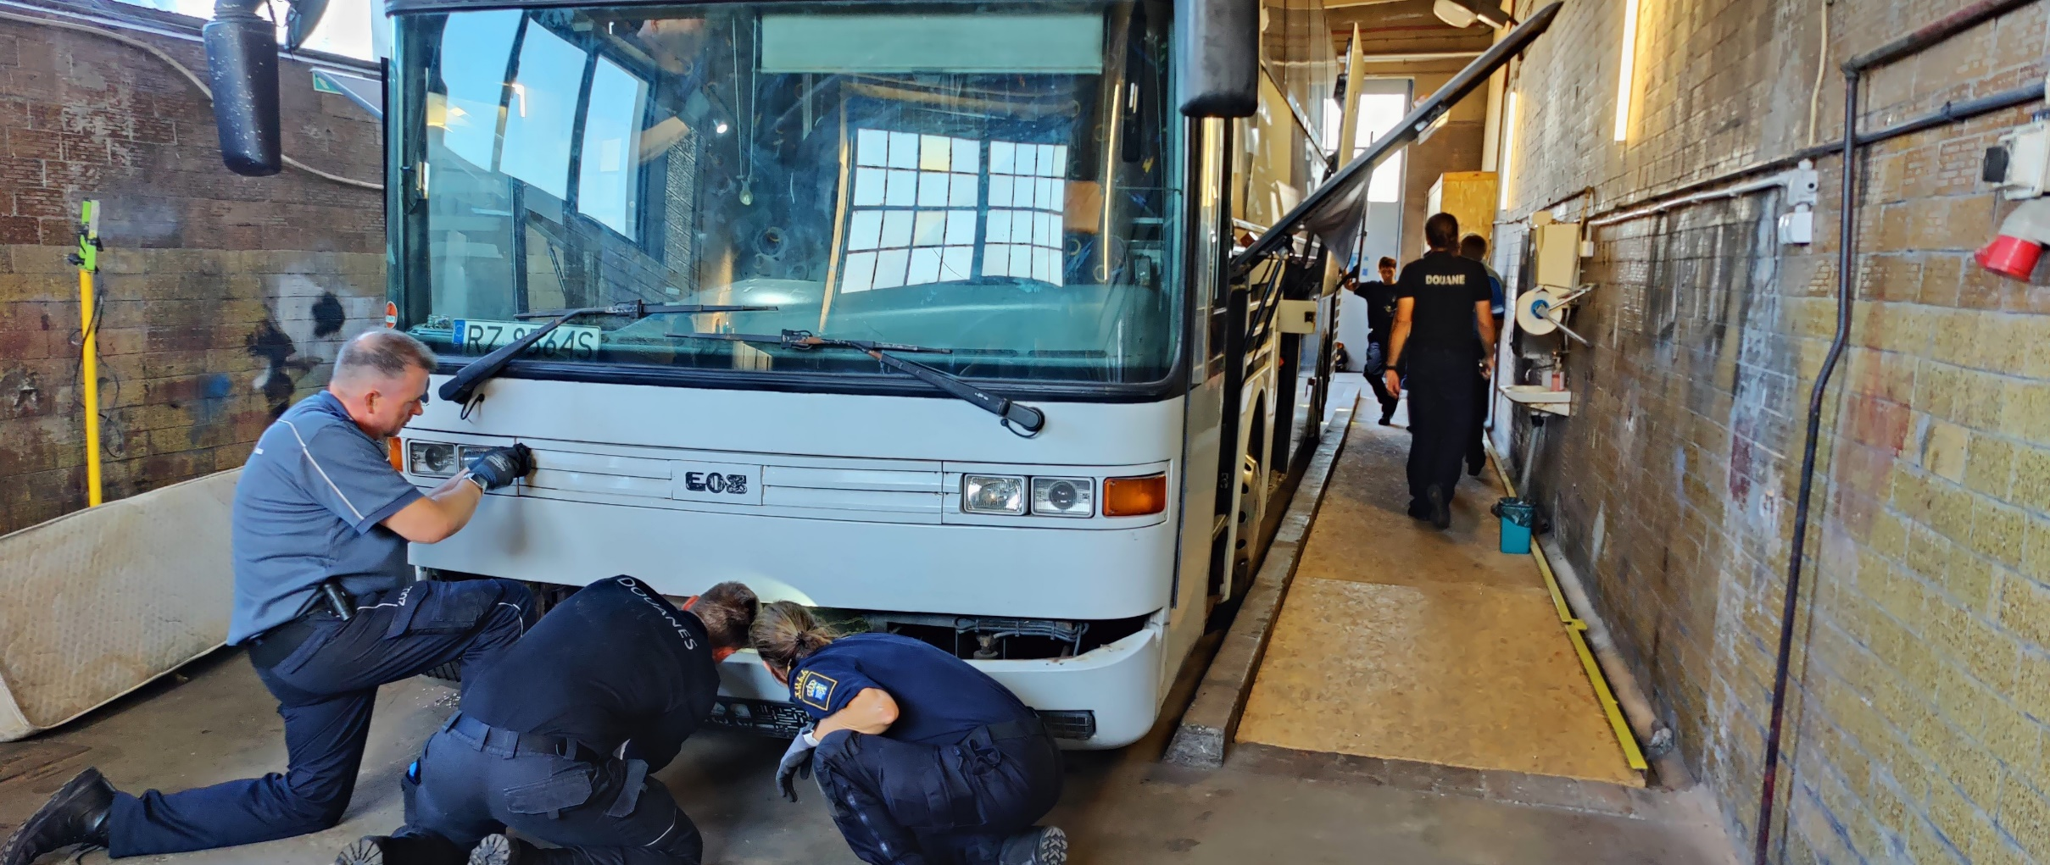
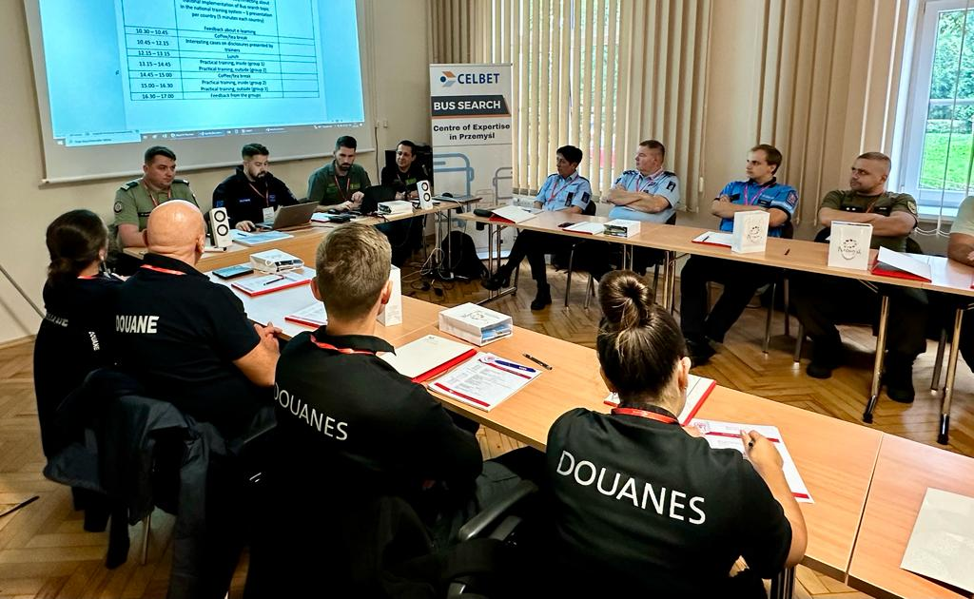
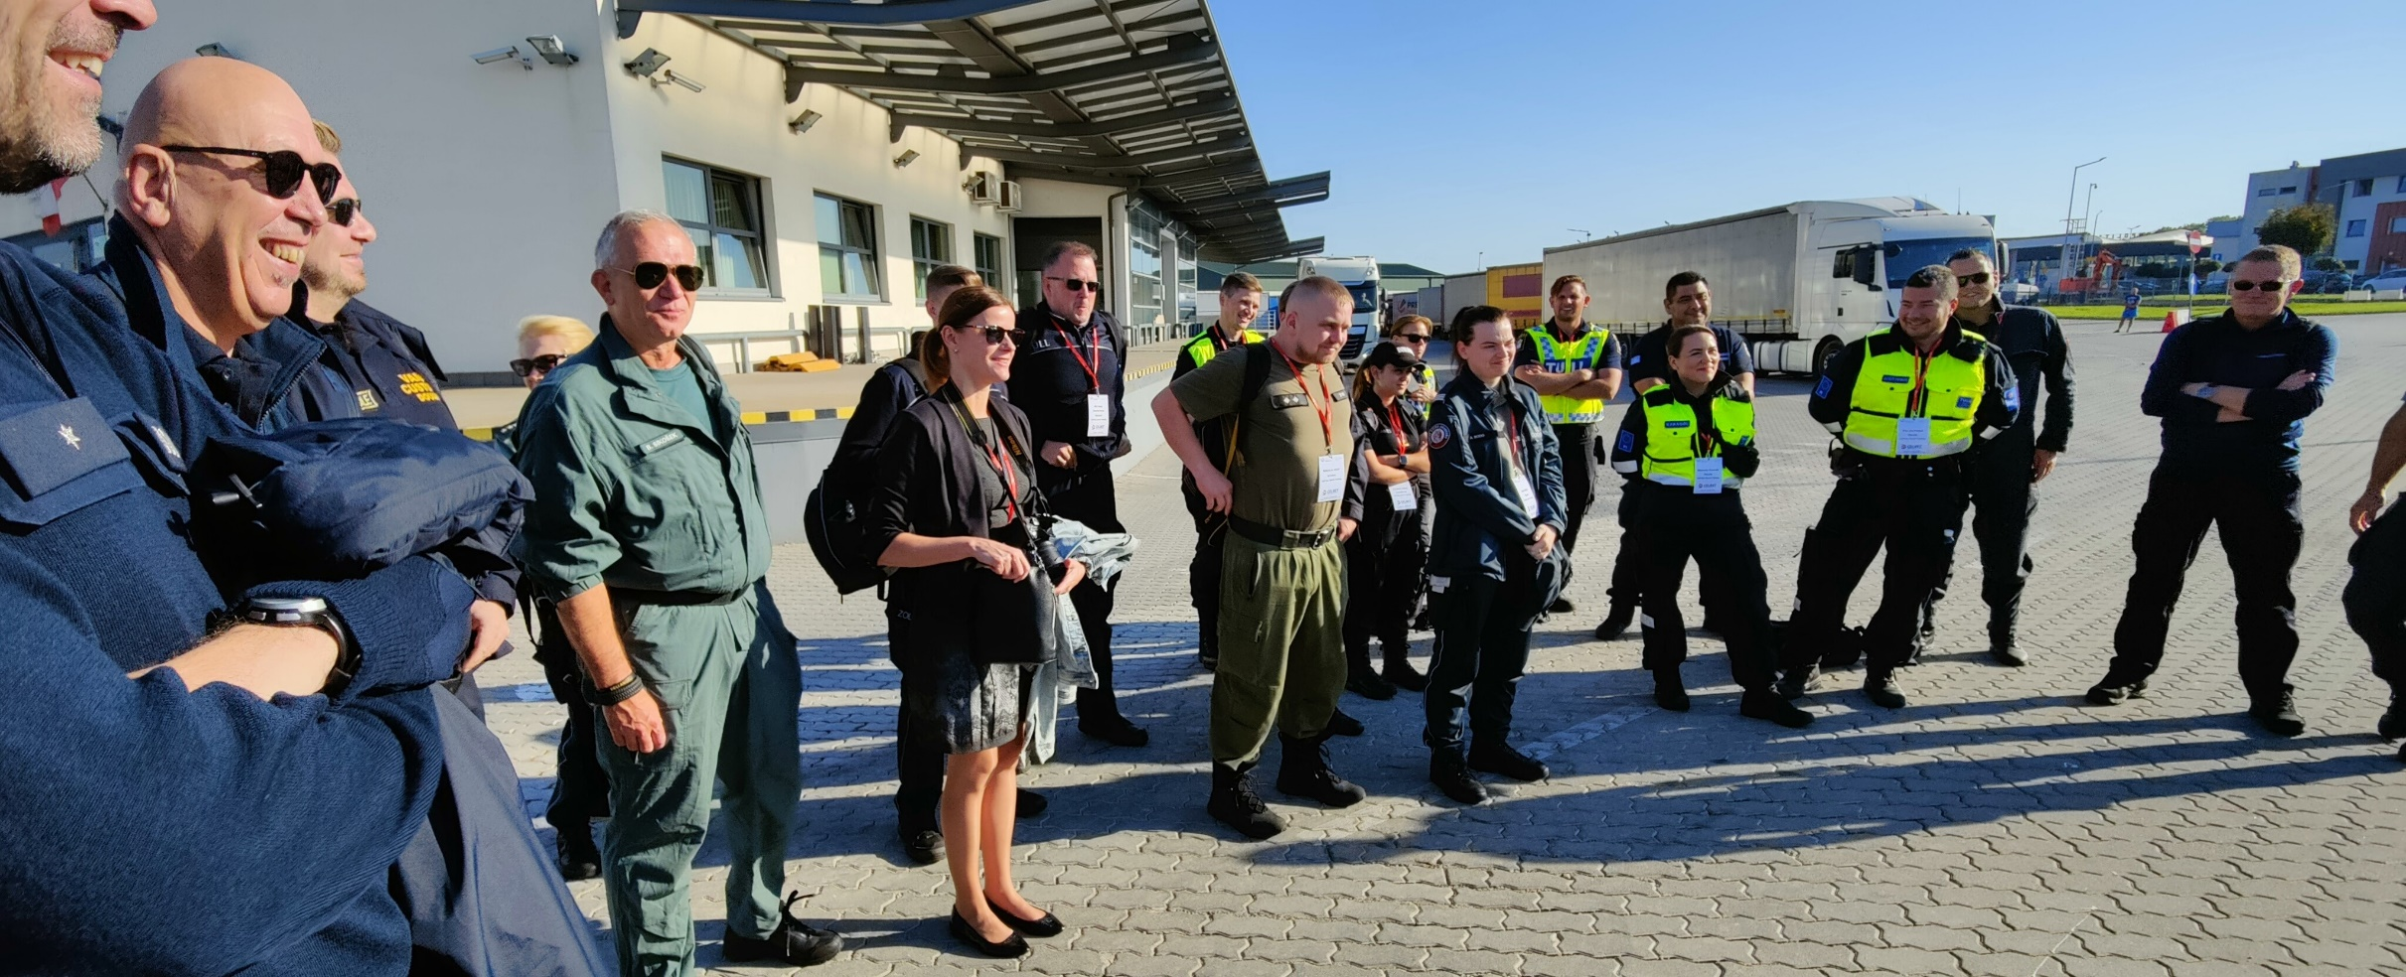
Bus search training September 26-28 2023
Participant's comment about the training:
“Definitely the best part of the course was noticing the incredible opportunities and unity the EU offers us. It was interesting to hear about current smuggling trends from inspector colleagues and to compare their own work environment with others. In addition to physical inspection skills, the work of today's customs inspector requires mental skills, the ability to withstand pressure and social gifts. I warmly recommend applying to CELBET's courses.”
The training consisted of the theory of bus inspection and two practical exercises
Theory at the Tax&Customs Academy in Przemyśl, practical parts at the training center and Medyka BCP
Training focused at inspection process, different inspection methods and the correct and safe use of inspection equipment
Customs inspectors from 15 countries participated in the training: Belgium, Austria, Greece, Luxembourg, Poland, Romania, Sweden, Germany, Slovakia, Slovenia, Finland, Denmark, Czech Republic, Hungary and Estonia

Slide 3
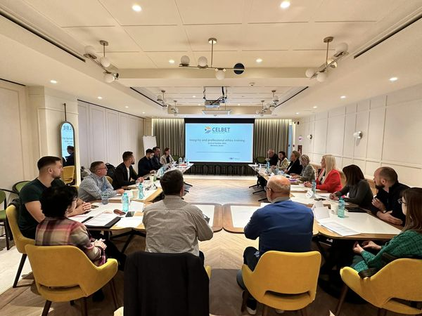
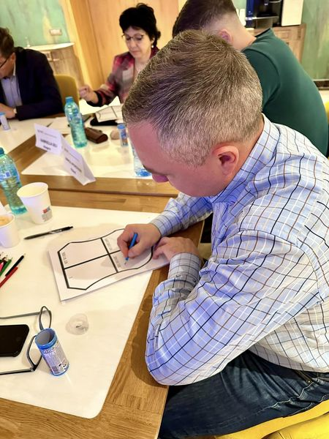
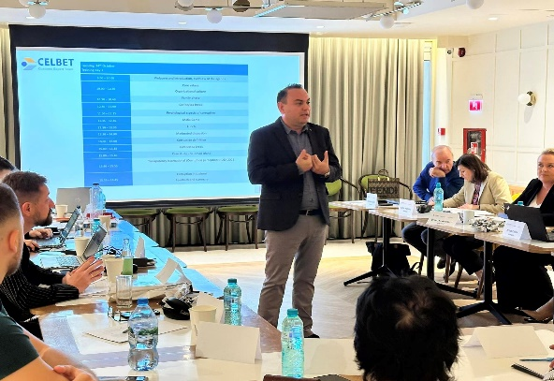
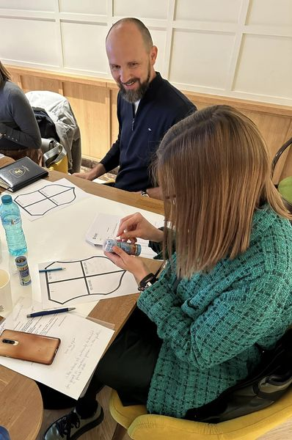
Integrity and professional ethics October 24-252023
First integrity training
Forms of corruption, occurrence and its prevention
Participatory training methods
One of the goals of the training was to develop capabilities for training the subject at the national level
Frontex participation in training
There were a total of 17 participants from various customs and taxation positions in Greece, Poland, Hungary, Estonia, Romania, Latvia, Croatia and Finland.

Slide 4
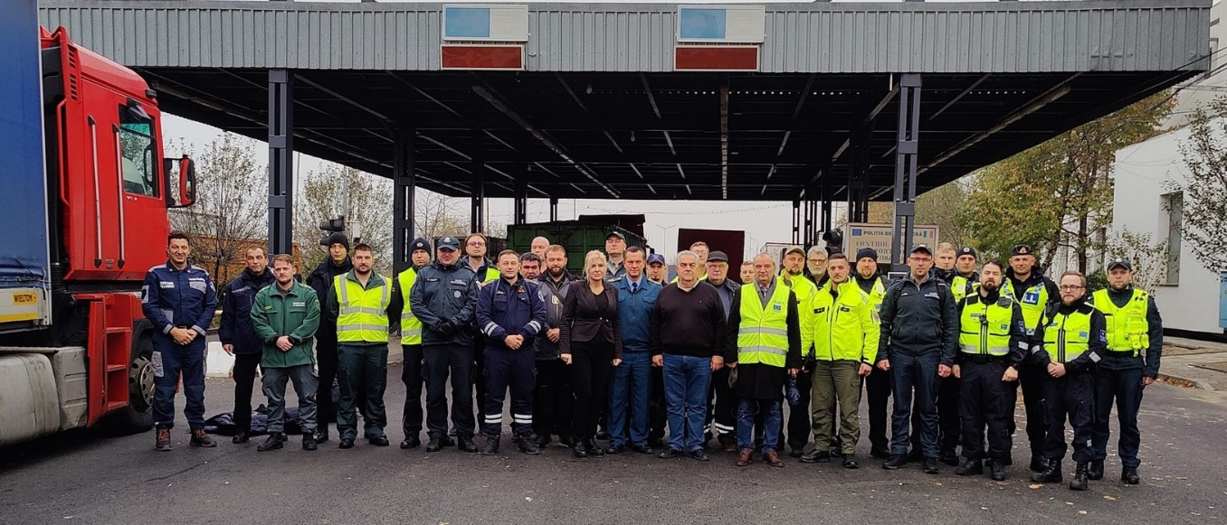
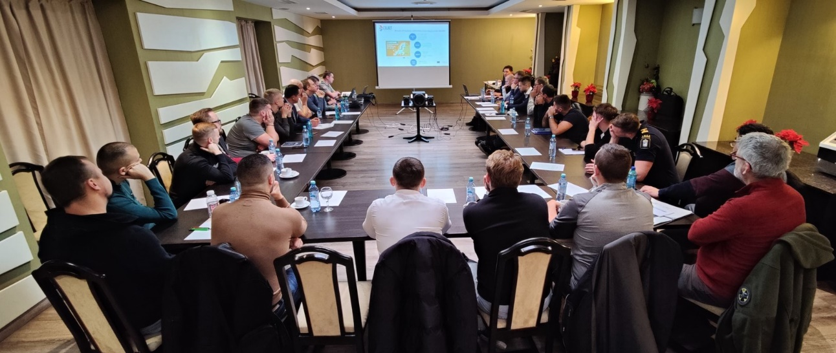
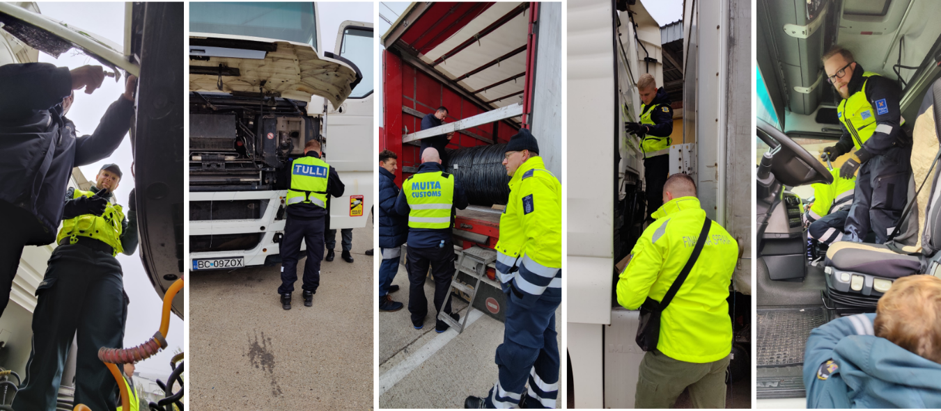
Truck search training November 21-23 2023
First Truck search training
Main training topics were profiling, driver interview, inspection and follow-up measures, occupational safety, inspection methods and securing the investigation
Theory in Iasi, practice Albita BCP
In the training, one of the main goals was networking and sharing information
22 customs inspectors from 16 countries participated in the training: Bulgaria, Czech Republic, Serbia, Denmark, Germany, Estonia, Latvia, Hungary, Poland, Romania, Slovenia, Slovakia, Finland, Sweden, Greece and Ukraine.
Trainers comment about the training:
"From the trainer's point of view, it was rewarding to be able to kick off the first course after a long preparation. It was also nice to notice that we have things quite good in Finland in terms of infrastructure, equipment and education. After this, you can also appreciate the Finnish mentality in a completely different way, because the cultural differences offered challenges both in the preparation of the training, as well as in the implementation itself. In any case, it was nice to meet new colleagues from different parts of Europe."

Slide 5
Thank you

Slide 6
Training evaluation

Slide 7
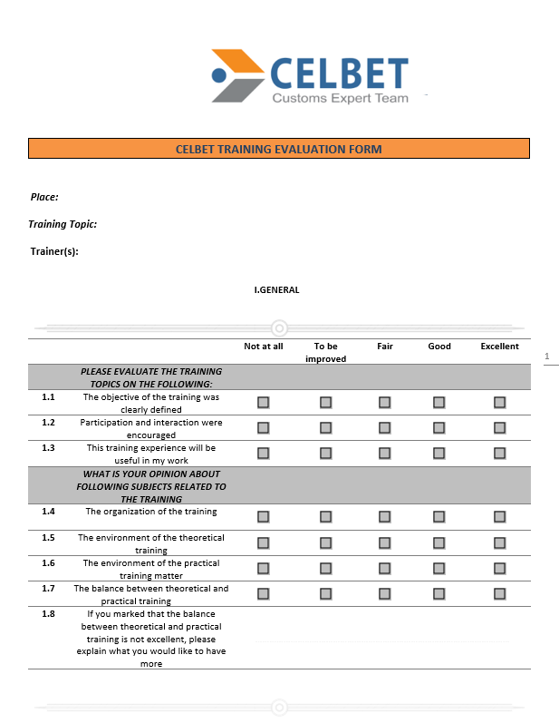
Experiences with feedback practice
During each training, a feedback survey is carried out
To maximize feedback, a paper version is used
Response rate from the last three trainings 100%
Feedback is used to develop operations and training

Slide 8
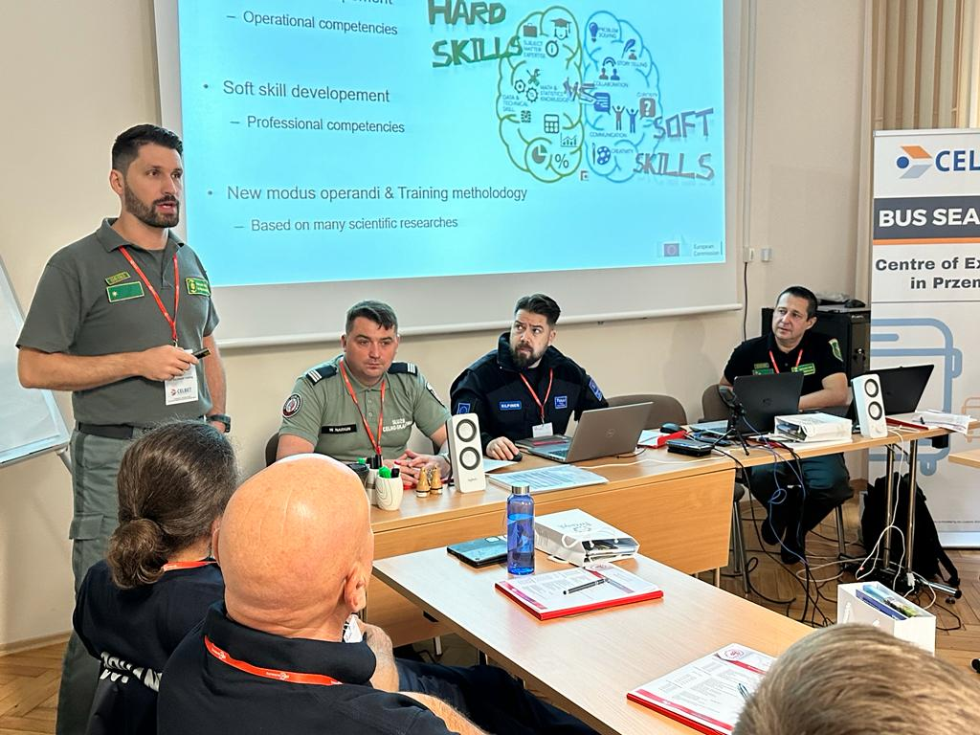
General questions options: fair, good, exellent
An example of using a feedback survey
The objective of the training was clearly defined: EXELLENT (0, 5, 17)
Participation and interaction were encouraged: (0, 6, 16)
This training experience will be useful in my work: (0, 4, 18)
Organization of the training: (1, 3, 18)
Environment theoretical training: (0, 6, 16)
Environment practical training (0, 5, 17)
Balance between theoretical and practical training (2, 8, 12)

Slide 9
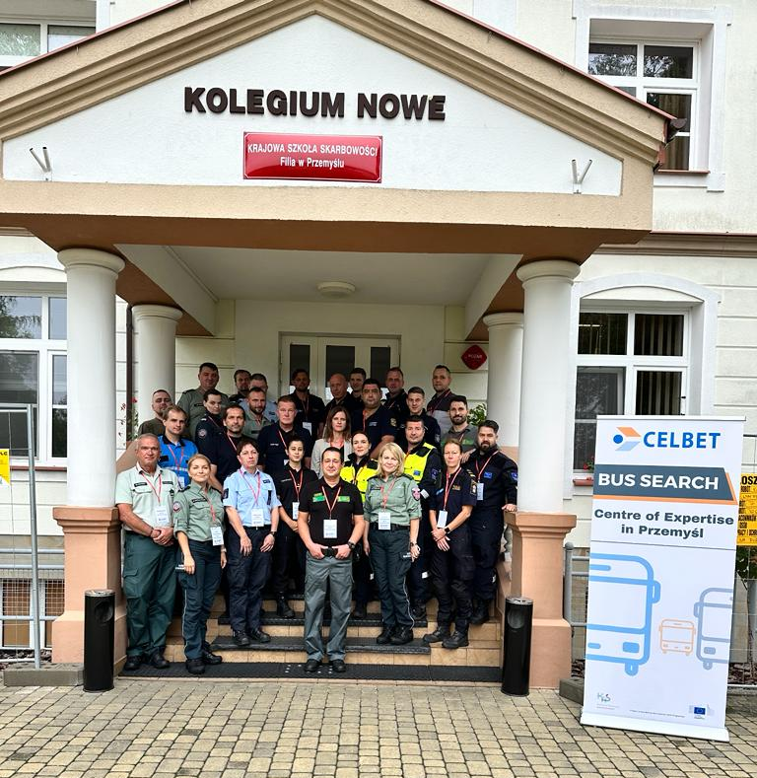
Do you have any suggestion in order to improve next training on this topic?
“to have 1 additional day of practice”
“more theoretical training on bus”
”more practise”
“more practical training - 1 extra day”
“not enough time for practice, 1 day should be added”
“a little bit more practical, theory should be explained during the practical part”
“the practical training could be better organized with a couple of workshops and groups who rotate for examp every hour”

Slide 10
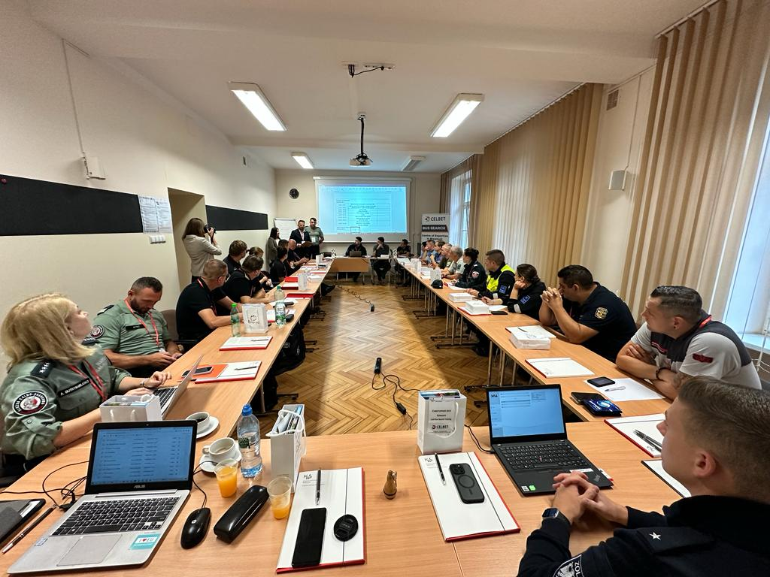
Do you have any suggestion in order to improve next training on this topic?
“to inform participants to bring some tools like scredrivers, flaslights etc..”
“more time, course 4 days, 2 days of theory and 2 practice”
”it was perfect”
“the organizer should inform trainees to take own tools”

